Slide 1
Options and challenges for commissioning domiciliary care
Led by Professor John Bolton

Slide 2
Three changes for Domiciliary Care
Domiciliary Care is not “one” service but a range of different services from which we might expect different outcomes which need to be measured in relation to the outcomes delivered
The way in which we assess people for care and the way in which that care is delivered makes a big difference for the outcomes for the recipient
Domiciliary Care can be wrongly proscribed (one in five cases)
We should review who actually is in the best place to assess someone for a service – reablement/ therapist; longer-term/provider with outcome measures;

Slide 3
Different dimensions to Domiciliary Care
Main aim is to assist with personal care people with eligible needs to remain in their own home (failure would be a person not being able to be cared for in their own home) for as long as is feasible
Short-term recovery (domiciliary care reablement versus self- managed recovery) – hospital discharges?
Longer term recovery (evidence at which point do people recover and who will benefit)
Helping a person to live with / manage a long-term condition (or more likely set of long-term conditions)
Helping a person live with /manage having memory loss or dementia
Helping a person receive end of life care
Supporting a carer who is helping any of the above
Supporting a person with health care

Slide 4
Issues from the assessment
The way in which a person is assessed for a service and the way in which that service is delivered has a massive impact on the outcome for that person.
Assessments take place usually in a timely manner – but reviews don’t? can you trust Providers to tell you when people need no further support e.g. 2 weeks post discharge (Leicestershire)
Who is best to assess for reablement – OTs and Physios?
When do you assess?
Do you assess for outcomes or inputs?
Asset model vs Deficit model – who else can help? E.g. tackling social isolation

Slide 5
Is domiciliary care over-proscribed?
There is significant over –proscribing of social care
Low level care – tackling social isolation or just checking
Discharge from hospital
Partnership with carers
Care can be delivered in a way that further incapacitates the recipient or it can be enhancing and supportive – a “dollop of care” can increase someone's needs by 120%
Unmet needs at lower levels don’t lead to poor well-being
https://www.ipsos-mori.com/researchpublications/publications/1885/Unmet-social-care-needs-and-wellbeing.aspx

Slide 6
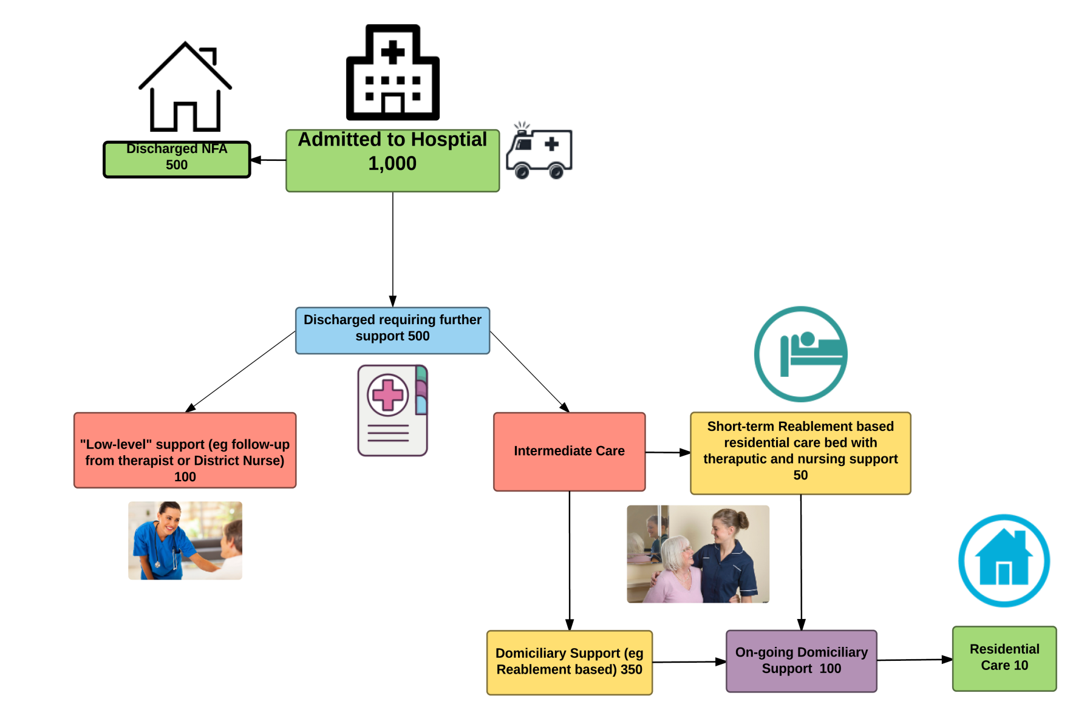
Hospital Discharges

Slide 7
Procurement/ Commissioning/ Personalisation
Are you wanting to procure a service at the lowest possible cost to help people who need care in their own homes?
OR
Are you wanting to develop a range of services that will help a person live a more independent life
OR
Are you looking to recruit and retain Personal Assistants

Slide 8
New providers or existing supply?
There have been significant challenges for new providers in entering a care market for the first time:
Most providers pay people to write their bids – “it isn't always what is says on the tin”
Due diligence – investigate what others have really achieved
Staff from other agencies don’t want to move over
Long time to recruit new staff – don’t trust unknown brand
Hard to recruit local managers and hard to establish local office (needs to be local)
Customers resent change
Takes 3-4 years to bed in!

Slide 9
Outcomes from Reablement
How are people assessed for the service?
How focused is the service on the range of different interventions that are required for different conditions?
How much training is offered by reablement workers for customers:
To Manage their condition
To use equipment provided (including telecare)
To link to local community
How well supported is the service by nurses and therapists?
Is the demand for the service understood?
How does it fit with other Intermediate Care Services?
How are people assessed for longer term?
Are other client groups helped?

Slide 10
Longer-term reablement – people living with long-term conditions
Percentage of people who completed short-term reablement but were assessed as still requiring a service after 8 weeks – less than 33%
Percentage of people whose needs are reduced within first year of receiving the service – over 20%
Percentage of people whose needs either remain the same or reduce over time 70%
Percentage of people who are admitted to residential care who are in the service – less than 10%
Percentage of people who are admitted to hospital within 2 years of receiving the service – less than 15%
Percentage of people who have to visit GP?

Slide 11
People receiving palliative care
People receiving auxiliary nursing
Percentage of people who do not need to see a District Nurse except for discharge– over 75%
Percentage who are not readmitted to hospital – over 90%
Percentage of people who died in their own home – over 80%

Slide 12
More Information
Papers on Managing Demand and Outcome Based Commissioning:
http://ipc.brookes.ac.uk/publications/
John Bolton
john.bolton@jrfb.co.uk
07789748166

