Slide 1
Self referral portal
User guide for essential workers- including personal care assistants- to book a test at a regional testing site or via home delivery
28th April 2020

Slide 2
Contents
Programme context | 3
What is the self referral portal? | 4
How will self referral work for regional testing sites? | 5
How will self referral work for home testing? | 6
How to choose a testing route | 7
Regional testing site: step by step guidance
How to register for a test at a regional testing site | 13
How to book an appointment at a regional testing site | 18
How to order a home test kit | 28
Frequently asked questions | 36
Notes:
update

Slide 3
The Coronavirus National Testing Programme
The coronavirus pandemic presents a critical national challenge and testing for the virus is a central part of the Government’s response. One of the most challenging things about coronavirus is the uncertainty. Good-quality testing can help provide us with greater certainty. It’s a big part of how we’re going to defeat this disease.
Our response so far:
As part of the government’s 5-pillar strategy for coronavirus testing, we are testing essential workers who have coronavirus-like symptoms to see if they currently have the virus. Our aim is that anyone who needs such a test will be able to have one.
We are establishing a nation-wide network of drive-through regional testing sites, which eligible essential workers are able to use. We are also in the process of rolling out a limited number of home test deliveries.
Self Referral Portal:
We have now launched a new self referral portal here: www.gov.uk/coronavirus
All essential workers will be able to register and book a test for themselves and/ or their household member(s) if they have coronavirus-like symptoms. Personal care assistants (PA) are deemed essential workers, and therefore are able to access tests via the self-referral portal.
There are two ways to get a test:
1) Book an appointment at a regional testing site
2) Request a home delivery test

Slide 4
What is the self referral portal?
The self referral portal allows essential workers who are self-isolating either because they or member(s) of their household have coronavirus-like symptoms, to register to be tested.
It is a secure portal for essential workers to register their details and book a coronavirus test. There are two ways to get a test:
1) Regional testing site
2) Home delivery
Initially, numbers will be limited for the home delivery route. This will increase over the next few weeks.

Slide 5
How will self referral work for regional testing sites?
The following steps outline how essential workers and their household member(s) can arrange a coronavirus test at a regional testing site:
The essential worker will click on the link and register either their details (if they have symptoms) or household member(s) with coronavirus-like symptoms. The essential worker or household member(s) will be added to a list and depending on capacity at regional testing sites, will be invited to book an appointment for a test.
The individual(s) being tested will receive a text message inviting them to book an appointment. The text message will contain a link to the appointment booking system and a unique 16 digit code.
The individual will click on the text message link and be directed to the appointment booking system where they will be asked to enter their unique 16 digit code. They will then be able to book a specific appointment for a coronavirus test at a regional testing site.
The individual will receive a confirmation of their appointment via text message and email. These will contain a QR code, which will need to be shown to security at the regional testing site. Only one QR code is required, either on a smartphone or a printed copy of the email.

Slide 6
How will self referral work for home testing?
The following steps outline how essential workers and their household members can arrange for a coronavirus test(s) to be delivered to their home
The essential worker will click on the link and register their details, via the online self referral portal. These details will be used to verify the identity of the essential worker before they order their test(s) for delivery. If the essential worker has access to their work email they should use this to support with the verification process.
The essential worker will then receive an email with a one-time code. If the email address cannot be verified, we will need them to complete a short verification check through TransUnion. This is not a credit check- it is simply a way of verifying your identification. Alternatively, the essential worker can choose to apply for a test at a drive-through centre.
The essential worker will then be able to request up to five tests for members of their household displaying symptoms of the coronavirus. Order details should then be reviewed and confirmed.
The individual will receive a confirmation of their order by email, as well as details of what to do next. Tracking details for their delivery will also be provided. Once the individual receives their test kit they should follow the instructions provided.

Slide 7
How to choose a testing route

Slide 8
Process overview for choosing a testing route
Below is an overview of the process that individuals with coronavirus-like symptoms should take in order to choose a testing route via the self referral portal:
These steps are laid out in the following slides, with accompanying screenshots
1
Enter the self referral portal and check eligibility
2
Confirm who is being tested and choose a testing route
3
Once you've selected a testing route, you can complete registration

Slide 9
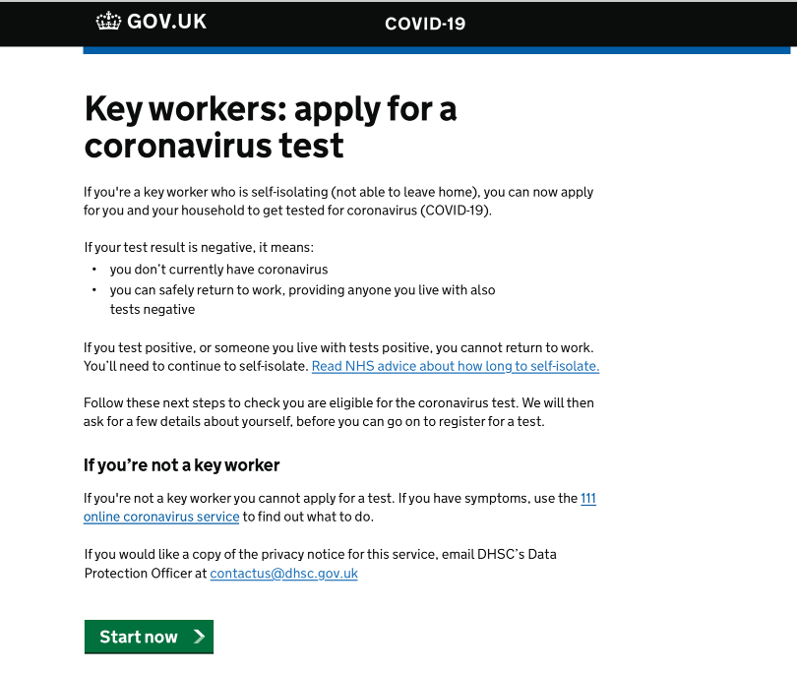
1. Enter the self referral portal and check eligibility
A
1. Go to the self referral portal by entering the following web address into your web browser (do not use Internet Explorer to access): www.gov.uk/coronavirus
B
Please read the information provided on the self referral portal landing page.
Only essential workers and their household member(s) should proceed to register for coronavirus testing.
Click ‘Start now’ to continue to registration.
C
Check to see if you or your household member(s) are eligible for taking a coronavirus test.
Click ‘Ok, I qualify’ to continue to registration.

Slide 10
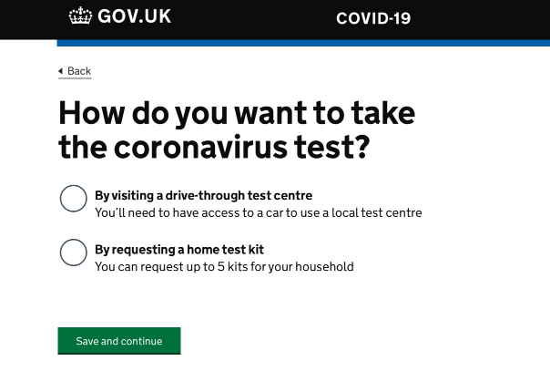
2. Confirm who is being tested and how
Select the option that best describes your current situation, outlining who will require coronavirus testing.
Choose to register for a coronavirus test for either:
A essential worker or
essential worker householder member(s)
The individual ordering the coronavirus test should continue with registration
Click ‘Save and continue’.
D
E
Choose where the individual(s) would like to take the coronavirus test, either at a testing site or at home via a home test kit.
Once selected, click ‘Save and continue’.
Notes:
Home delivery message – expectation management for individuals who want home testing
Public will have a different website portal for testing – create a briefing pack

Slide 11
If you choose the regional testing site route go to slide 12 If you choose the home testing route go to slide 28

Slide 12
Regional testing site: step by step guidance

Slide 13
How to register for a test at a regional testing site

Slide 14
Process overview for regional testing site registration
Below is an overview of the process that essential workers should take in order to register for a coronavirus test via the self referral portal:
These steps are laid out in the following slides, with accompanying screenshots
1
Register personal details (for the individual being tested)
2
Verify details and submit registration
3
Receive an invitation to book an appointment

Slide 15
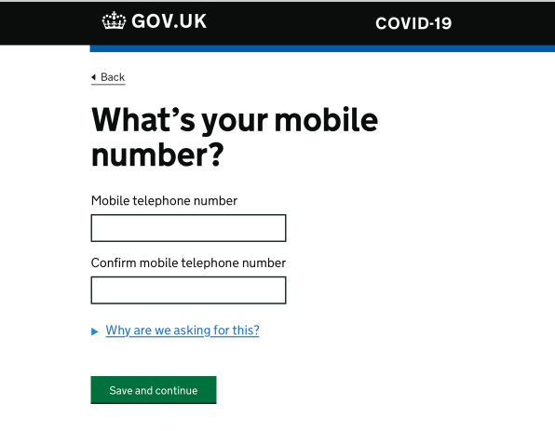
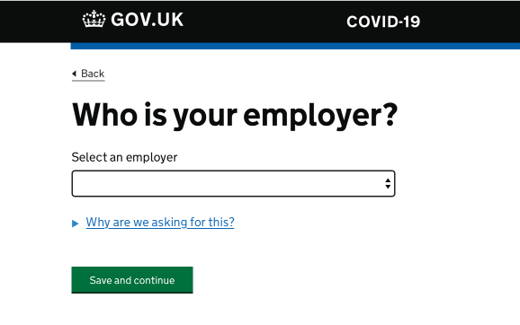
1. Register personal details (for the individual being tested)
Enter the individual’s employer
Click ‘Save and continue’
For PAs, please answer this question based on the services being provided (i.e. if you are providing care and support via a personal health budget, you should put ‘healthcare’- for care and support provided via a personal budget, you should put ‘social care’ This also applies to PAs who are self-employed.
A
Enter the individual’s mobile number
Click ‘Save and continue’
B
C
Enter the individual’s first and last name
Click ‘Save and continue’

Slide 16
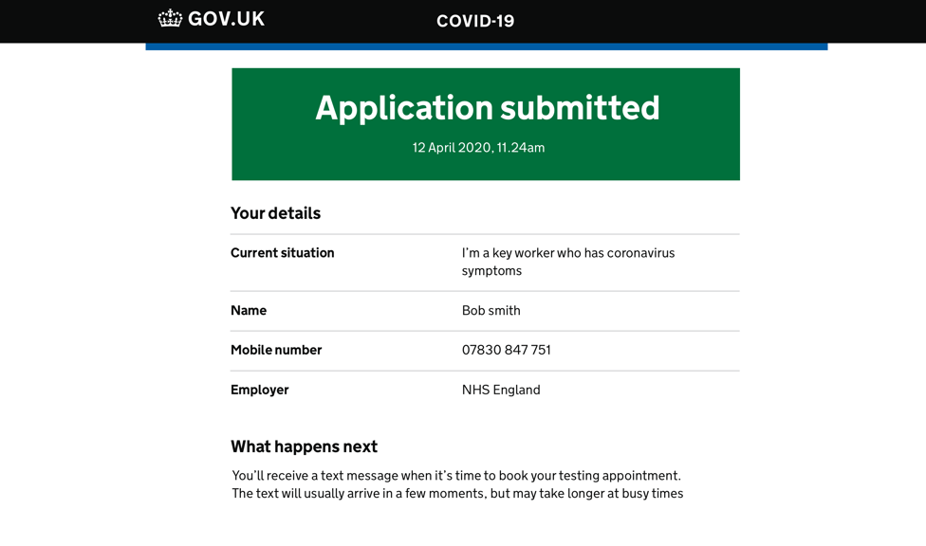
2. Verify details and submit registration
A confirmation of the individual’s application is shown.
NEXT STEPS:
Look out for a text message with an invitation to book an appointment for testing.
All registrations will be shortlisted for testing and when capacity at testing sites allows, text message for appointment booking will be sent. This could be immediately or in a few days depending on capacity.
D
E
Check that the information entered for the individual is correct.
Click ‘Submit application’ when ready to submit registration.

Slide 17
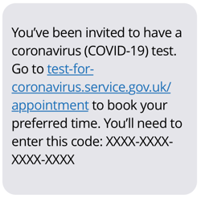
3. Receive an invitation to book an appointment
The individual will receive a text message from UK_Gov to invite them to book a specific appointment at a regional testing site.
The individual will click the text message link and enter their unique 16 digit code to access the appointment booking system.
.

Slide 18
How to book an appointment at a regional testing site

Slide 19
Process overview for booking an appointment
Below is an overview of the process that essential workers should take in order to book an appointment for a coronavirus test at a regional testing site:
1
Access the appointment booking portal
2
Enter personal details for the individual being tested
3
Enter NHS number, if applicable
4
Add household member(s) to the booking
5
Choose a regional testing site and time to be tested
6
Verify details and submit appointment booking
7
Receive appointment confirmation email and text message
These steps are laid out in the following slides, with accompanying screenshots

Slide 20
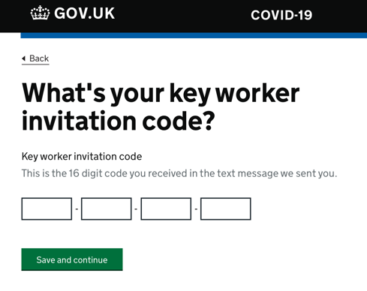
1. Access the appointment booking portal
A
Read the information on the appointment booking page. Check you understand:
Who is eligible for a test
What happens at a regional testing site
The information that you need to complete your appointment booking
Click ‘Start now’ to begin your appointment booking registration
B
Input your unique 16 digit number. This can be found on the text message sent, inviting you to book an appointment
Notes:
Check on decision – different shape/ colour for regional testing vs home delivery

Slide 21
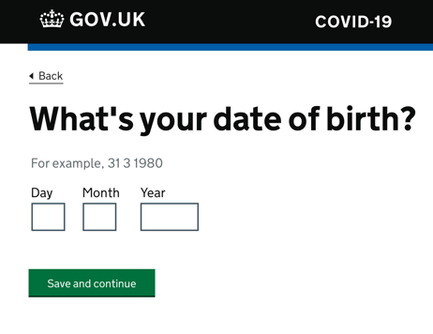
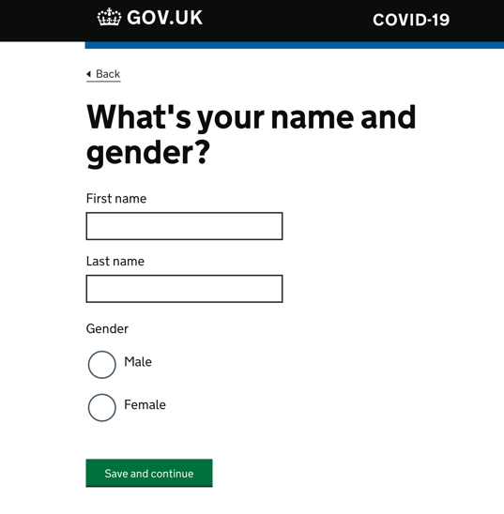
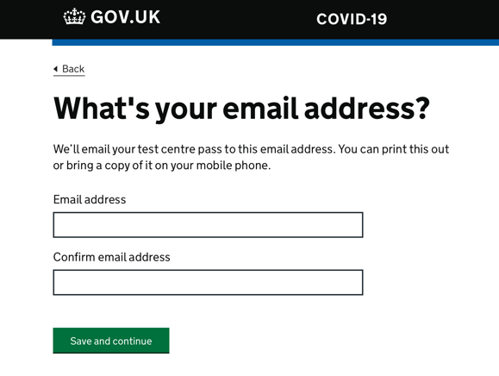
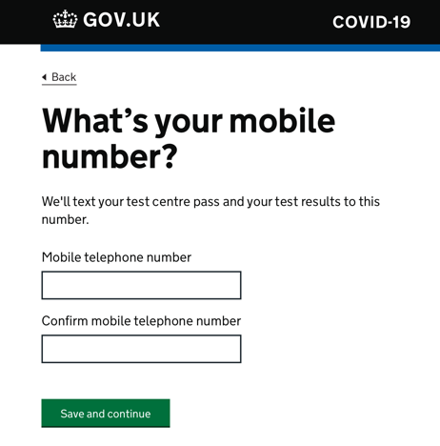
2. Enter personal details for the individual being tested
C
D
Enter the individual’s personal details:
C. Car registration
D. Date of birth
E. Name and gender
F. Email address
G. Mobile number
Click ‘Save and continue’ to progress through the appointment booking
E
F
G

Slide 22
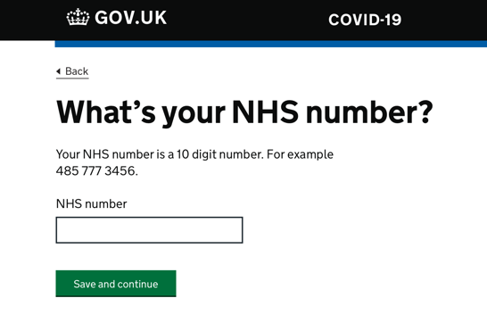
3. Enter NHS number, if applicable
H
Enter the individual’s NHS number, if applicable.
Click ‘Save and continue’ to progress through the appointment booking system.
I

Slide 23
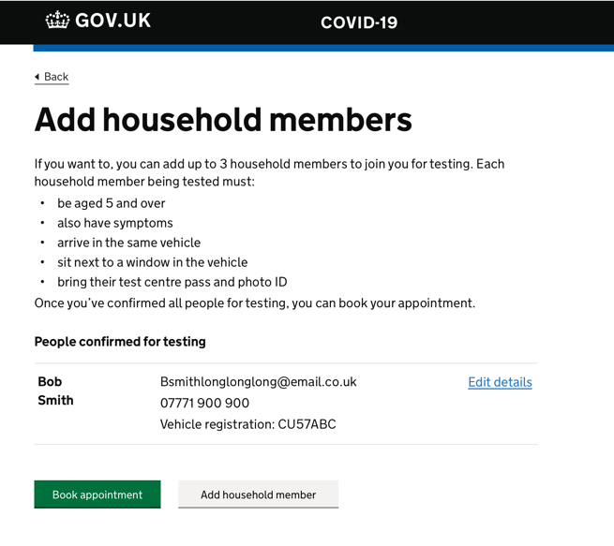
4. Add household member(s) to the booking
J
An individual (adult or child aged 5 or over) with coronavirus symptoms living in the same household as a essential worker can be invited for testing.
Check the eligibility for testing before booking anyone for a test.
K
Provide personal details of the household member(s), information required:
Name and gender
Date of birth
Email address
Mobile number
Check the information provided for household members is correct.
Click ‘Save and continue’ to progress to the appointment booking.
If only the essential worker registered needs a test, proceed to appointment booking by clicking on ‘Book appointment’

Slide 24
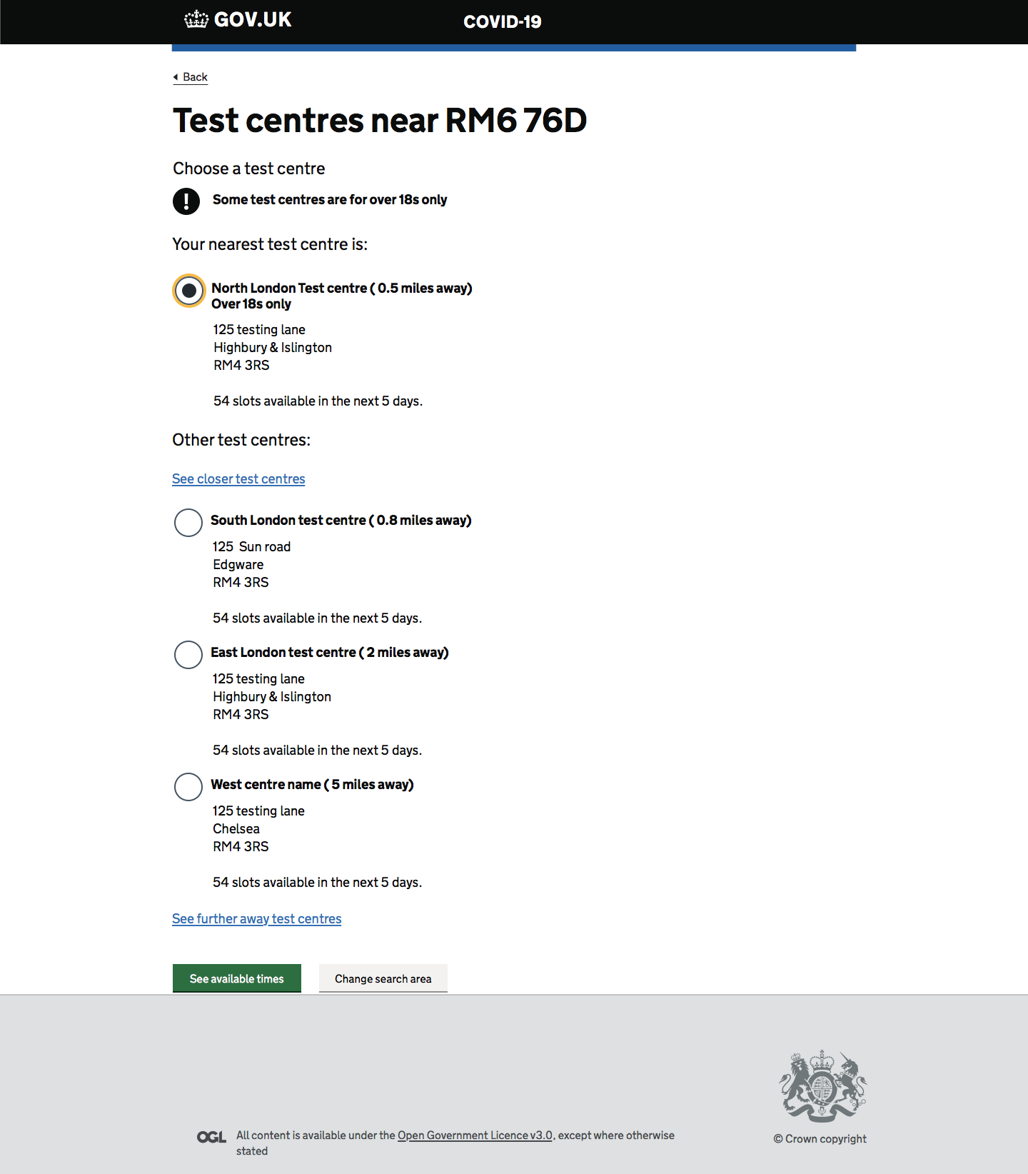
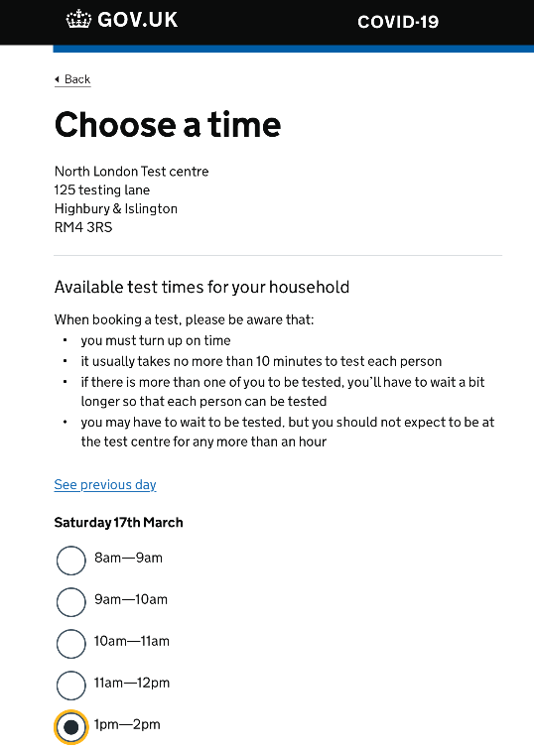
5. Choose a regional testing site and time to be tested
L
M
N
Enter your post code to find a regional testing site near home.
Click ‘Find site’
Choose from the list of regional testing sites available. Click ‘See available times’
Select a time for an appointment
Click ‘Save and continue’

Slide 25
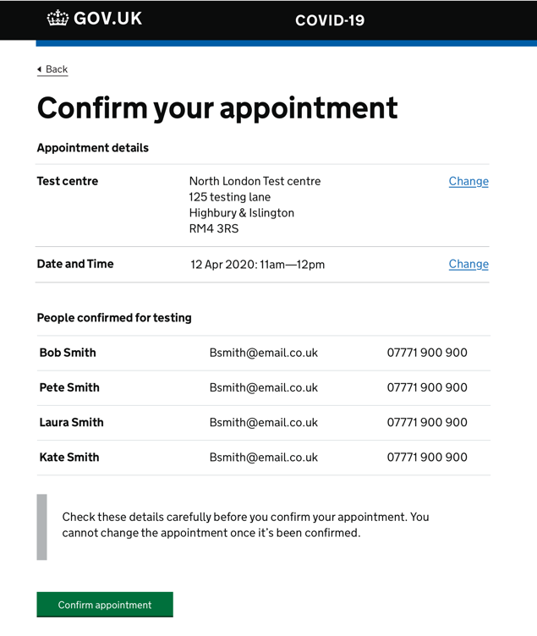
6. Verify details and submit appointment booking
O
P
A confirmation of the individual’s appointment booking is shown.
NEXT STEPS:
A text message and email will be sent to each individual confirming the appointment booking. The email and text message will contain a QR code which will need to be shown to security when entering the regional testing site.
Check that the information entered is correct.
Click ‘Confirm appointment’ when ready to confirm the appointment.

Slide 26
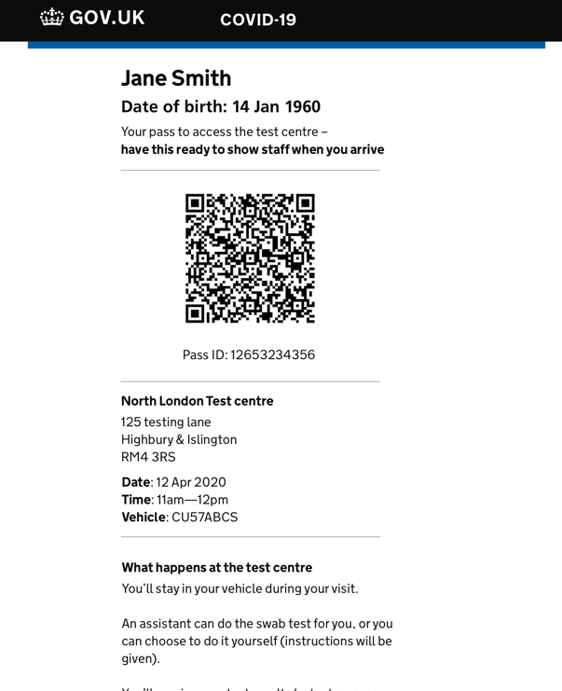
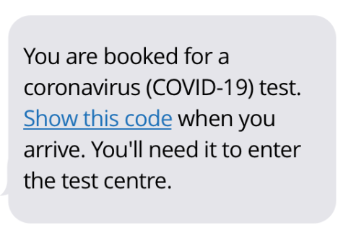
7. Receive appointment confirmation email and text message
Individuals who have successfully booked a specific slot at a testing site will receive an email and text confirmation.
Individuals will need to bring the QR code, either on their smartphone or printout of the email, to their coronavirus test appointment. You will not require any additional identification that verifies you are a PA- the email confirmation and QR code is all you require.
Security will ask to see the QR code at the testing site gate.
The QR code will also be scanned and attributed to the individual’s coronavirus test.
.

Slide 27
Home testing: step by step guidance

Slide 28
How to order a home test kit

Slide 29
How to order a home test kit
Below is an overview of the process that essential workers should take in order to request order testing kits for home delivery:
1
Access the home kit ordering portal
2
Enter essential worker personal details
3
Verify essential worker email address
4
Verify essential worker identity
5
Provide details for ordering home testing kit(s)
6
Receive order confirmation details
These steps are laid out in the following slides, with accompanying screenshots

Slide 30
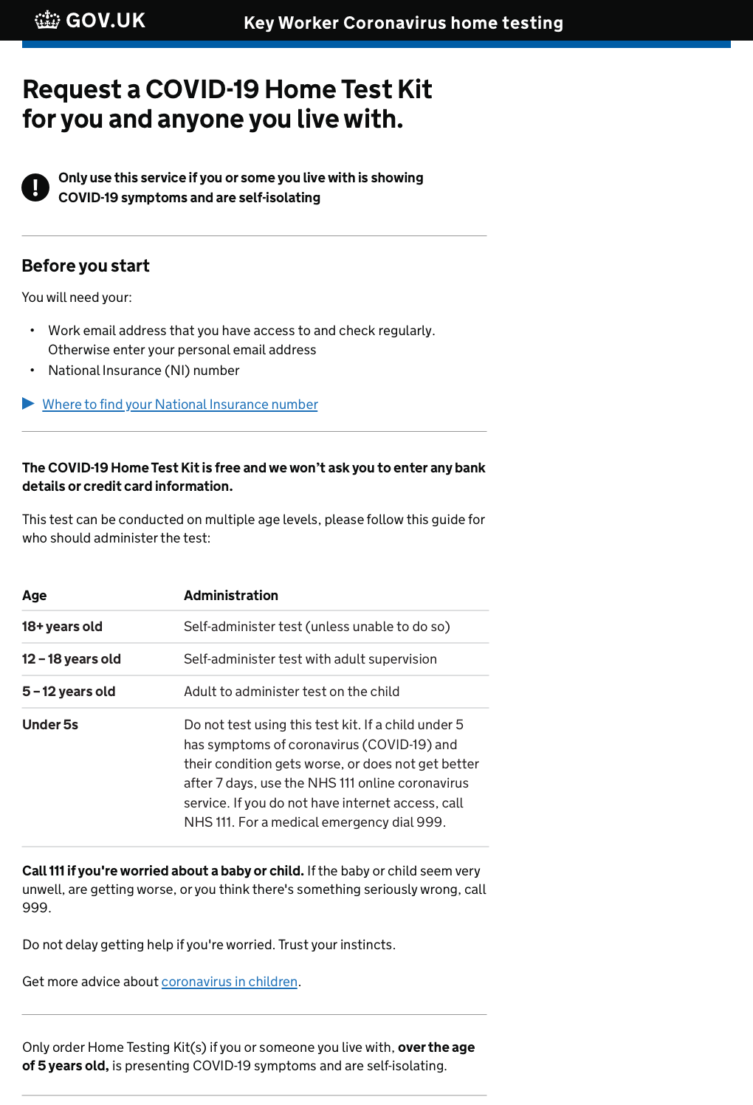
1. Access the home kit ordering portal
A
Read the information on the home testing booking page:
Who is eligible for a test, including the guidance for different age groups
Key information needed to complete the home test kit ordering process:
A work or personal email address that you can access and check regularly
National Insurance Number
Click ‘Start now’ to begin the Home Test Kit ordering process
Notes:
Check on decision – different shape/ colour for regional testing vs home delivery

Slide 31
2. Enter essential worker personal details
B
Enter the essential worker’s personal details:
Name
Date of birth
Address where you are self-isolating
National Insurance Number
Mobile number
Email address (work email if accessible)
Click ‘Continue’ to progress through the home test booking process

Slide 32
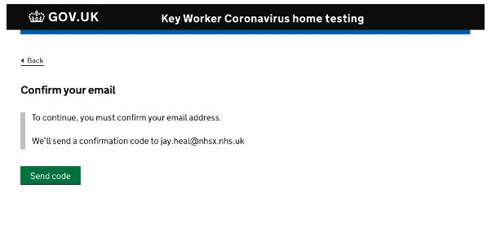
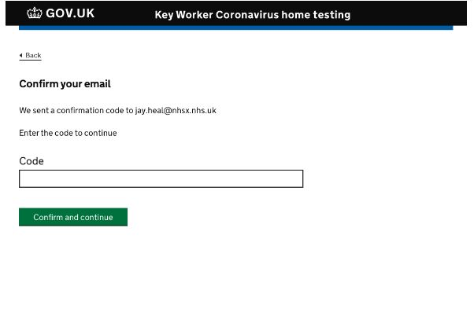
3. Verify essential worker email address
C
Locate the one-time password sent to your chosen email address
D
To continue, you must confirm your email address.
Enter the one-time code and click 'Confirm and continue'
We'll send a confirmation code to Bsmithlonglonglong@email.co.uk
I
Dear Bob Smith
E
Click send code to receive a one-time email passcode
We sent a confirmation code to Bsmithlonglonglong@email.co.uk
Enter the code to continue

Slide 33
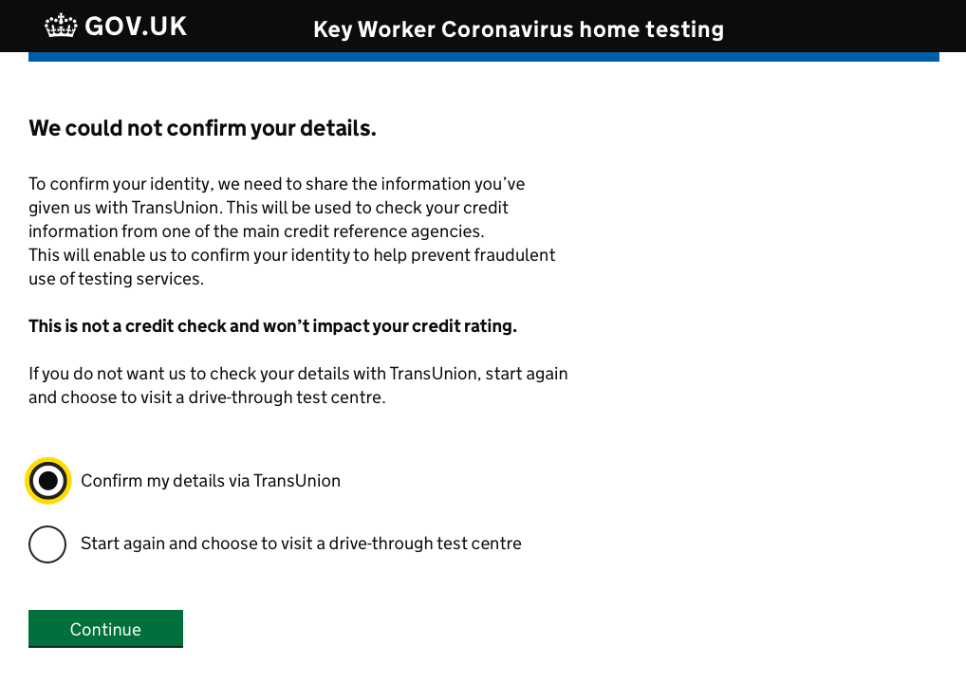
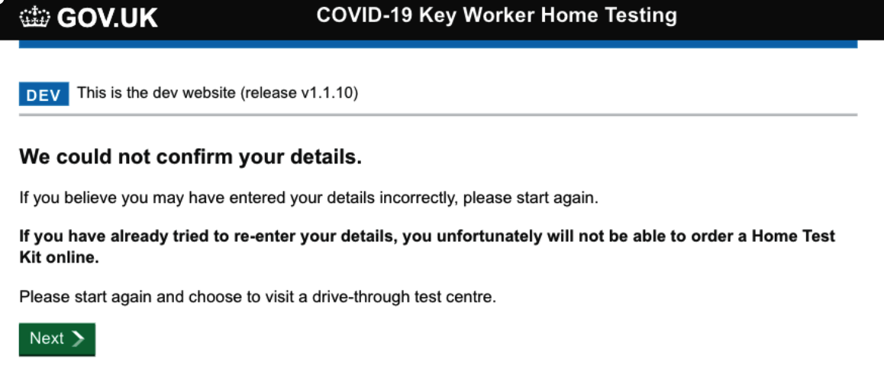
4. Verify critical worker identity
F
If we are not able to confirm critical worker details, we will need to complete a short verification through the TransUnion Service.
Alternatively, the critical worker can choose to apply for a test at a drive-through centre if they do not wish to complete the identity verification check
G
Click continue to proceed to the TransUnion Service or to book a drive-through test
If we cannot verify critical worker details they will still be able to book a test by clicking next and returning to the drive-through test centre option

Slide 34
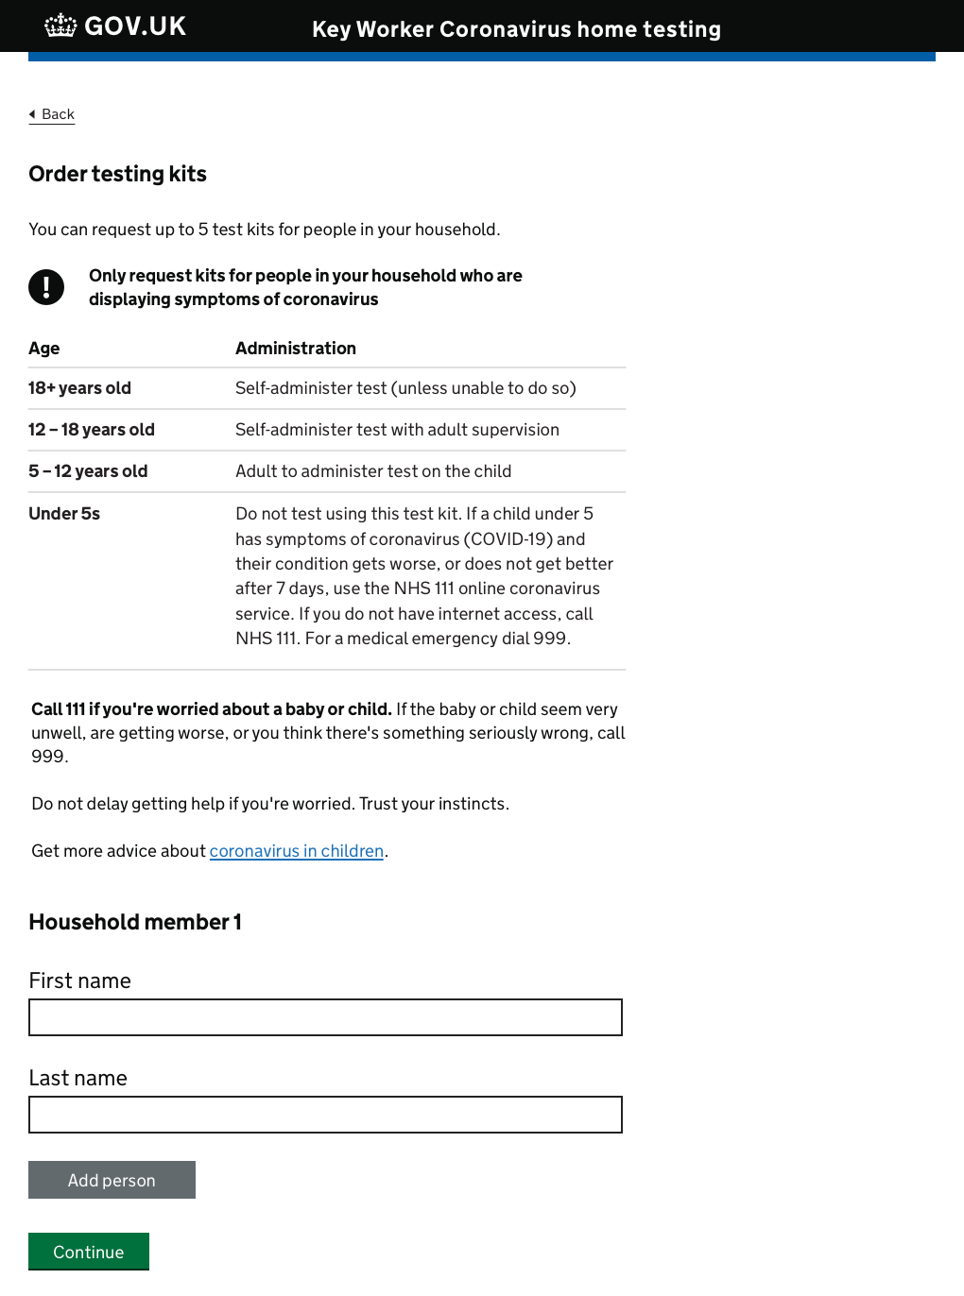
5. Provide details for ordering home testing kit(s)
H
A essential worker can request up to 5 test kits for members of their household who are displaying symptoms of coronavirus
I
Bob Smith
Note the age-related guidance relating to test administration
Bsmithlonglonglong@email.co.uk
07771 900 900
Add additional names by clicking the 'add person' button. When all individual's details have been included click continue to view the order summary
Review the Order Summary, ensuring the details are correct.
Read and confirm your understanding of the Terms and Conditions by clicking here
Place the order by clicking here

Slide 35
6. Receive order confirmation details
J
The essential worker will be presented with a confirmation of their order
Once completed, we will send a confirmation email including details on next steps
We will also send a separate e-mail containing tracking information for the order
K
Please take note of the instructions on the confirmation page.
It is important to read carefully the detailed instructions included in the home test kit(s) when it arrives

Slide 36
Frequently asked questions

Slide 37
Frequently asked questions (FAQs)
Eligibility for testing
To meet the testing criteria you must either be:
An individual (adult or child) with coronavirus symptoms living in the same household as a essential worker
OR
An essential worker, with coronavirus symptoms.
In addition, you should be in the first three days of the onset of your coronavirus symptoms at the time the swab is taken - although testing is considered effective up until day five.
No testing should be undertaken after day five, unless it’s for a specific reason agreed on a case by case basis by local microbiologists.
For further guidance and advice, please visit: www.gov.uk/coronavirus-get-tested
Coronavirus Testing Helpdesk: 0300 303 2713

Slide 38
FAQs continued
Will families of essential workers be tested?
Yes. If they are symptomatic and live in the same household they can be tested. This is limited to up to three family members for a drive-through test, and up to five tests for home testing
What about others who provide care and support voluntarily? Are they eligible for testing?
Yes. All voluntary workers are included under the NHS/social care definition on gov.uk.
Can I walk in or taxi to a test site?
You must drive/be driven to the test site in your own household’s car. There is no option for public transport, walking or taxis.
When will I get the results?
As quickly as possible. We expect this will take up to 48 hours from the point of testing.
Does the test hurt?
The test involves taking a swab of the nose and throat. You may experience some mild discomfort and you may feel a gagging sensation, but it should not hurt.
When is the right time to get tested?
The test is designed for anyone showing coronavirus symptoms and is most accurate if it’s taken in the first three days of showing symptoms.
What will the test tell me?
The test will confirm if an individual who is showing symptoms of the disease actually has it.
It will not confirm if you have had it and have now recovered.
How will I get my results?
You will get your results by email or text. We are aiming to return results within 48 hours of taking the test.

Slide 39
Additional FAQs for PAs
When registering for a test, who do I put as my ‘employer’ if not the individual I support?
Please respond to this question based on the services being provided (i.e. if you are providing care and support via a personal health budget, you should put ‘healthcare’, if you are providing care or support via a personal budget, you should put ‘social care’. This also applies to PAs who are self-employed.
If I test negative, return to work as a PA, and then later I develop symptoms, can I get tested again?
Yes. If you are experiencing coronavirus symptoms, you can be tested again via the same route.
Can my employer get a copy of my test results?
As a PA, it is your responsibility to communicate your own, or your household member’s, test result to your employer and together discuss a return to work.
What do I do if the test centre turns me away?
As a PA, you should not be turned away, and test centres have been directed that you are a key frontline worker, and have access accordingly. Your confirmation of registration- complete with QR code- is all that is required for you to access the site.
Will I be paid transport costs to access the regional testing site?
There are no central plans to fund transport costs. If you believe this is required, you should discuss this with the CCG/LA who provided the direct payment.
What ID do I take to the regional testing site?
You will need your confirmation email which contained your QR code. This code will need to be shown to security at the regional testing site. Only one QR code is required, either on a smartphone or a printed copy of the email.
Further FAQs can be found at https://www.gov.uk/government/publications/coronavirus-covid-19-guidance-for-people-receiving-direct-payments. This FAQ will shortly be updated to include additional questions on testing.

