Slide 1
Storytelling for Insight
May 2017
Gary Copitch Chief Executive
Gary@peoplesvoicemedia.co.uk
Peoplesvoicemedia.co.uk
Notes:
Thanks

Slide 2
Who are we?
We are a charity and a not for profit business founded in 1995. We work across Europe.
We specialise in gathering people’s authentic voices and stories. These stories give insight that influence and inform people and organisations.

Slide 3
Stories of lived experience

Slide 4
Look at the whole story
Notes:
360 approach people live in communities with families approach which is silo break the silo

Slide 5
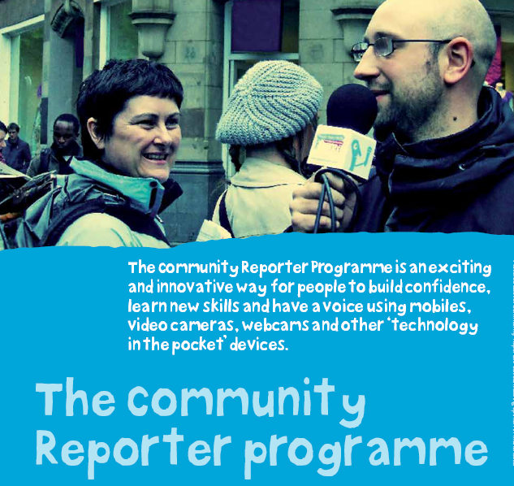
Community Reporters
Notes:
Stated in 2007 Central to Community Reporting is the belief that people telling authentic stories about their own lived experience offers a valuable understanding and insight of their lives and supports people to have a voice to challenge perceptions and describe their own reality.

Slide 6
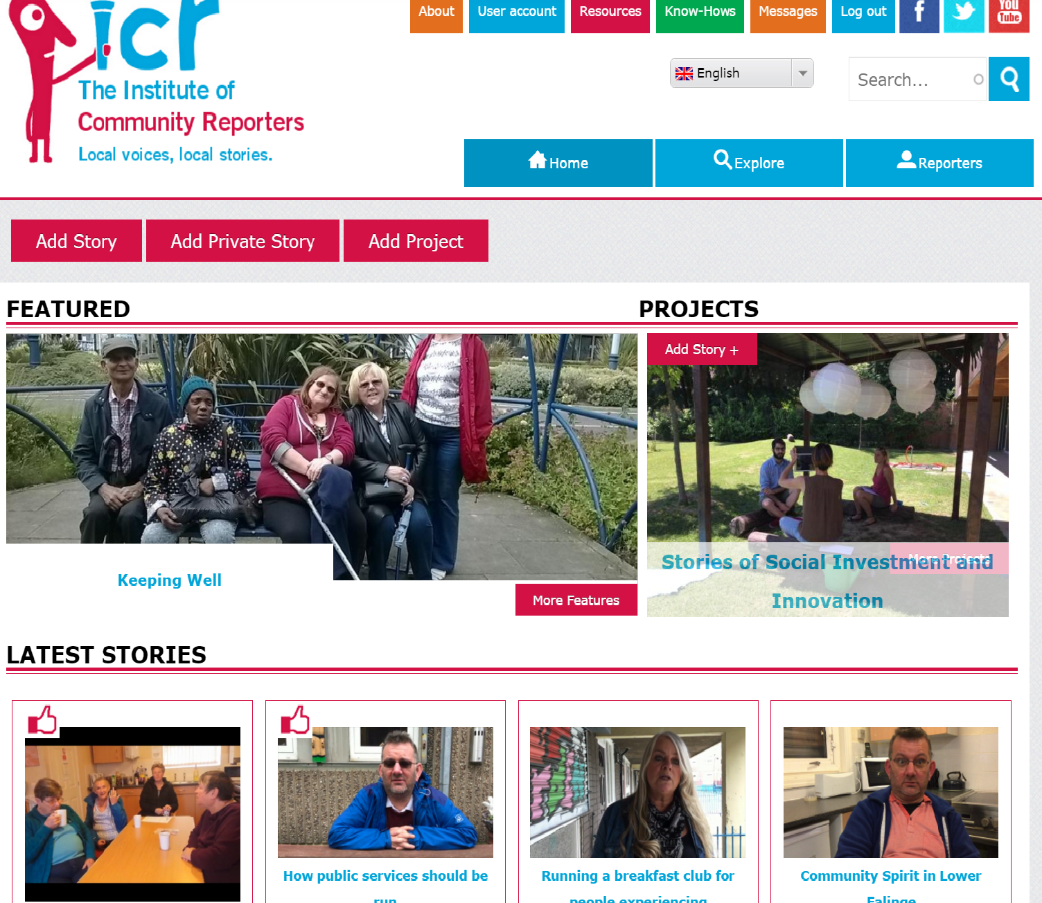
Our model
Replicate
36 social
licencees
Train
Capture story
Create Impact
Network of over
1800 reporters
communityreporter.net
Notes:
Train 2/3 day programmes responsible story telling, and story telling practice your own and others receive digital confidence – technology in the pocket devices
Capture ask about who has mobiles video/audio/written and photo appear on cr site
Replicate local provison feeding local network
Curate reporters look at all stories collected and say whats authentic and feed back to commisionier or to create a feture on cr web site unsolicited.
Network mixed peol 11- 90 across us and Europe mainlt c2,d and E

Slide 7
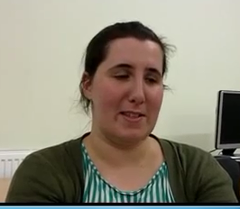
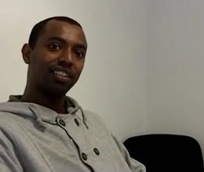
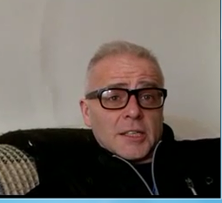
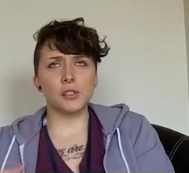
Who are the reporters?
We support people to tell their stories from a range of demographics including:
BME, LGBT, white, disabled, employed and unemployed people, FGM, Older
Age range from 11 to 80+

Slide 8
In addition each reporter receives training on:
- Responsible storytelling methods
- Story collection techniques
- Able to use “technology in the pocket devices”
including video, audio and photography functions
- Digital literacy skills and confidence building
- Peer to peer collection

Slide 9
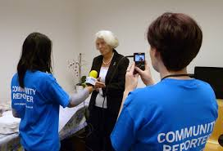
What Community Reporters receive
Become part of the Institute of Community Reporters movement and are able to share experience and thoughts online and in meet ups and provide ongoing story
Feel that someone is listerning
Be recognised for their contribution though the Insittue of Community Reporter badging and certification programme
Post course training on curation

Slide 10
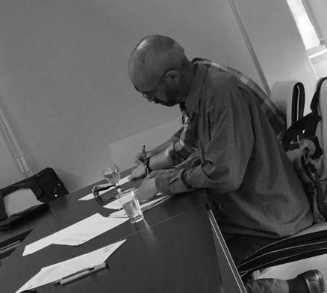
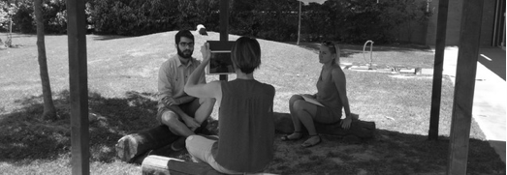
Storytelling approach
Snapshot
Stories
Dialogue
Story
Personal Monologues
Notes:
Snapshot Stories: These stories engage people in talking about their opinions on a particular topic.
Dialogue Interviews: These are peer-to-peer ‘interviews’ that do not have pre-determined questions.open question enables the storyteller to start Community Reporter recording the story
Personal Monologues: people record themselves talking about a particular topic, experience, life journey etc. planned mind-mapping exercises, journey story maps, story and ideas boards, and story element planning sheets.

Slide 11
Greater Manchester Public service Reform

Slide 12
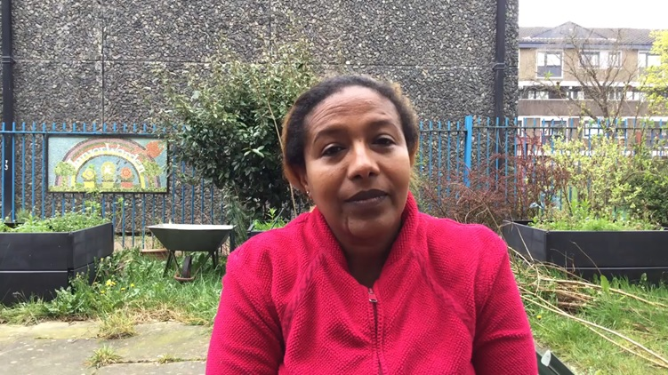
Snapshot story
Challenging Perceptions
Notes:
Snapshot public servce refoms

Slide 13
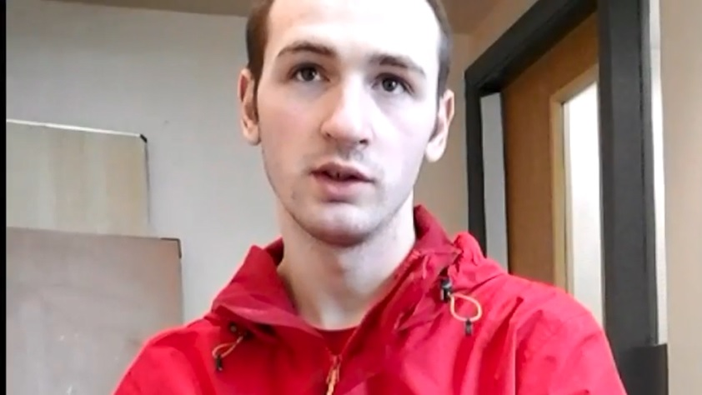
Dialogue story
Describing their own reality
Notes:
Also story of other people his mother workers involved in order to give 360 story curated and will be sent to public service reform Peer to peer reporter did dialogue not researcher asking questions

Slide 14
Curating Stories
Our analysis process
The WHAT
e.g. I keep well through walking my dog.
Topic
1
The WHY
e.g. My husband died and the dog gave me a reason to go out and get back to normal, so I wasn’t on my own.
Content
The HOW
e.g. Being outside in the park gives me a boost. It helps me to meet other people.
2
3
Context
The Findings & Insights

Slide 15
Notes:
Just done this across greater Manchester collected x no of stories from x number of people across 10 borughs user persectve to inform public service teams findings still In draft change is often at local level and idea to be disruptor

Slide 16
Community Reporting looking at the 360

Slide 17
Community Reporting for Co-production

Slide 18
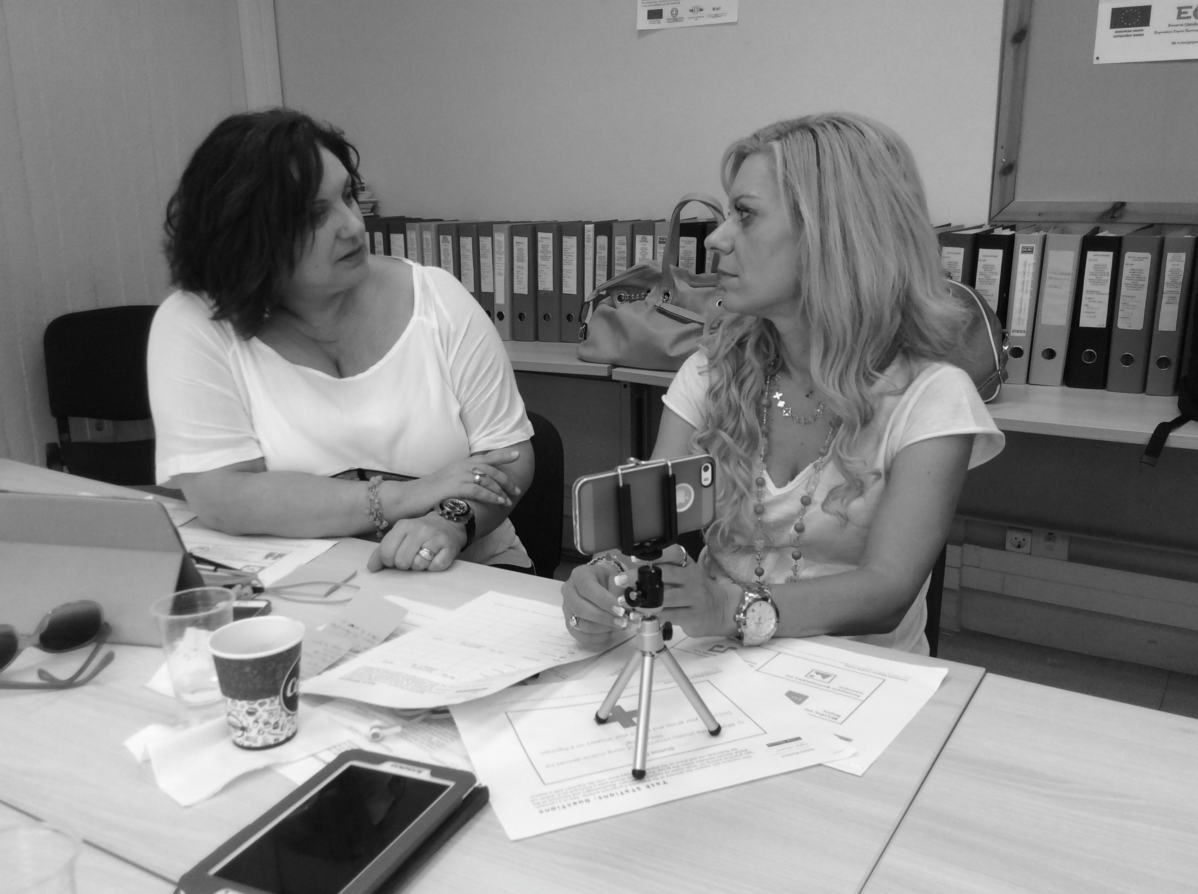
Pan European project on
Social Investment and Innovation
Partnership with 10 European Universities.
Our role was to provide insight on user perspective

Slide 19
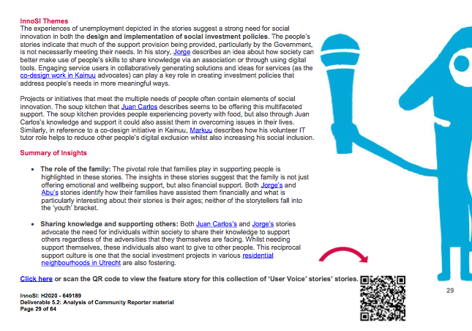
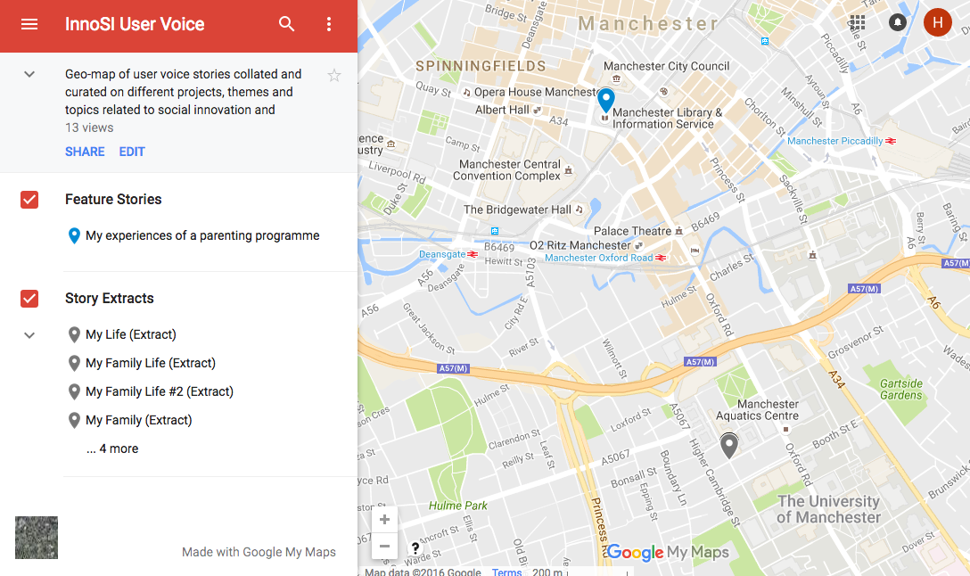
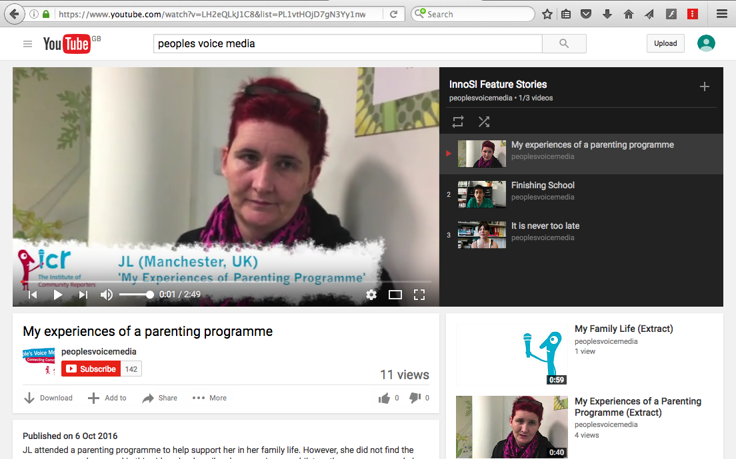
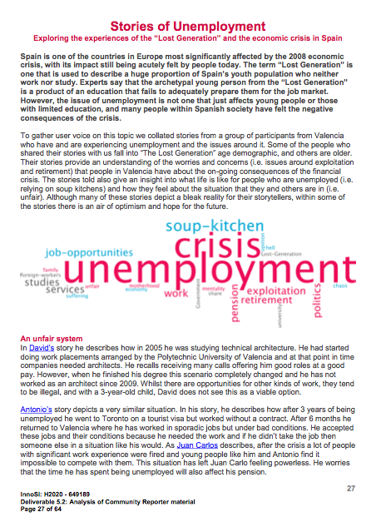
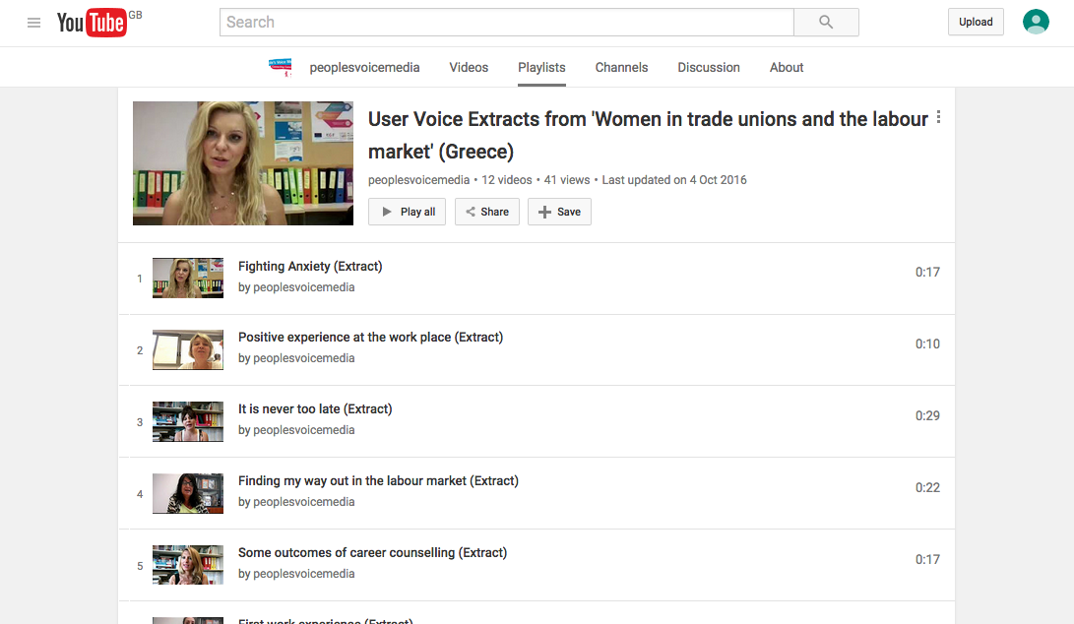
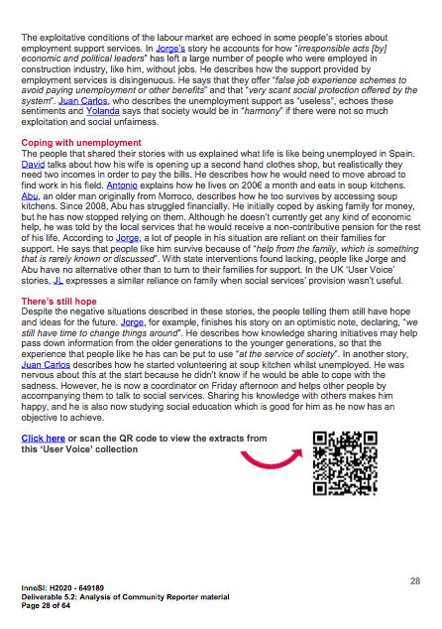
Curating Stories
What we gave them

Slide 20
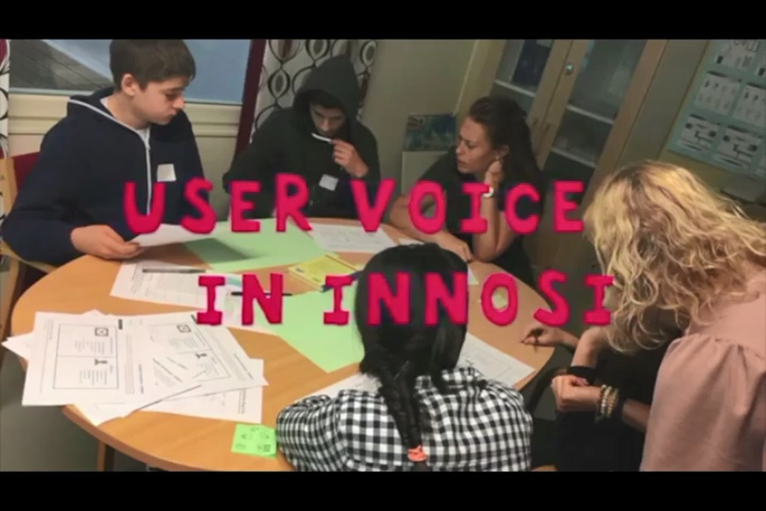
https://communityreporter.net/story/user-voice-innosi

Slide 21
Web Site: peoplesvoicemedia.co.uk Email: gary@peoplesvoicemedia.co.uk Twitter: @peoplesvoice For reporter content see communityreporter.net
Thank You!

