Slide 1
The Company of Community Organisers
Nick Gardham – Chief Executive Officer
t. @nickgardham
e. nick.gardham@corganisers.org.uk

Slide 2
Background and context
The Community Organiser Programme and creation of The Company of Community Organisers

Slide 3
The context: 2010 onwards
“
The goal of the Big Society is to transfer power from the state to individuals, neighbourhoods or the lowest possible tier of Government, in that priority. What remains of state power will be used galvanising, catalysing, prompting, encouraging and agitating for community engagement and social renewal
David Cameron, Conservative Party Conference 2010
”

Slide 4
What is Community Organising?
Community Organising is the work of building relationships in communities to activate people and create social and political change through collective action. It enables communities to empower themselves and harnesses the power of individuals to work together in their shared self-interest
Community Organisers Ltd
“

Slide 5
What is listening?
Listening, in short, is the capacity to discern the underlying habitual character and attitudes of people with whom we communicate, including ourselves, in such a way that, at its best, brings about a sense of shared experience and mutual understanding
G. Brodie & N. Crick 2014
“
Notes:
Listening is far more than just finding out what people want.
Its about rebuilding trust and relationship
Parking of agenda
Uncovering what lies below the surface
Identifying and addressing the root causes of inequality
Create connections and form allegiances between people
Building powerful connections that can in turn be powerful networks

Slide 6
Perspective from which we see the world
Communities are full of potential.
The skills and talents of people and their potential exists – but may lay dormant
The assets and resources need to be unlocked so that the ‘invisible’ becomes ‘visible’
Communities are made of people suffering multiple disadvantages
There are inherent problems with crime, disorder, unemployment and welfare claimants
People are hard to reach and are not using the services that they should be

Slide 7
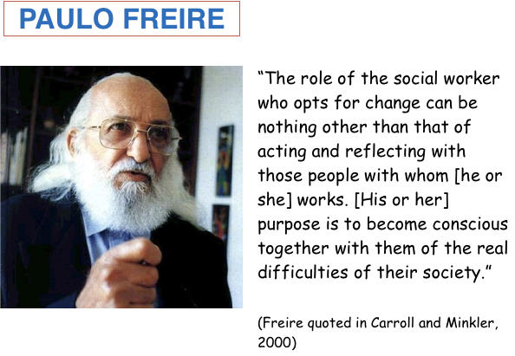

Slide 8
Saul Alinsky
“As an organizer, I start from where the world is, as it is, not as I would like it to be. That we accept the world as it is does not in any sense weaken our desire to change it into what we believe it should be - it is necessary to begin where the world is if we are going to change it to what we think it should be. That means working in the system.”
Saul Alinsky

Slide 9
Tacking Isolation, Halifax
“If the project was going to be different, I wanted it to start with listening. We already think we understand the needs. But it’s a new area of service for us. We wanted to start from scratch. We wanted the discipline of listening.”
Barbara Harbinson, CEO, Halifax Opportunities
Trust
Notes:
Our Place Halifax project aims to address the problems of loneliness and isolation, mainly amongst older people in the area and to start to do this through listening.
Our Place Halifax project is led by the Halifax Opportunities Trust (HOT), a community based development trust in West Central Halifax, West Yorkshire. It was set up by the Park Ward community in 2002 to help open up employment and business opportunities and support children and families. Thirteen years on, it offers this support across the whole of Calderdale.
The vision for project is to make Park Ward a more supportive area for those who feel isolated or lonely and to create a coordinated and sustainable menu of options to address the problem. The plan is to do this by listening to those experiencing loneliness and to develop with partners a stronger infrastructure of volunteering, improved access to existing and new local facilities and opportunities.
The Trust has been working with community organisers for nearly two years now. Listening had already identified isolation as an issue. The first stage of the project was designed to:
• carry out more listenings, especially with older people who would be using new or
redesigned services • to use the community organising process of building trust and identifying leaders to
find people interested in joining planning groups • support people to set up and develop their own groups and projects.
Barbara Harbinson of HOT says:
“If the project was going to be different, I wanted it to start with listening. We already think we understand the needs. But it’s a new area of service for us. We wanted to start from scratch. We wanted the discipline of listening.”
The project has been more challenging than originally envisaged. It has been hard to find places to listen to older people. GPs did not respond well to the idea of listenings taking place in their premises. Nor did sheltered housing complexes. However the community organiser has listened in supermarkets, existing clubs, on the door step, at one GP surgery and one sheltered housing block.
One thing the community organiser has learnt is that people don’t want to be labelled as ‘in need’ of services because of their age. What works best is to go through the usual listening process which doesn’t stigmatise. Once trust is built then they can ask about any issues which particularly relate to age or vulnerability. If someone is very interested, the community organiser will arrange to return and meet a group of friends or neighbours and work with them on an idea or action plan. These can then be fed to commissioners or become self-supporting projects. The Trust is now developing a hub at their Hanson Lane Centre where the community organiser can bring together volunteers and leaders they discover and start developing ideas and designing services.
Natalie ratner, Community Organiser in Halifax says:
“Community organising is not just consultation. It’s about motivating people to get involved.”

Slide 10
Building the voice, Portland
The residents used to refer to the warden as their jailer and talked about setting up escape committees to get out of the home!
Elderly residents, LOCOG Olympic Village Officer and County Councillors worked together to create a new daily bus service to access shops as well as improved the roads so elderly people could walk safely along them
Notes:
Bill and i were listening in the Castletown area of Portland - we were deliberately listening there because the Olympics were coming in to full effect and LOCOG had just implemented a no go area and cordoned off half of the Castletown area to protect the Olympic Village. Portland was host to the Olympic sailing events.
With the permission of the warden we held a group listening on one of the residents coffee mornings. During the listening we heard alarming words used such as 'fear, isolation, danger, trapped, abandoned etc). We went back a week later and did a further listening with a larger group of residents.
It turned out that the Foylebank home was particularly affected by the Olympic Village. The large security wall was directly opposite their entrance and stopped use of the pavement opposite. This pavement was vital for them to use to get to public transport (disabled access was blocked). Many of the residents would be effectively trapped in their building for the 3 months of the Olympic 'shut down'.
The residents used to refer to the warden as their jailer and talked about setting up escape committees to get out of the home!
Several of the residents took active roles. One wrote to the local councillors and LOCOG, whilst another (who was wheelchair bound), went to every resident asking them to sign a petition and listen to any other concerns around the Olympics.
They eventually called a meeting that was attended by Council highways, LOCOG village manager and 2 county councillors.
The result was - LOCOG took the residents for VIP visit to the Olympic Village, they also provided a daily bus service to the shops. Highways put in drop curbs to allow better movement for the residents. The county councillors set up a monthly surgery at Foylebank to support the residents needs. And best of all - the residents built a better relationship with the warden who supported them with all of their actions.

Slide 11
Homelessness, Birmingham
For the first time in his life Bill is very much a part of his community. He has 5 youngsters who run errands for him, (he keeps them out of trouble) and if people run out of gas or electricity he send his runners and they collect the cards and cash and top the cards up for them.
From being homeless and alone Bill is
now part of over 30 families on the
estate. He says “it’s like having an
extended family”.
Notes:
Bill was a homeless guy who slept in the park and I sometimes go and have a chat and listen to his troubles. We often shared ‘my’ sandwiches. As he spoke he seemed to be rather posh and he didn’t have the ‘Black Country’ accent. I probed all the time until he finally told me his story. He used to work as a Bank Manager in a high street bank the one with the griffin he used to say. But after commuting and rushing about for 40 years and the death of his wife it made him take stock of his life, he thought he had missed out on so much by gaining this top job, with money and status came stress and ill health. He lost his wife and didn’t think he could go on, so he went on a journey to ‘find himself’
But then his ill health escalated and he had a heart attack and thought his world was falling apart, but he said “I looked around me and I actually had everything” I just didn’t know it at the time.
He ended up after a few lonely days sleeping rough and although he said it was tough on cold nights the network was amazing, people helping each other, sharing food, well he said they shared everything.
Returning to the estate/community and as I listened to a few other people in the area, they were moaning about the state of a house in their row, which was bringing down the prices I put two and two together it was Bill’s!
I spoke to him several times more to find out about his house and what troubles people had were having with the area of his house and the 3 high rise flats, transient people, young families stuck, young families alone. I told him we had a group of people that could really do with his help and understanding and how I had been talking about bulk buying – “potatoes” He said leave it with me.
Several days later I returned to the park and looked for Bill and couldn’t find him, days turned into weeks and I got a bit worried so I asked about and the local greengrocer and she said that Bill had moved back into his house.
I went there and he had moved back in, I spoke to him over many hours and discovered he wanted to help but also wanted help and wouldn’t ask for it. I already had 5 ladies who were interested in bulk buying and Bill was the link. I suggested a house meeting in a local café and they all turned up apart from Bill. I rang him and he said he didn’t think he was the one to help but they could use his garage. I told him to get to café his cuppa tea was getting cold. 5 minutes late Bill arrived, He volunteered to help them. He had the knowledge and the garage and the network to distribute, he then got in touch with a company in Dudley to supply and even borrowed some scales from the local shop and off they went with the potatoes sale. You had to pay upfront and the potatoes were then delivered to your door.
This then progressed into Nappies, school uniform, thrift shop for children clothes all in Bill’s garage.
But as Bill was looking after these 34 flats at the time, they were giving something back, they started to help Bill ‘mend’ his house, whilst mending his house they mended his heart he told me. Hel felt part of something, he was part of the community, for the first time in his life. Bill is very much a part of his community now, he has 5 youngsters who run errands for him, (he keeps them out of trouble) if people run out of Gas or electricity he send his runners and they collect the cards & cash and top the cards up for them. These are mothers who would otherwise have to wait or get the kids up first. He is very much a ‘kind’ elderly gentleman who everyone needs in their lives. Bill gets it done, he says “it’s like having an extended family”.
He is now enjoying life, has people in and out all the time, his house looks great and so does he.

Slide 12
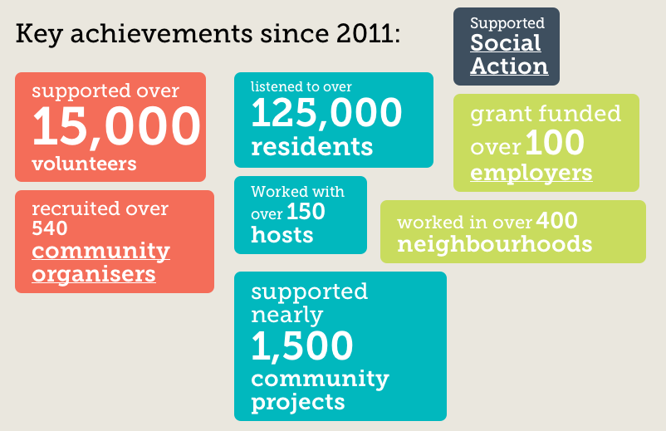

Slide 13
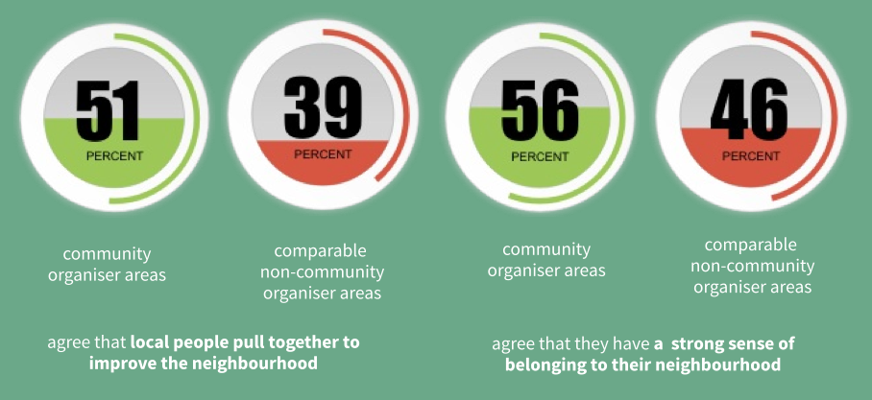
It’s the beginning of the journey…
…but what has been found out so far?
Ipsos Mori and NEF Consulting, Evaluation Report - 2014

Slide 14
The Company of Community Organisers
Two key objectives:
To be the national membership body for Community Organisers and those committed to the values and principles of community organising
To provide training for individuals, community organisations and public bodies in the theory, practice, principles and process of community organising

Slide 15
The growth of Community Organising
The Community Organiser Expansion Programme

Slide 16
CO Expansion Programme
The Programme will:
Embed community organising in 20 areas across England by setting up Social Action Hubs in each area to lead on the training, recruitment and development of Community Organising.
Set up the National Academy for Community Organising to be the home of the “Foundations of Community Organising” qualification.
Build new partnerships and alliances to expand the community organising network. Engage a network of Member Support Organisers to strengthen the network of Community Organisers.

Slide 17
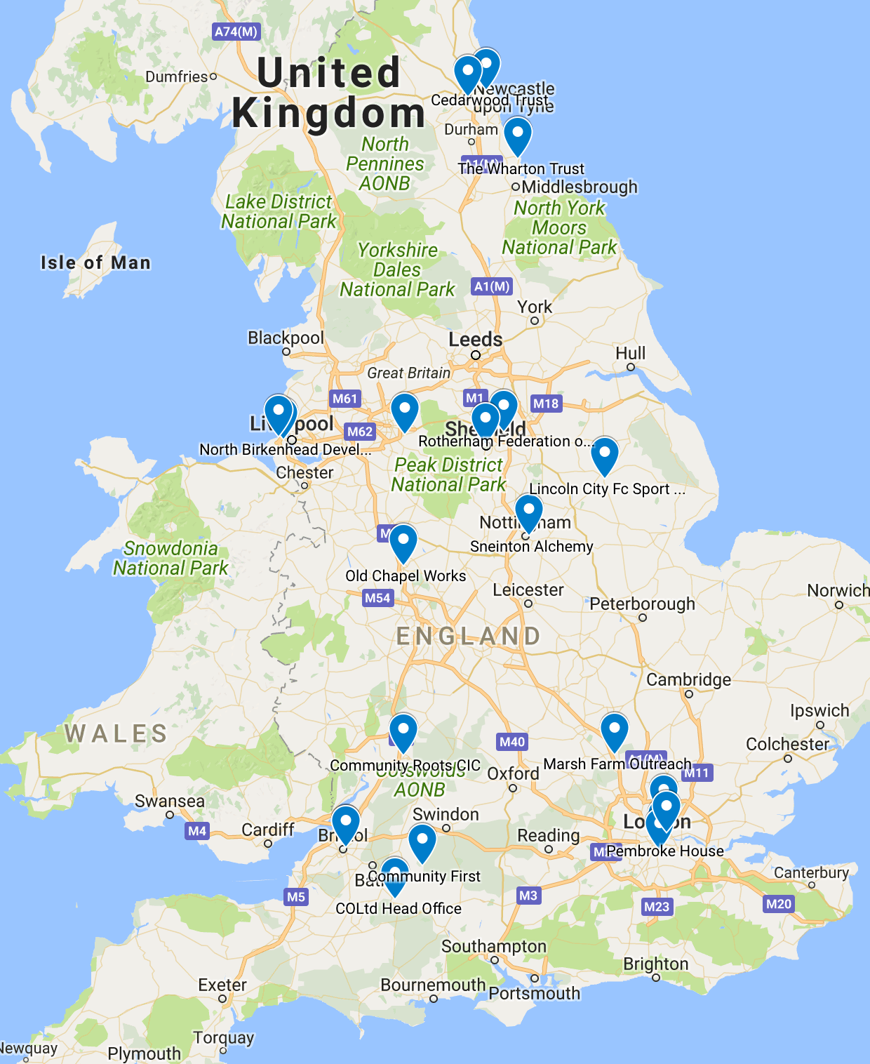
CO Expansion Programme
North East
Hartlepool, Newcastle, North Tyneside
North West
Stockport, Birkenhead, Leasowe
Yorkshire and Humber
Rotherham, Sheffield
Midlands
Nottingham, Stafford, Luton
South West
Gloucester, Bristol, Swindon
London
Haringey, Lambeth, Southwark, Hackney

Slide 18
Community Organising on Prescription
Ryan McMurdo - Training Officer
Starting Point Community Learning Partnership

Slide 19
Ingredients
Patients that want to be part of the health provision.
Members of the community that want to see things happening.
A community space.
A practice manager that wants to improve the wellbeing of her community.
A community organiser
The belief that kindness and togetherness can offer ‘more than medicine’.

Slide 20
Method
Offer informal training in ‘An Introduction to Community Organising’.
Invite patients and community members to attend training.
Show them that listening and accepting people’s emotions leads to action and change. The word emotion contains the word motion after all!
Give them a space to listen. Their local coffee shop, the waiting room of the health centre or even the queue in the Fish & Chip Shop. You have to go to the people. They won’t come to you!
Allow people the chance to shape their community.

Slide 21
Results
Volunteer Patient Champions who have learnt the key basics of community organising.
Support and contact for the most vulnerable and isolated in the community, in a place where they feel safe.
Activities from veg on prescription, a peer ran ‘plot-to-plate’ scheme with no expert, dietician or public health person in sight to a weekly walking class and singing with John and Harry; which see’s ‘You’ll Never Walk Alone’ sang in a coffee shop owned by a Rangers and Manchester United fan. What’s next, Blue Moon?
A 20% reduction in GP appointments as people feel the ‘More than Medicine’ approach is working!

Slide 22
Why Community Organising & Why Prescribe it?
Both Alvanley Family practice and Starting Point want to listen, engage and empower as many people in their community as they can. Community organising offers a pathway to doing just that.
Why prescribe it? Illness is often prescribed medication. But what do you offer somebody who wants to get more involved in their community and feels they don’t have a space.
Growing evidence that a ‘More than Medicine’ approach can heap benefits not just on the attendee’s of sessions like the Knit & Natter sessions but on the volunteer champions and the wider community as a whole.

Slide 23
