Slide 1
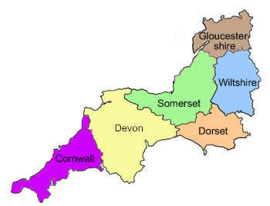
Individual Service Funds our approach in
Dorset & the Southwest
Gary Kent- New key
Chris Watson- Dorset County council
Rachael Mason- 24/7 grid

Slide 2

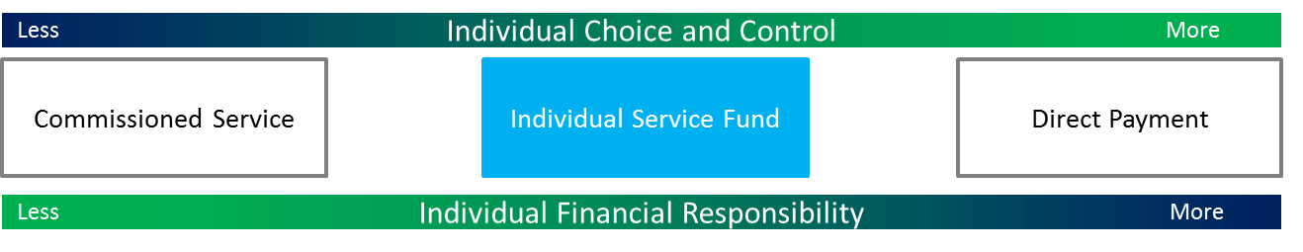
Personal budgets in Dorset
Taken as any of these options (or a mixture):

Slide 3

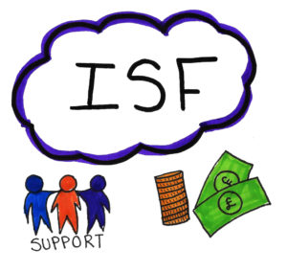
Individual Service Funds
In September 2016 we created a register for providers who want to offer ISF’s
Entry is light touch – Applications are reviewed by a Quality panel made up of those who use services and family carers and the focus is on organisational values
Details of providers offering ISF’s are put onto our local online support directory. People can choose the provider they want.
The person has a support agreement with their ISF provider outlining how their budget is to be managed/used
Providers must show they are co –designing the support plan with the person and their circle of support. They can use tools like the 247grid to enable people where and when they want support and be more aware of how their money is spent
It mirrors the direct payments process exactly (including back office business process)
Notes:
In September 2016 we created a register for providers who want to offer ISF’s
Entry is light touch – applications are peer reviewed and the focus is on organisational values
Details of providers offering ISF’s are put onto our local online support directory
The person has a support agreement with their ISF provider outlining how their budget is to be managed/used
It mirrors the direct payments process exactly (including back office business process)

Slide 4
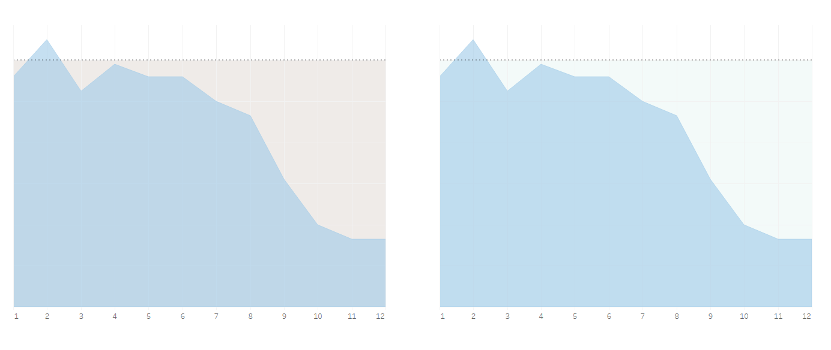
Assessment
Initial
assessment
12 month
review
Assessment and personal budget often allocated at time of highest support need
Often lack of team capacity meant that, unless deemed urgent from safety perspective, a review/ reassessment could take months, if at all
Once the person settled, the budget was often over compensating
Contract systems made it impossible for providers to change support packages without formal reassessment.
Contract wording made it difficult to pool budgets or spend the funding on innovative solutions
Inefficient spend £
Package cost
Changing needs
Months since 1st assessment
Notes:
Assessment and personal budget allocated at time of highest support need
Often lack of team capacity meant that, unless deemed urgent from safety perspective, a reassessment could take weeks
Often the budget was over provided Contract systems made it impossible for providers to change support packages without formal reassessment

Slide 5
Win -win
Initial
assessment
Provider & client in control
Rolling review/ self assessment
Individuals get the choice & control they want
Providers are more accountable to the person within a commissioned service
Our new hypothesis on getting best value in terms of quality and cost
Provider acts as a holding account for the budget and is expected to invoice against it for work done. The person now has the opportunity to pool budgets and buy services and support from outside of this organisation
Unspent funds can be returned to the local authority by the support provider – (this has started to happen)
Returned £
Changing needs
Package cost
Months since 1st review
Notes:
Our new hypothesis on getting best value in terms of quality and cost
Provider acts as a holding account for the budget and is expected to only use budget if required
Unspent funds can be returned to the local authority by the support provider – this has started to happen

Slide 6

The Future
Growing alternatives to just using hands on support - particularly working with the third sector to develop community based options
Deregistration or remodelling of all residential care homes – unlocking these contracts
Driving up quality in the provider sector through focus on outcomes and innovation
Joining up with other south west LA’s to develop the same offer and processes
Notes:
Growing alternatives to just using hands on support - particularly working with the third sector to develop community based options
Deregistration or remodelling of all residential care homes – unlocking these contracts
Driving up quality in the provider sector through focus on outcomes and innovation

Slide 7


What is an ISF (family perspective)
An ISF offers transparency and accountability that we didnt have before.
Our package of care is no longer ‘given to a provider’ after a tendering process, but we have choice over who that provider is.
We are ‘at the table’ as partners for the whole journey
We know what the budget is for, how much it is and together we decide how it is spent
It is made clear which are shared hours , which are specifically yours
The provider supports us to pool budgets and find innovative alternatives

Slide 8
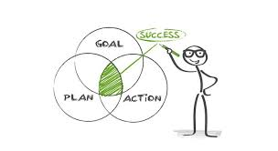

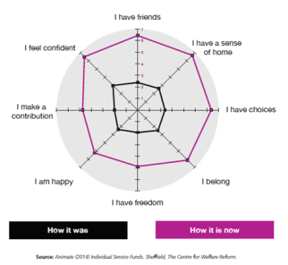

Business as usual..
Co-design the care plan
regular meetings(rolling revieW)
Working not working
Recording progress
Celebrating independence

Slide 9
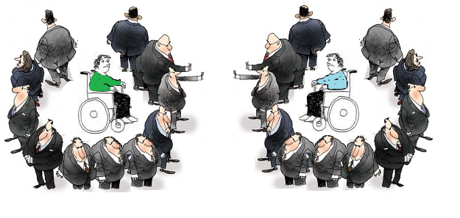
Although neighbours.. Service land makes it impossible to connect
Legitimate data protection – or providers protecting their allocated funding?

Slide 10

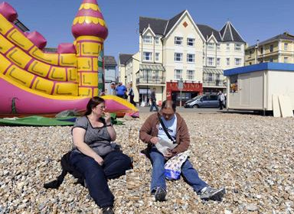



I’m not bored.. but I’m lonely
Pooling budgets
£120
DP
2.5 Days
£8phr
DP
DP
4 Days
£10phr
5 Days
DP
ISF
DP
£12phr
5.5 Days
DP
ISF
ISF
ISF
£15phr

Slide 11
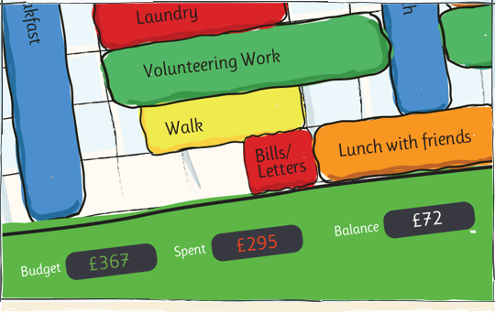

An empowering way to manage your personal budget with your chosen provider
“A better conversation”
www.247grid.com

Slide 12

Gary Kent
The provider perspective
How I got involved with Dorset
Working alongside commissioning last 2yrs
Provider workshops
Sharing good practice

Slide 13

Outcomes
Developed pilot for ISFs in Dorset
Transparency and accountability to the people we support
We ensure all support is effective, meaningful and always moving someone forwards
The person has the control

Slide 14



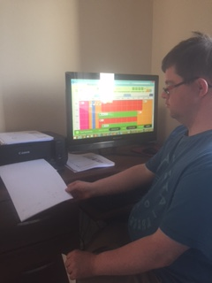
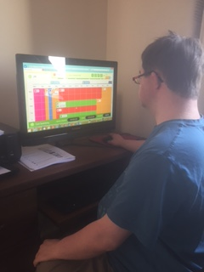
PILOTING THE 247GRIDS
Regularly sitting with the person and their CoS. Using their Grid to:
Look at their weekly activities
The type* of support they choose
How each activity is linked to their outcomes
How their money is being spent
Do they want to spend it differently?

Slide 15
WHAT THE FUTRE HOLDS FOR PROVIDERS
Adopt AN ENABLEMENT APPROACH
To work in partnership with THE person they support
transparency & accountability to the person as to how their funding is spent
giving the person CHOICE & CONTROL
Build COMMUNITY Circles of support
Personalised, local support that Focuses on Outcomes & reducing long-term reliance on funded support services
Collaborate & network with other providers , pool resources
PEOPLE & THEIR Circle of support, COMMUNITIES AND PROVIDERS COPRODUCE commissioning

