Slide 1
Connecting Differently
Jonathan Monk
Head of Quality
September 2017

Slide 2
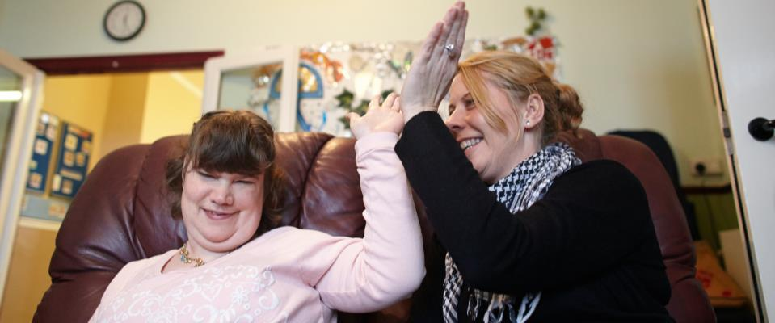
Connecting Differently
Sense is a national disability charity supporting people with complex communication needs to be understood, connected and valued
Supporting children, young people, adults and families in their own homes and in the community
Support with education, transition to adulthood, holidays, arts, sports and well-being programmes

Slide 3
Quality Matters
Our operational services support over 700 people
54 CQC registered services
98% services rated ‘Good’ or above
Sense College and holidays and short breaks programme rated as ‘Good’ by OFSTED
2017 Skills for Care Accolade for Best Employer Support for Registered Managers

Slide 4
Outcomes Focused
To feel safe, independent and engaged
To experience emotional and physical well-being
To have a sense of self and create relationships and friendships
To have choice and control over your life and support
To be included and make a contribution to the community
To experience pleasure, purpose, fulfilment and achievement

Slide 5
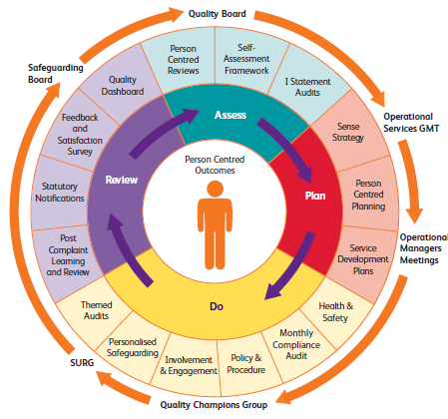

Slide 6
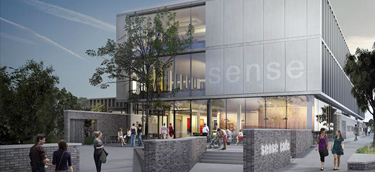
Creating Connections
Touchbase Pears multi-purpose venue in Selly Oak opened in July 2017 as a place for people to come together and do remarkable things
Personalised day opportunities base for people to choose how to spend their time
Family friendly café
Vibrant centre for inclusive and sensory arts
Physical activity programmes to support people to stay fit, healthy and happy
Volunteering and work based opportunities

Slide 7
14
Asset Based Support
Communication
Creativity
Unlocking
Communication
and use of technology
Promoting opportunities around expression and creativity
Connection
Community
Connecting with individuals and bringing people together
Supporting relationships, being part of the community

Slide 8
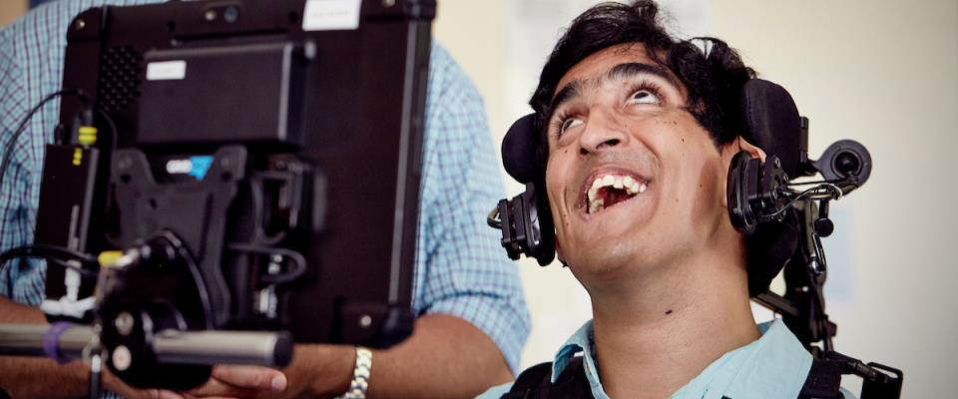
Jack’s Story
Jack lives in an Sense residential setting in Birmingham.
He has multi-sensory impairment and experiences difficulties with communication which he finds frustrating.
His social network was limited and he lacked confidence to make choices and would often ask staff to decide for him.

Slide 9
Two years ago, he became involved with the Touchbase Champions – a group of people using Sense services to influence the design and development of the building. He was also involved in the recruitment to key staff working at Touchbase Pears
He is completing a work placement at Touchbase Pears working front of house in the busy reception area. He enjoys the buzz of this work and the interaction with colleagues and members of the public.
He is also currently undertaking an accredited course in customer service skills.

Slide 10
He contributes to the Sense User Reference Group to influence the planning and development of Sense services.
He has worked hard to develop his signing and literacy skills. This has increased his independence and his confidence to express his choices and opinions.
He is excited about his future opportunities and is now exploring paid employment.

