Slide 1
Harnessing the power of communities

Slide 2
Starting with values – shared
Organisations and people already delivering great stuff
Co-operating

Slide 3
Who are we?
A mixture of people and organisations frustrated with the pace and direction of public service change, who want to positively develop and demonstrate a different way – local approaches and visions are typical
We happen to live, learn, work and relax in, and enjoy Doncaster
We all have different perspectives, connections, strengths, knowledge, talents
We share aspirations about change and a direction of travel for that change

Slide 4
Who are we?
Change advocates with a variety of policy, systems and practice knowledge and local system context
Disabled people’s user led organisation providing a wide range of direct payment support and nurturing PA’s
Network of befrienders
New small registered provider of regulated home care and other wider unregulated care and support
Community organisations offering personalised and inspirational day and evening opportunities
Network of artists and alternative therapists supporting carers
Independent social worker
A community allotment organised as a social enterprise

Slide 5
Our aspirations
An empowered community and voluntary sector actively engaged, leading on design and delivery of care and support.
All people have genuine choice and access to high quality resources available through current, accurate and relevant information.
A listening system that reflects and is responsive to individual needs.

Slide 6
Our values, or what we believe:
We uphold citizens’ rights and challenge them to take responsibility for their choices, decisions and actions.
Citizens enjoy a sense of well-being and a good quality of life by using acquired knowledge and engaging personal circles/networks of support.
Citizens decide what quality means by exercising choice to use resources available to them in a free market of solutions that can meet need.
Citizens want to be in control, power dynamics between citizens and health and social care professionals are always equalised
Citizens are at the heart and centre of all we do
Satisfaction should be a bare minimum in their experience
Information Technology (IT) will play a key role in new models of citizen-centric health and social care support.
We uphold the principles of Independent Living as paramount rights of citizens.
We promote the social model of disability and discourage the medical model as it disempowers citizens.
We promote anti-oppressive practice across health and social care and wider agendas such as education, environment and economy.
We focus on well-being outcomes for citizens relentlessly.
Living a fulfilling life involves risk-we support positive risk-taking.

Slide 7
Seven principles of co-operatives
Voluntary and open membership
Democratic member control - equality
Member economic participation - equity
Autonomy and independence
Education training and information
Cooperation amongst co-operatives
Concern for community

Slide 8
A multi-stakeholder
Co-operative
Deciding together
Direction
Development
Dividend
Supporters
Employees
Users
Equalising power dynamics

Slide 9
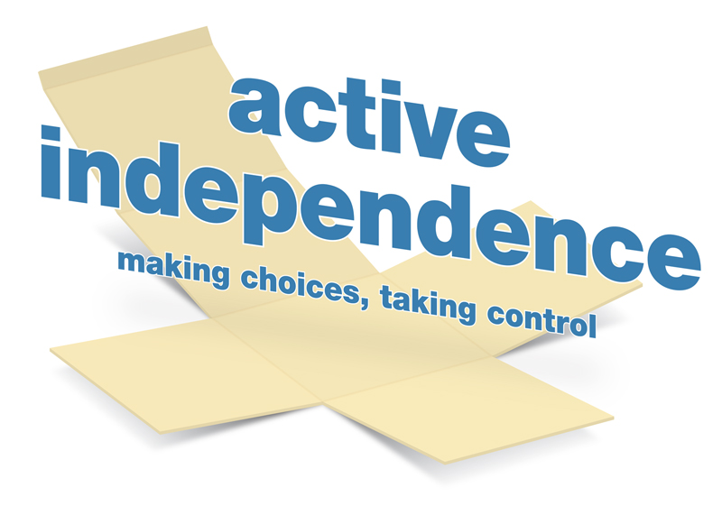
Active Independence
Who we are:
100% disabled persons led organisation
Our aim is to raise aspirations and confidence amongst disabled people and to promote increased choice and control in leading an independent life

Slide 10
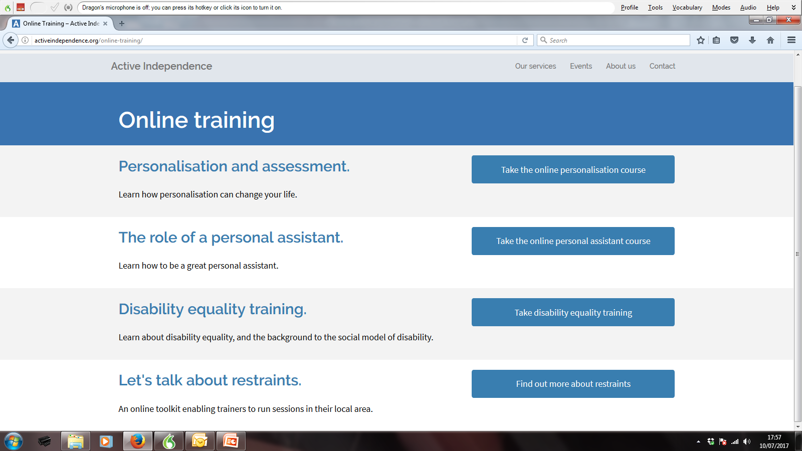
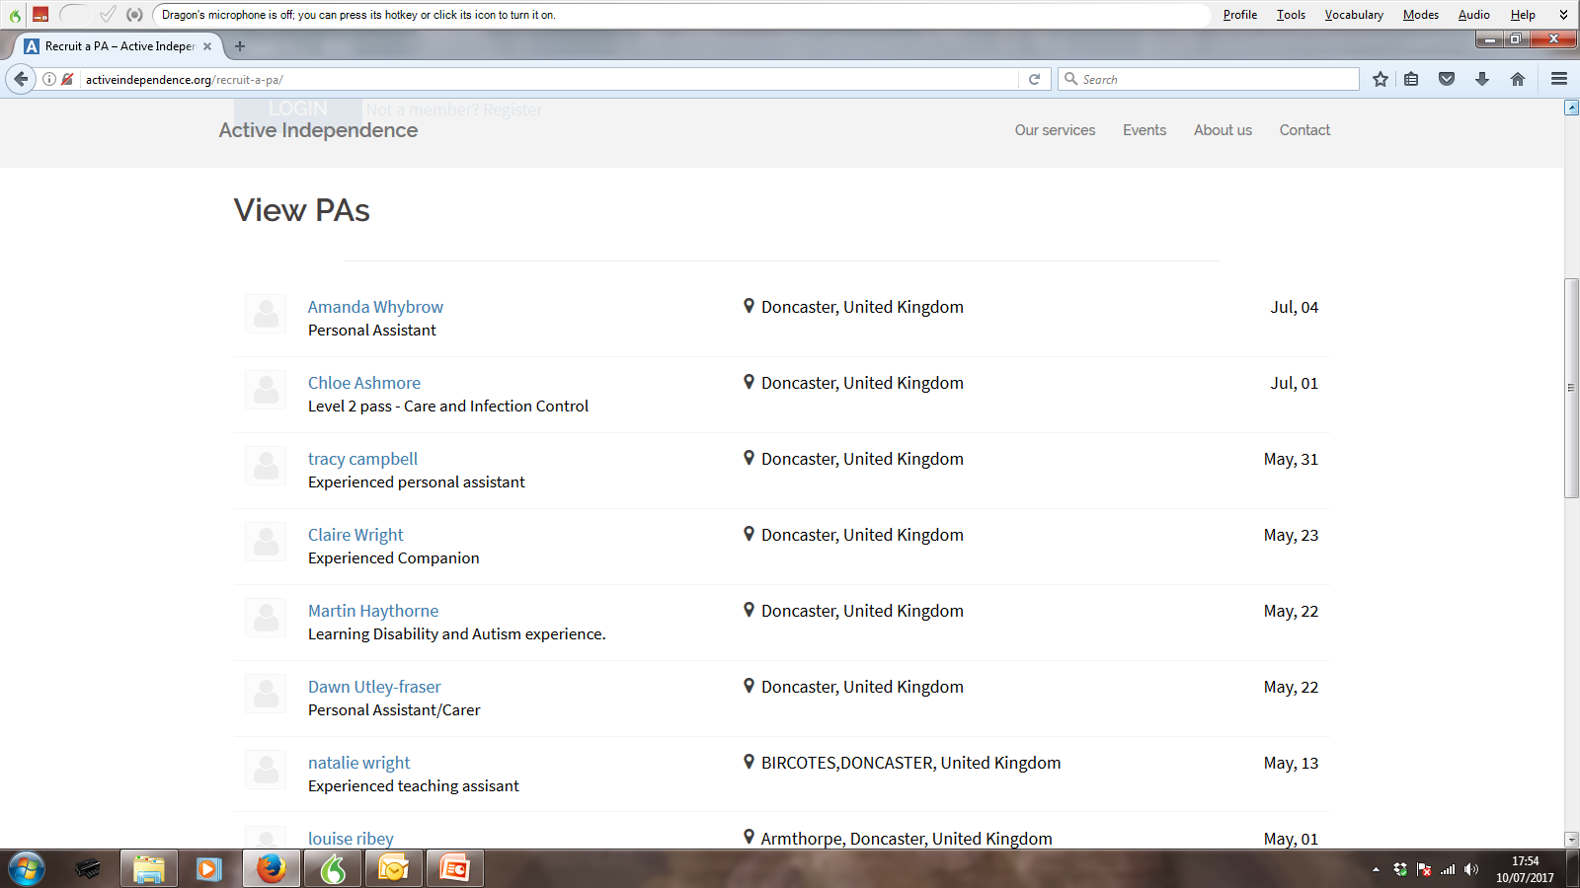
Our services and activities
Advocacy
Training
PA recruitment & employer support
PA Support Service
Campaigning & influence
Partnership &innovation

Slide 11
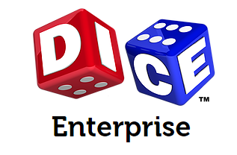
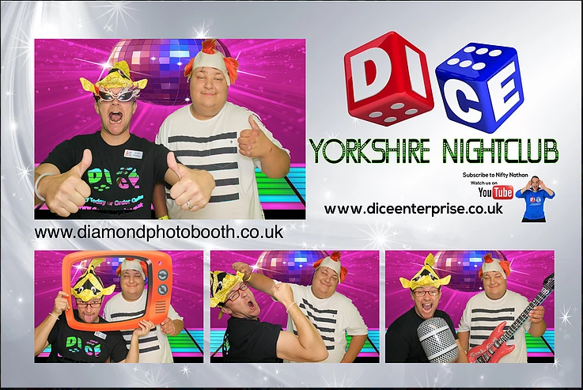
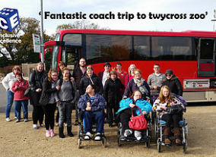
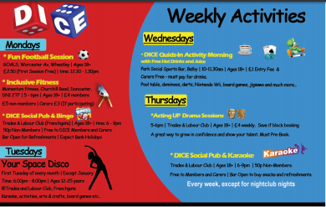

Slide 12
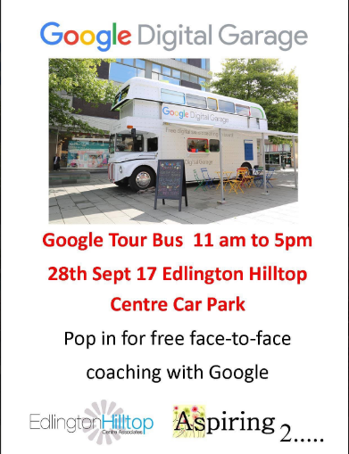
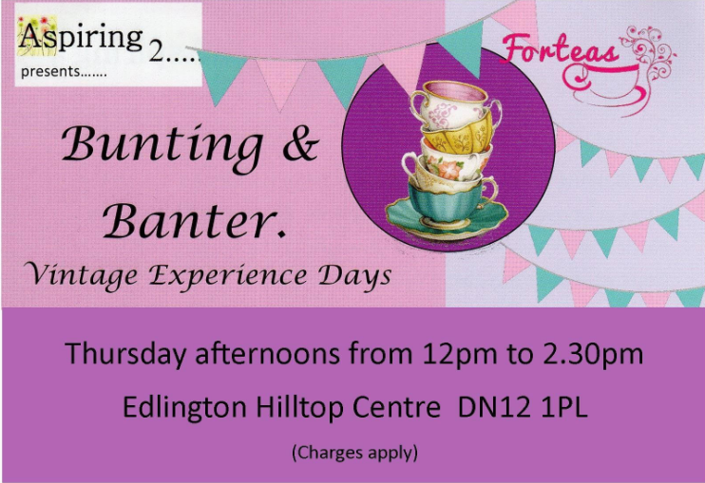
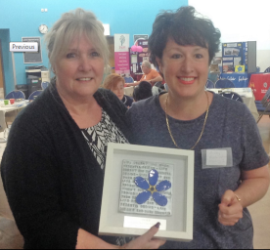

Slide 13
Challenges and opportunities
Getting and keeping everyone on the same page
Different levels of understanding, but universal commitment
Keeping the essence and quality of ‘small good stuff’
Money – priming the ‘money go round’
‘Free stuff’ is not free
Engaging with ‘the system’
Collecting in information about everyone’s ‘offer’
Not fully launched – getting communication and marketing right

Slide 14
Outcomes
Secured support of ‘the hive’ to help us form as a co-op
Secured support from the local Council – befriending contract to test model and learn
Two staff employed to deliver befriending contract, one development worker to grow the co-op soon
Two volunteers recruited through co-operating
Twenty families benefitting from befriending, wider support anticipated
‘CHAS’ approval around organisations health and safety management systems and processes
Ten co-op members, board established
Co-operation across members – e.g. day opportunities
Interest in press, printed and on-line, and within co-op movement
Better lives for people needing support

