Slide 1

Self Directed Support is Co production, not going it alone
“Let’s have a better conversation”
Rachel Mason
Family carer, personalisation consultant

Slide 2


Austerity
Nothing about us.. Without us

Slide 3
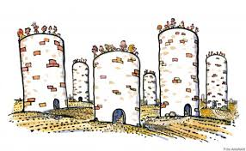

The perception of keeping control
I see commissioning in silos, which does not reflect the make up of communities nor how someone would choose to Self direct their support
MARKET
OP
LD
PERSONALISATION

Slide 4
Systems still get in the way!
Commissioned services
ISF
CHC
PHB/IPC
Direct Payment
Self funding
Self Directed support ?

Slide 5
Sharing budget information
Every year most Councils produce a local account of adult social care services.
It offers accountability and transparency and an opportunity for communities to say how they would self direct the budget
The local account explains how much the Council spends, what it spends money on, what it is doing and future plans for its services, including any improvements.
Somerset’s last one was 2013/14. It was comprehensive, and really well coproduced with local people, those who use services and carers.
We got a glimpse of what could be.. Then it disappears

Slide 6

Co production
Is where individuals, groups, organisations work together toward common goals and outcomes
Shared vision
Co Designing from the start
Aware of each others perspectives
Pooling skills and resources
Including all parties in a meaningful way
Knowing each others limitations
Knowing what each wants to get out of it

Slide 7
Everyone’s perspective
Tax payers – Council tax paying for Social care
Communities – Expectation growing
End users – Choice & control + responsibility
Unpaid carers – Invest in
Service providers – market dev / career/ pay
Social services, CCGs – Budgets/ Duty of care/ enablement/ prevention
National government – Responsibility?

Slide 8

Services sweep in with their value base and what they think needs to be put in place for a certain user group
We are often not on the same journey!
Services interfere with a person’s life rather than enable it

Slide 9
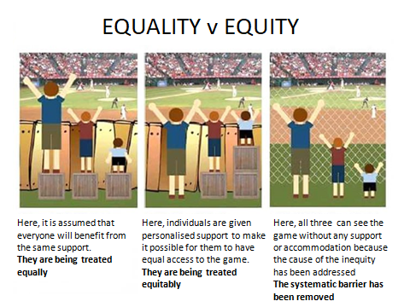

Slide 10

What are the outcomes we are aspiring to?
To live a full and valued life in our community
Appropriate housing and Tenancy
Have a community with awareness
Access to the local amenities
The ability to get out and about safely
Find and Participate in local activities/work
Be a valued member of the community
Develop and maintain a circle of friends
Gain independence and respect from parents as adults
To have ALL the personal skills, resources and support(where appropriate) to achieve this

Slide 11
Self Directed Support (SDS)
Care act : Self- directed support (SDS) gives a person as much choice and control as they want over how their support is arranged and provided,
to meet agreed health and social care outcomes, whether this is within a fully commissioned service or the person chooses to take their individual personal budget as a direct payment.

Slide 12
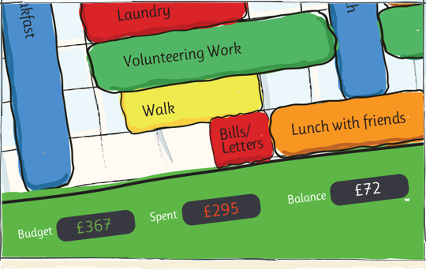
What should be the conversation?

Slide 13

Trust
How can families like ours, get LA community teams to trust our judgment?
What could be put in place to help LAs to feel more confident in people taking DPs/ISFs?
What resources need to be offered to families and providers holding ISFs?
Would training be appropriate?
What review process delivers accountability with a ‘light touch’ approach to scrutiny

Slide 14


Making it Real
Let us help you ‘cut the cloth’

Slide 15
Where can Self direct support begin?

Slide 16

It starts at a person’s front door!

Slide 17
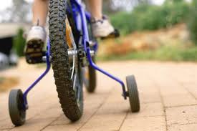
How can services be more effective?
By empowering people to know when and how they need support and then stepping back

Slide 18
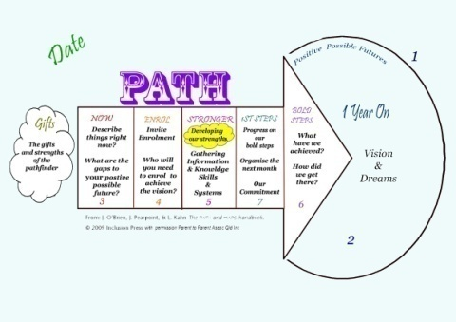
Enabling SDS
Know where you are going (aspirations)
Identify the barriers
Source the support and the solutions
Agree the outcomes (Eligible/non eligible)
Now in better position to know if current services are working/not working
Take control (SDS) – Take back ownership & responsibility for your life’s course

Slide 19
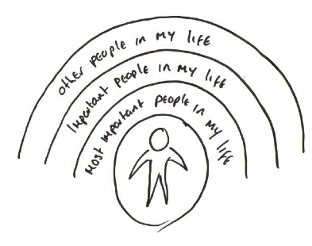
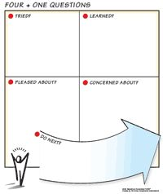
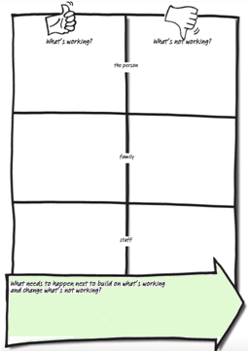
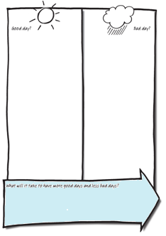
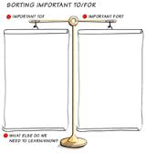
Person centred planning tools

Slide 20

True Partnership
We expect
Enough support (£) to make it happen
Enablement/Re-ablement
Flexible
Reliable
Responsive
Personalised
Minimal intervention*
Signing from the same Hymn sheet
You/society expect
Ownership
Responsibility
To reach our potential
Reduce long term reliance

Slide 21

Reduce reliance on long term care
.. But difficult to apply the agreement when you’re no given the right tools!

Slide 22
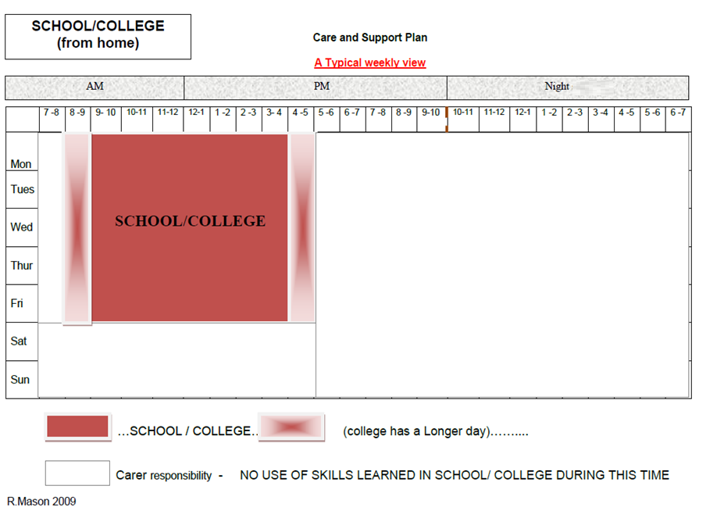
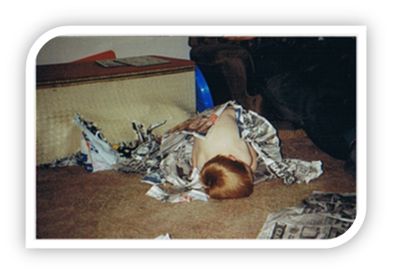
The conversation begins early

Slide 23
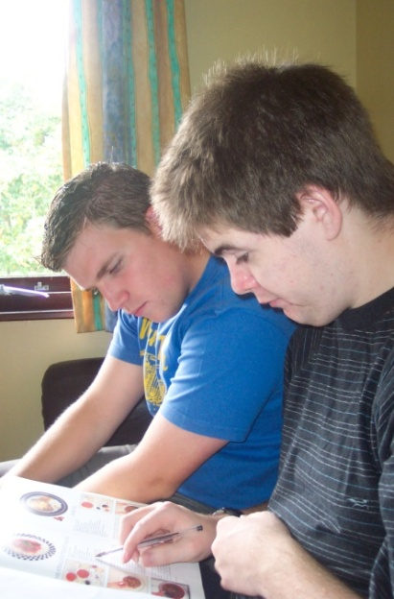
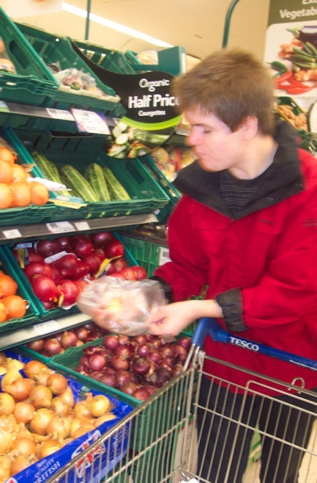
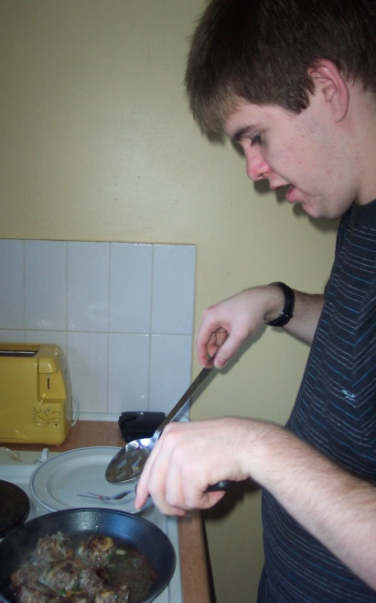
We decided to opt out of residential respite and take a Direct Payment. It was a win/win for us both.. It was 1/3 of the cost to the LA and met our outcomes!
.. we made the Respite breaks more meaningful
The purpose of the respite break was now to check the ‘transferability’ of lessons into his daily life in a community setting.
He enjoyed taking the photos and videos into school –
It was now a coordinated partnership between us, the school and respite

Slide 24

Communities can create change quicker
We have seen Communities that take collective ownership of each other are resilient – less needy
Communities pool assets and resources
Do not work in silos, but on common interests or needs
Know what is needed - Social support, Health needs, Housing, shops, transport, leisure, education ..
Set up effective sustainable communication networks quicker than organisations
Community coordinators/village agents

Slide 25
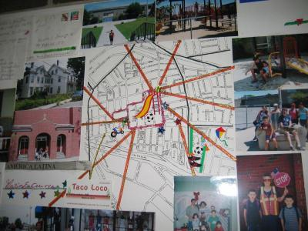







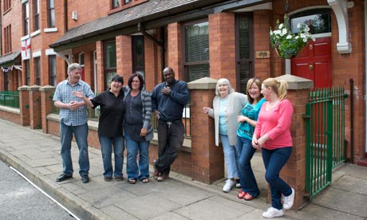



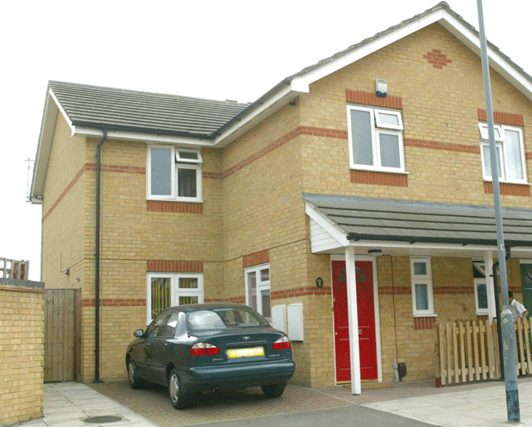


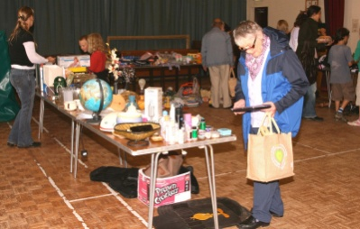
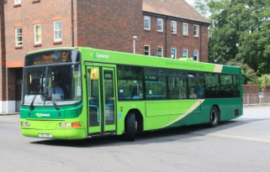

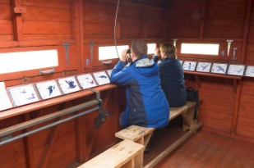
Started to map around the centre

Slide 26
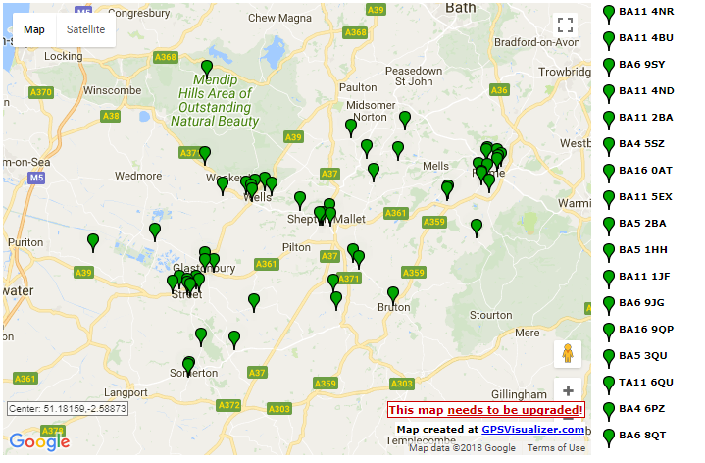

Slide 27
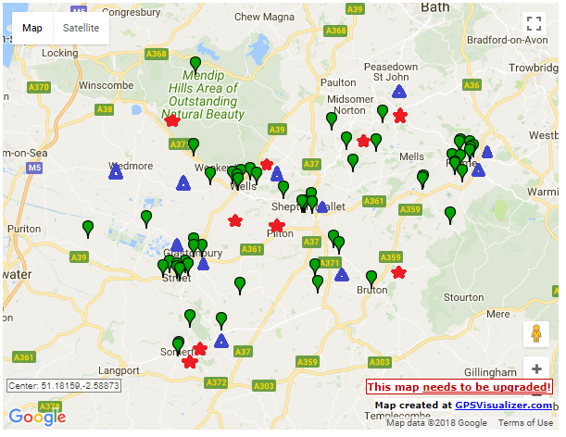

Slide 28
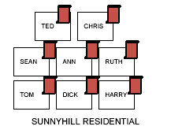
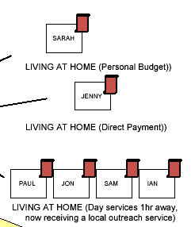
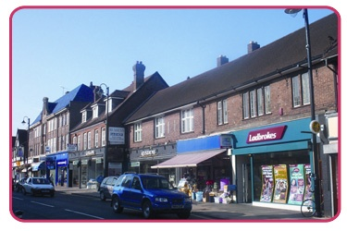
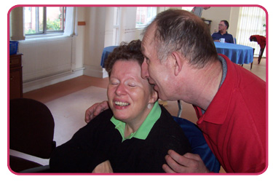


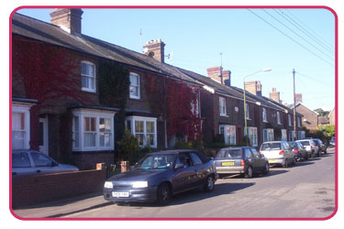

Maintaining friendships
PROVIDER 3
HOSPITAL UNIT
RESIDENTAIL HOME
LIAM
GEORGE
HELEN
DP (Direct Payment) HOLDERS
NOT ELIGIBLE FOR SERVICES
Removing the barriers
At last my son’s friends tied within a commissioned contract could begin to share their activities with him by pooling budgets
PROVIDER 1

Slide 29
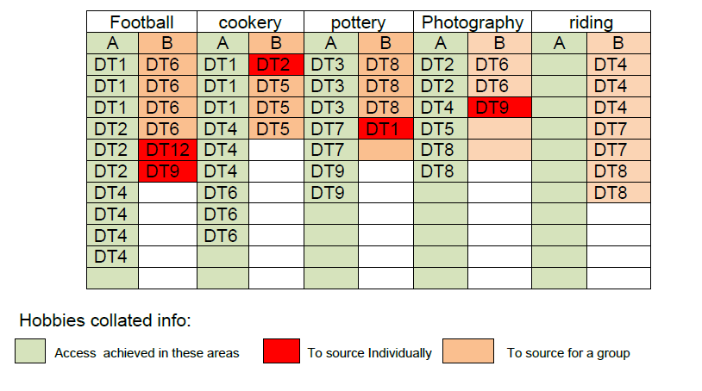
Gathering the right information allows service commissioners brokers to focus scarce resources and funding in the right areas
Housing Sp. Provider Micro Prov Mapping Area CoOrd
Cycling
Strategic data needed from transition

Slide 30
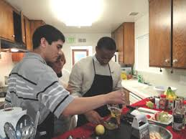
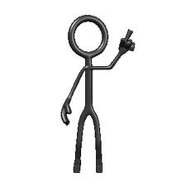



Pooling budgets
Is so much more than ‘block contracts’ for economy of scale
£120
DP
2.5 Days
£8phr
DP
DP
4 Days
£10phr
Self funder
5 Days
DP
ISF
£12phr
Self funder
5.5 Days
DP
ISF
ISF
£15phr

Slide 31
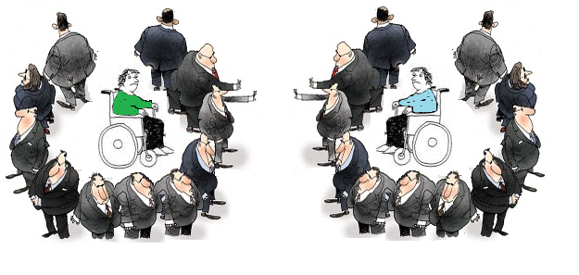
Although neighbours.. Service led contracts makes it impossible to connect
SUPPORTED LIVING/ RESIDENTIAL CARE PROVIDER
DAY CENTRE PROVIDER
Legitimate data protection – or providers protecting ‘their’ allocated funding?

Slide 32


I think ISFs are the answer
An ISF offers transparency and accountability on both parts, that we didn’t have before.
The package of care is no longer ‘given to a provider’ after a tendering process, but we have choice over who that provider is.
We coproduce the Care Plan with the agreed outcomes and Co-design a support plan with the provider
We know what the budget is, and together with the provider, we decide how to spent it
We can negotiate and Pool hours (budget) in a shared setting or with other people with other providers

Slide 33
As you see, Self Directed Support is not just about ‘opting out’ and taking a Direct Payment
What do you think you could do differently to empower and enable people to Self Direct their lives?

