Slide 1

A comprehensive model for Personalised Care
September 2018

Slide 2


Comprehensive Model for Personalised Care
All age, whole population approach to Personalised Care
TARGET POPULATIONS
INTERVENTIONS
OUTCOMES
People with long term physical
and mental health conditions
30%
Specialist
Integrated Personal Commissioning, including proactive case finding, and personalised care and support planning through multidisciplinary teams, personal health budgets and
integrated personal budgets.
People
with
complex needs
5%
Empowering people,
integrating care and
reducing unplanned
service use.
Plus Universal and Targeted interventions
Targeted
Proactive case finding and personalised care and support planning through General Practice. Support to self manage by increasing
patient activation through access to health coaching, peer support and self management education.
Supporting people to
build knowledge, skills
and confidence and to live
well with their health
conditions.
INCREASING COMPLEXITY
PEOPLE MOVE AS THEIR HEALTH AND WELLBEING CHANGES
Plus Universal interventions
Universal
Shared Decision Making.
Enabling choice (e.g. in maternity, elective
and end of life care).
Social prescribing and link worker roles.
Community-based support.
Supporting people to stay well and building community resilience, enabling people to make informed decisions and choices when their health changes.
Whole population
100%

Slide 3
Personalised Care Operating Model
WHOLE POPULATION
when someone’s health status changes
30% OF POPULATION
People with long term physical and mental health conditions
Cohorts proactively identified on basis of local priorities and needs
Shared Decision Making
People are supported to a) understand the care, treatment
and support options available and the risks, benefits and
consequences of those options, and b) make a decision about a preferred course of action, based on their personal preferences and, where relevant, utilising legal rights to choice (All tiers)
Personalised Care and Support Planning
People have a proactive, personalised conversation which focuses on what matters to them, delivered through a six-stage process and paying attention to their clinical needs as well as their wider health and wellbeing.
LEADERSHIP, CO-PRODUCTION AND CHANGE ENABLER
FINANCE ENABLER
Review
A key aspect of the personalised care and support planning cycle.
Check what is working and not working and adjust the plan
(and budget where applicable)
Social Prescribing and Community-Based Support
Enables professionals to
refer people to a ‘link worker’
to connect them into
community-based support,
building on what matters to the
person and making the most of
community and informal
support (All tiers)
Supported Self
Management
Support people to develop the
knowledge, skills and confidence (patient activation) to manage their health and wellbeing through interventions such as health coaching, peer support and self-management education (Targeted and Specialist)
Personal Health Budgets and Integrated Personal
Budgets
An amount of money to support a person’s identified health and wellbeing needs, planned and agreed between them and their local CCG. May lead to integrated personal budgets for those with both health and social care needs (Initially Specialist)
WORKFORCE ENABLER
Optimal
Medical
Pathway
COMMISSIONINGAND PAYMENT ENABLER

Slide 4




Personalised Care Group Programmes
Patient Activation Measurement | (Nine distinct programmes focussed on National Priorities e.g. Mental Health, LD, CHC) | Legal Rights to Choice
Social Prescribing and Community Based Interventions | Maternity Pioneers
National Wheelchair Programme | Shared Lives Plus | Shared Decision Making / Person Centred Care & Support Planning
National End of Life Care Programme |  | Self Care/Self Management Support

Slide 5






Significant delivery of Personalised Care
Shared decision making
Personalised care and support planning
Enabling choice
In 2017/18 SDM was embedded into:
Musculoskeletal elective care pathways in 13 CCGs
Respiratory elective care pathways in 8 CCGs
75,914 people had a personalised care and support plan by March 2018
Over 180,000 people supported by integrated, personalised approaches
83% of CCGs have now completed Choice Planning and Improvement self-assessment
Of these, 80% also now have a patient choice improvement plan
Social prescribing & community-based support
Personal health budgets & integrated personal budgets
Supported self management
68,977 referrals in 2017/18
331 link workers employed in local areas
Over 70,000 patient activation assessments delivered in total
8,229 people attended group-based or peer support activities
16,000 people had self-management education or health coaching
28,040 PHBs by March 2018
83% up year-on -year in 2018-19 to date
15% jointly funded with social care
19,241 Personal Maternity Care Budgets delivered by March 2018 across 36 CCGs

Slide 6




The difference personalised care makes
To people’s experiences
To the workforce experience
86% of people said they achieved what they wanted with their PHB.
77% of people would recommend PHBs to others with similar needs.
There is extensive evidence of improved wellbeing, satisfaction and experience through good personalised care and support planning.
75% of people who booked hospital outpatient appointments online felt they were able to make choices which met their needs.
Personalised care and support planning has been shown to improve GP and other professionals’ job satisfaction.
59% of GPs think social prescribing can help reduce their workload.
To the system
To people’s outcomes
PHBs provide an average saving of 17% on direct costs of conventional CHC packages for home care, and indirect savings of £4,000 per person per year.
Integrated Personal Commissioning (IPC) in one area resulted in 15% reduction in delayed transfers of care and 10% reduction in A&E attendances.
Integrated Personal Commissioning in one area led to a reduction of 50% in A&E presentations in people with substance misuse problems.
Evidence has shown that those with the highest knowledge, skills and confidence through supported self-management had 19% fewer GP appointments and 38% fewer A&E attendances than those with the lowest levels of activation.
People and professionals consistently overestimate treatment benefits and underestimate harms. Shared decision making helps reduce uptake of high-risk, high-cost interventions by up to 20%.
In one area 83% of people were able to die in a place of their choice, against a local average of 26% because of personalised care at end of life.
There is emerging evidence that social prescribing leads to a range of positive health and wellbeing outcomes, including improved quality of life and emotional wellbeing.

Slide 7
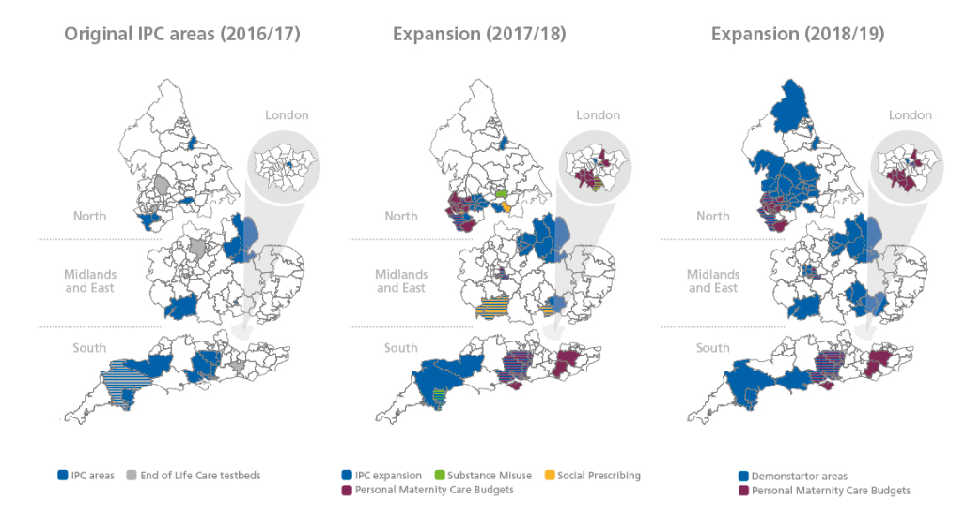
Expansion of personalised care over the last 3 years

Slide 8
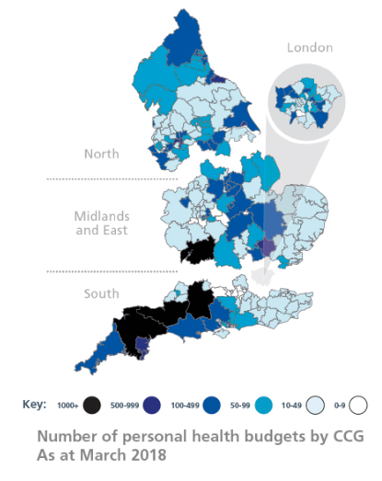
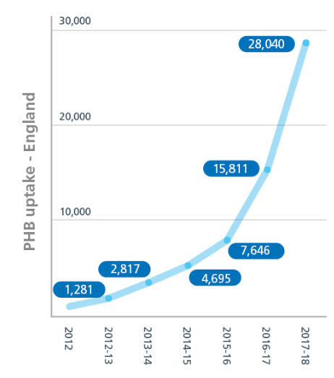
Spread of Personal Health Budgets

Slide 9

Emerging Evidence
Across Continuing Health Care, direct savings of up to 17%; indirect savings of £4k per person
WARRINGTON
FYLDE COAST
STOCKTON-ON-TEES
NOTTINGHAMSHIRE
Personal health budgets in end of life care - 83% were able to die in a place of their choosing, against an average of 26%
85% improved or
maintained level of patient activation (average shift of 9.7 points), with attendant decrease in likelihood of hospital admission
12% reduction
in emergency admissions for older people with frailty
£19,000 saving in transport costs for siblings with very complex health conditions
15% reduction in delayed transfers of care due to IPC
Lease their own adapted vehicle through a personal health budget for journeys to day centre and respite, instead of a commissioned transport package
One week’s worth of traditional services funds six weeks of services commissioned through a personal health budget
10% reduction in
A&E attendances due to IPC
www.england.nhs.uk

Slide 10
Future vision for personalised care
There is a fully-developed and costed plan for personalised care, which was developed for July’s Public Board
This paper set out that by 2029, our ambitious but achievable goal is that around six million people in total could benefit from personalised care as business as usual across the health and care system
21 actions to achieve this vision have been set out, which were developed in partnership with internal and external stakeholders
Component | Ambitious but achievable goal by 2029
Shared decision making | Shared decision making embedded in 30 high value clinical situations in primary care, secondary care and at the primary/secondary interface where it will have the greatest impact on experience, outcomes and cost
Personalised care and support planning | 2.5 million people with long-term conditions
Enabling choice, including legal rights to choice | Legal rights to choice are maintained throughout wider system transformation, with 100% of elective referrals exercising choice through the electronic Referral System and 100% of CCGs compliant with choice improvement guide
Social prescribing | 95% geographic coverage of standard model for social prescribing, including a link worker scheme, covering 3% of population – a total of approximately 1.8million people
Supported Self-Management | 2 million people have an assessment of their knowledge, skills and confidence (activation level)
Personal health budgets and integrated personal budgets | 450,000 to 500,000 people benefitting from personal health budgets or integrated personal budgets

Slide 11
Addressing health inequalities
There is a dedicated section on addressing health inequalities in the personalised care vision paper
Evidence shows personalised care reduces health inequalities:
  People from lower socioeconomic backgrounds benefit the most from personalised care because they have the lowest levels of knowledge, skills and confidence to manage their health in the first place
  A systematic evidence review has shown shared decision making interventions significantly improve outcomes for disadvantaged people
  Improving choice and control, including through PHBs, enables more bespoke responses to people’s specific needs and backgrounds
Proposed actions for personalised care:
  Work in partnership with voluntary and community sector organisations representing different groups to ensure that personalised care is reaching those who could benefit the most. This includes working with the Health and Wellbeing Alliance
  Commit to implement a self-assessment within personalised care programmes to reduce health inequalities, and develop further research with targeted cohorts
  Work with public health to reduce health inequalities by utilising existing resources, tools and evidence
  Ensure that training for the workforce explicitly and meaningfully takes into account health inequalities, in order that positive action and regard to this is consistent and intentiona
  Develop quality measures for personalised care in a way which supports efforts to reduce health inequalities
  Explore including a mandatory breakdown of personalised care data by diversity characteristics to identify any trends and any disproportionate impact on certain groups
  Ensure that communication strategies take into account the communication needs of people that experience health inequalities, including, for example, people with learning disabilities and those with lower levels of health literacy
  Provide best practice and case study materials that explicitly include people from different groups

Slide 12
Stakeholders already engaged
There are three sets of stakeholders beyond NHSE we have worked with to develop the personalised care vision:
Agreed co-signatories to the vision:
Academy of Medical Royal Colleges
Association of Directors of Adult Social Services
Care Quality Commission
Coalition for Collaborative Care
Council for Disabled Children
Disability Rights UK
Healthwatch England
Health Education England
Local Government Association
National Voices
Nesta
NHS Digital
NHS Improvement
Public Health England
Royal College of General Practitioners
Royal College of Nursing
Royal College of Occupational Therapists
Royal College of Physicians (tbc)
Richmond Group
Skills for Care
Skills for Health
Think Local Act Personal
Voluntary Organisations Disability Group
Reference group:
Nigel Acheson (Medical director, NHSE South)
Vidhya Alakeson (Power to Change)
Charles Alessi (Public Health England)
Tracey Bleakley (Hospice UK)
Sue Bott (DRUK)
Amanda Cheesley (RCN)
Angela Coulter (University of Oxford)
Neil Crowther (Independent)
Amanda Doyle (Blackpool & Fylde)
Jon Glasby (University of Birmingham)
Chris Hatton (University of Lancaster)
Steve Holmes (CQC)
Celia Ingham-Clarke (NHSE Medical Directorate)
Halima Khan (Nesta)
Christine Lenehan (Council for Disabled Children)
Martin Marshall (RCGP)
Nigel Mathers (RCGP)
Martin McShane (former NHSE)
Ruth Owen (Whizz Kidz)
David Paynton (RCGP)
David Pearson (DASS, Notts)
Don Redding (National Voices)
Andrea Sutcliffe (CQC)
Dawn Wakeling (DASS, Barnet)
Wider input / comments from:
Mind
Young Minds
Motor Neurone Disease Association (MNDA)
MS Society
Alzheimer's Society
Ollie Hart (GP)
Alex Fox (Shared Lives)
Carers UK
Healthcare Financial Management Association (HFMA)
NICE
Nursing and Midwifery Council (NMC)
Deans for Health
Queen’s Nursing Institute
Chartered Society of Physiotherapists
Royal College of Speech and Language Therapists (RCSLT)
Lyn Romeo (Chief Social Worker for Adults)
DHSC, DfE, DWP, HMT, MHCLG
Also attended: EPC taskforce workshop, C4CC partners meeting, TLAP partners meeting, PHE Board, as well as April’s Commissioning Committee and May’s EGM

Slide 13
Interdependence with other NHSE progs
The following sets out the main interdependencies and work we have done with other NHSE programmes and teams so far. This covers all six components of personalised care
Empowering People and Communities Taskforce
National Clinical Directors, including Bee Wee (End of Life Care), Mike Dixon (social prescribing)
Primary care (Nikita Kanani, Dominic Hardy, Ed Waller)
Strategy team (Emily Hough)
Systems Transformation Group (Michael MacDonnell, Jacquie White, Dan Northam-Jones, Helen Arthur)
Horizons team (Helen Bevan)
Digital Transformation (Polly Bishop, Juliet Bauer)
Cancer, mental health and dementia programmes
CHC and BCF teams
Maternity (Matt Tagney, Karen Kennedy)
Patient Experience (Neil Churchill, Emma Easton)
Medical (Luke O'Shea, Steve Powis)
New Business Models and Primary Care Contracts (Ed Waller, Gaby Darby, Anton Obholzer)
Commissioning Policy (Taryn Harding)
Prevention (Karen Turner)

Slide 14
Further information https://www.england.nhs.uk/personalised-health-and-care/
@Pers_Care
@NHSPHB
#personalisedcare #futurenhs
Vision paper: rich.watts@nhs.net

