Slide 1


Slide 2

Asset Based Approach

Slide 3
Asset Based Thinking:
Demands that we value and trust people….

Slide 4
What is a personal Budget ?

Slide 5
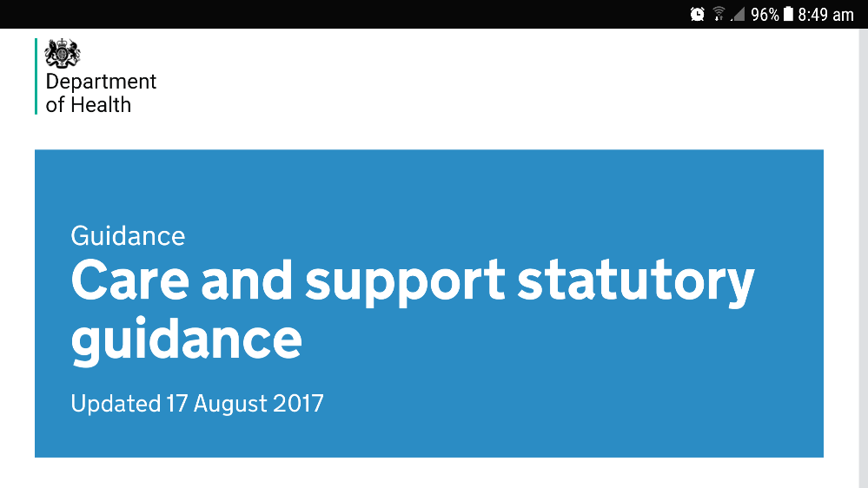
Personal Budgets are now Law in England. Care act.
Everyone whose needs are met by the local authority, whether those needs are eligible, or if the authority has chosen to meet other needs, must receive a personal budget….. (11.7)
……. An indicative amount should be shared with the person, and anybody else involved, at the start of care and support planning, with the final amount of the personal budget confirmed through this process.

Slide 6

Personal Budgets are now Law in England. Care act.
The personal budget is the mechanism that, in conjunction with the care and support plan, or support plan, enables the person, and their advocate if they have one, to exercise greater choice and take control over how their care and support needs are met. It means:
knowing, before care and support planning begins, an estimate of how much money will be available to meet a person’s assessed needs and, with the final personal budget, having clear information about the total amount of the budget, including proportion the local authority will pay, and what amount (if any) the person will pay
being able to choose from a range of options for how the money is managed, including direct payments, the local authority managing the budget and a provider or third party managing the budget on the individual’s behalf (an individual service fund), or a combination of these approaches
having a choice over who is involved in developing the care and support plan for how the personal budget will be spent, including from family or friends
having greater choice and control over the way the personal budget is used to purchase
care and support, and from whom

Slide 8
A personal budget is one small part of a bigger process

Slide 9
How can I use my
Personal Budget ?

Slide 10
How can I use my
Personal Health Budget ?

Slide 12
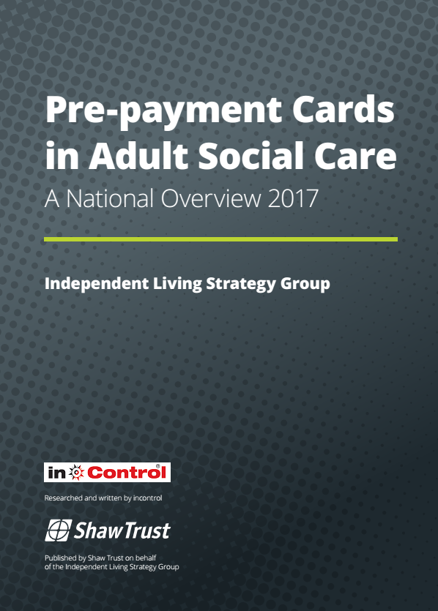
7.Payment Cards

Slide 13
Potential concerns
Poorly implemented there is a significant risk that payment cards could disrupt rather than support the intention of the care act. Rather than empowering citizens they act to shift the balance of power away from the induvial and towards the state. Particularly in relation to;
Managing the mechanisms of support.
When offered as a default or only option for personal budgets or direct payments they fall short of the statutory guidance describing what a personal budget is.
Choice and control over support;
If used to restrict an individual’s ability to freely conduct transactions, such as the use of restricted vendors, they provide a mechanism for reduction rather than promotion of individual choice and control.
Privacy and data management;
The high level of personal data collected on the accounts means local authorities are now routinely collecting large amounts of personal data on the activities of local people where previously they had not raising profound data management challenges.

Slide 14
It is also important that where a pre-paid card system is used, the person is still free to exercise choice and control. For example, there should not be blanket restrictions on cash withdrawals from pre-paid cards which could limit choice and control. The card must not be linked solely to an online market-place that only contains selected providers in which to choose from. Local authorities should therefore give consideration to how they develop card systems that encourage flexibility and innovation, and consider consulting care and support user groups on any proposed changes to direct payment processes.

Slide 15
12.58 Many local authorities have been developing the use of pre-paid cards as a mechanism to allow direct payments without the need for a separate bank account, or to ease the financial management of the payment. Whilst the use of such cards can be a useful step from managed services to direct payments, they should not be provided as the only option to take a direct payment The offer of a ‘traditional’ direct payment paid into a bank account should always be available if this is what the person requests and this is appropriate to meet needs. Consideration should be given to the benefit gained from this arrangement as opposed to receiving the payment via a pre-paid card.

Slide 16
Traditional direct payment to an individual’s own bank account | Payment Card Account
Responsibility and accountability for money
Money is transferred to the individual, and is under their sole and full control. The induvial is solely responsible and accountable for its use. | Money remains with the local authority, control is shared between the person and the authority.
Privacy and monitoring of financial affairs
Access to information about transactions on the bank account is under the full control of the person, and disclosed by them as part of an agreed audit process. | Live access to transaction information is available to the local authority.
Retrospective transfer of funds
Further payments into the account can be stopped by the local authority. | The local authority can without prior notice, and for a range of reasons, unilaterally claw back money previously allocated to the account.
Control of funds.
There are no restrictions on the use of the money once it has been paid into the account. A separate review process is in place to ensure money is spent on outcomes agreed in the Care Plan. | The local authority typically place restrictions on the use of money on the account. They can and often do limit spend to nominated vendors
Choice of financial provider
The individual is able to choose the institution with whom they bank. Individuals can make informed decisions about functionality and accessibility of the account its services and charges any charges. | The authority selects the financial provider, and functionality of the account. Potentially resulting in a ‘one size fits all approach to accessibility’

Slide 17
Who decides how the money going to be used ?

Slide 18
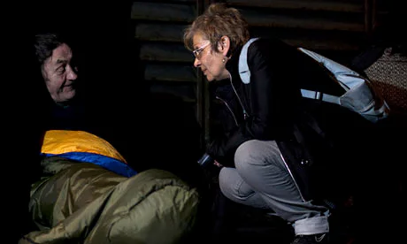
A partnership
based on Trust

Slide 19
The question really is do we want a system that assumes the worst or the best ….
An asset based system build on trust..

Slide 20
Criteria for approval of plans
The support plan describes a partnership between the Local Authority the person needing support and their family. It is more than a document detailing activity to be provided. A good support plans will;
Set out how the money in the personal budget is being used to meet the outcomes described in the persons assessment.
Is legal and ensures the safety and well-being of all involved.
Is within the allocated indicative budget and shows how the proposed spend represents good value for money.
Reflect the unique interest’s preferences and aspirations of the person needing support and their family and will draw on their strengths, gifts and talents.
Will compliment and sustain, rather than replace existing support available to the person from their family and wider community.
Is focussed on progression and promotes independence, looks to the future as well as addressing the here and now.

Slide 22
7.Payment Cards

Slide 23
A collection of issues that have reached the independent living strategy group…

Slide 24
Midlands: enforced prepayment card despite her stating she wanted to retain traditional direct payment account. They sent the card and ceased deposits into the DP account..
No choice but to activate the card on order to pay the PAs.
Person therefore removed all the funds from the prepayment card and put it in her DP account !!
Council not happy and asked her for evidence that she had closed the DP account she said no.

Slide 25
Leafy London Borough: “everyone is put on the prepayment card”. The transaction fee has just been increased from 30p to 45p and there is uncertainty as to whether people’s direct payment will cover this.

Slide 26
Shire County: a long-term recipient of direct payments was told she had to transfer onto a prepaid card. She challenged this through the formal complaints procedure and, after initially failing to have her complaint upheld a further challenge resulted in her being told she could keep her bank account for her direct payment. However, when she asked that all direct payment recipients be told they could opt for a bank account the local authority refused to do so.

Slide 27
Coastal City: “It’s the only option”.

Slide 28
Northern Industrial Town: “I was made to move over to the prepaid card system, the only say I had was when.”

Slide 29
Large city: “I was transferred to the prepaid card system last year. I didn’t have a choice and I believe they have implemented this across all adult care in the city.”

Slide 30
London Borough: information received by a local organisation that the LA intends to insist that everyone on a direct payment uses a prepaid card: “we have asked if The borough will be consulting with its service users. They responded that they wouldn't be talking with service users as they feel the changes are too complicated for them to understand.”

Slide 31
A rural shire: direct payments user reported that, at a meeting held by adult social services as part of a consultation on prepaid cards, people came away with the impression that this would not be a choice but would be compulsory if they wished to still receive a direct payment. The County Council’s website says: “A prepaid card account will be set up by Ruralshire County Council for on-going direct payments, unless it has been agreed you will set up your own separate bank account”. A twitter exchange with a local service user resulted in the County Council’s twitter account saying `’we are aware that the wording on the website does not make …[the ability to choose a bank account] clear, so this should be amended”.

Slide 32
From the midlands: “..they let us know by letter that we would all have to transfer to prepaid cards…..was told it was to help me, although every year when I am audited they put in writing that there was no mismanagement of my account, I pointed out it wasn't helping me, it was making a lot of work which was stressing me out, I pointed out that currently everything is set up for me by my branch…., I was told you either have a pre-paid card or don't get direct payments. …The roll out has been a nightmare, a lady phoned me out of the blue and tried to pressure me into an appointment to explain the system..[when she came]..she only had the sheet of information we'd already had, she couldn't answer half my questions…she couldn't even tell me how I would be able to pay for my insurance with the card. I haven't had the roll out yet, but have been left worrying about it for the last eight months.”

Slide 33
In the east: They have have implemented a prepaid card for children’s services. Local disability organisation: “I don’t think people are being ‘forced’ to have a pre-payment card, I just don’t think, as new clients, they are being told there is any other option”.

Slide 34
The independent living strategy
group will be looking more closely
at this issue……

Slide 35
So what about
FRAUD ?

Slide 36

How big a problem is DP / social care fraud?
CIPFA CFaCT 2016 – 352 reported cases of social care fraud, ave. value £9-10k
Notes:
Any ideas why it is considered a big, emerging risk, when the numbers are small – do people feel that this is the “tip of the iceberg”? Figures provided in pre-workshop questionnaires – 13 authorities reported having investigated cases – total of 74 investigated, with a value of c. £2.5m (includes one very big one) – that’s a fifth of all national reported cases. Are we really good at this in the North?? Interesting that some attendees don’t know their recorded outcomes for 16-17 – why is this? Where do your figures get reported? Do you not have an annual (or periodic) fraud report?
Re s42 referrals – just reflects that people with needs can be vulnerable to financial risks. Has anyone worked with their safeguarding teams to assess the s42 referrals and see how the LA is discharging its duties in this area?
N.B. s42 enquiry is where action taken or instigated by the local authority in response to a concern that abuse or neglect may be taking place. The purpose of the enquiry is to decide whether or not the local authority or another organisation, or person, should do something to help and protect the adult. LA may ask someone else to carry out the enquiry, but had overall responsibility for ensuring the process is carried out.
Actions could include:
• Referral to the OPG as to concerns regarding a person with a responsibility such as a PoA
• Application to the Court of Protection – for a best interests order, deputyship, or ousting an attorney who is behaving badly
• Referral to the police where a crime is suspected – for criminal prosecution

Slide 37
The Audit Commission (the Commission) reported that local authorities detected 438 cases of social care fraud in 2013-14 – more than three times the number in 2009-10 – with a total value of £6.3 million.
However, the Commission also highlighted that most authorities did not detect any social care fraud. The increase may reflect true growth in fraud, or improved detection.
The Commission reported that authorities viewed personal budgets as a significant new fraud risk.
Examples of fraud include multiple claims across different authorities and payments continuing after a user has died.
Authorities we visited did not report an increase in fraud associated with personal budgets and direct payments, although we heard of specific examples.
Since 2014-15, authorities must submit data on those receiving personal budgets to the National Fraud Initiative. This identifies data matches that may indicate fraud.
Personalised commissioning in adult social care
Ordered by the House of Commons to be printed on 2 March 2016

Slide 38
National Audit Office report
Local authorities spent £6.3 billion on long-term community care in 2014–15. Around 500,000 adults in England received personal budgets in 2014–15.
Fraud = £6.3 million
Budget = £6.30 Billion
Fraud - 0.01%
In 2016-17:
Gross Current Expenditure on Adult Social Care by Local Authorities was £17.5 billion

Slide 39
438 out of 500,000 people = 0.08%

Slide 40

Since 2014-15, authorities must submit data on those receiving personal budgets to the National Fraud Initiative. This identifies data matches that may indicate fraud.

Slide 41
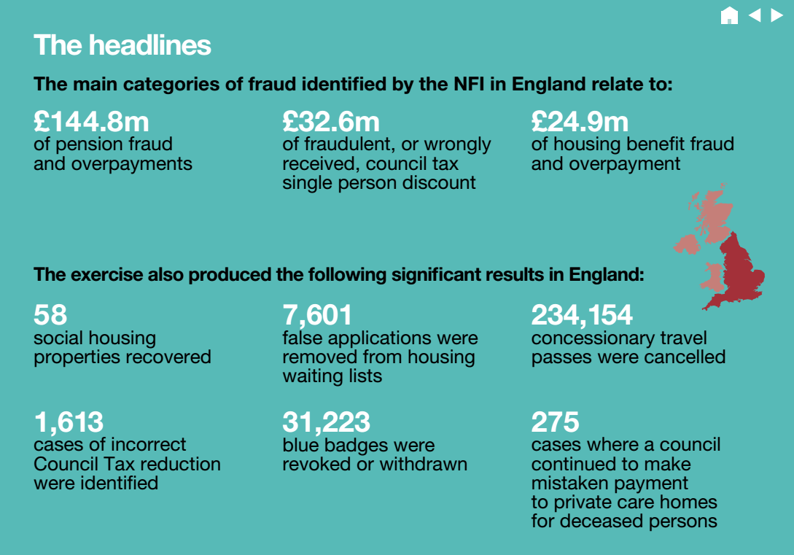

Slide 42
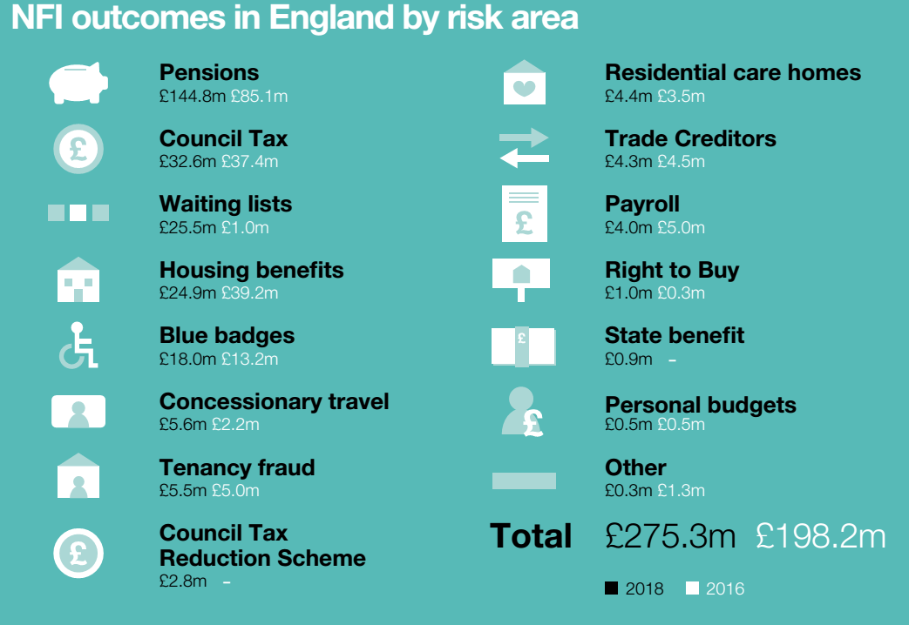

Slide 43

Findings From The Report
69
local authorities used payment cards and many others were introducing or considering introducing them
£1.5 M
spent by 71 local authorities introducing cards
Over million £ a year is spent on fees

Slide 44
Local authorities may suspend the card if they do not approve of how disabled people are using the cards.
We may suspend the use of a pre-paid card if the Council considers that the card is being used for anything other meeting individual customer eligible needs.

Slide 45
Local authorities can view transactions disabled people make on the cards by accessing the client’s account online.
What information about transactions made on individual cards is visible to the local authority?
We can view the prepayment card statements in real time and can see all transactions.
Date and amount of transaction - place where transaction took place, ie location of cash machine – history of transactions since card issued – current balance. Fee deducted from balance in relation to cash withdrawals- aggregate spend.
Date of transaction, type of transaction (e.g. online or direct debit), amount paid or received, merchant, value of cash withdrawal and location of ATM.
TSDFT operating on behalf of the LA can see all transactions made on the card.
The Council will be able to view the
customer’s bank account in real time.
Date and amount of transaction - place where transaction took place, ie location of cash machine – history of transactions since card issued – current balance. Fee deducted from balance in relation to cash withdrawals- aggregate spend

Slide 46
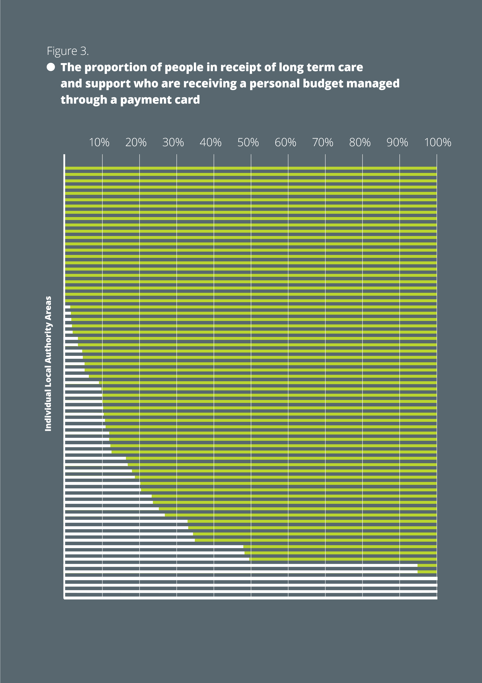
Some local authorities are imposing cards on recipients of direct payments contrary to statutory guidance. 3 LA’s practically all PB’s as a card.

Slide 47
Local authorities commonly tightly control the use of money on the cards.
At least 32,572 people using payment cards, 15% of all personal budgets in the areas using them. Likely to increase rapidly, as many authorities are just introducing the schemes, and some are making payment cards their default offer.

Slide 48
Are direct payment recipients offered the opportunity to have their direct payment paid using alternative options, including into a bank account?
The preferred payment method for all new direct payment cases is a prepaid card. However, in exception circumstances an individual can use a bank account instead
All Direct Payments are
paid this way at present.
No
Direct payment customers are not offered the opportunity to have their direct payment paid using alternative options
Default option
We do not offer an alternative option but this can be requested.
There are some circumstances where monies can be paid into a bank account eg. Carer 'one-off' payments
If direct payment recipients have issues in using the pre-paid card system, we look at alternatives with them, and these do include payment into a bank account of their choice.
In exceptional circumstances, if a citizen or their representatives are unable to use the pre-paid card facility, they will be offered alternatives such as opening up a bank account
If a client has good reason they may have a bank account.
It will be inevitable that some customers might need this service i.e. if they have no internet access. PPC will be the preferred option for Direct Payments.
If a pre-payment card was not appropriate for someone alternative options would be explored

Slide 49
Recommendations
1. Payment cards should be an active choice made by the person from a range of meaningful options, including a traditional direct payment paid into an account managed by the person or their representative.

Slide 50
Recommendations
2. In line with statutory guidance, it is important that where a payment card system is used, the person is still free to exercise full choice and control. There should be no blanket restrictions on cash withdrawals from payment cards. Due diligence is necessary. Therefore, accounting for cash withdrawals should be subject to the same returns and receipts policies that direct payments are subject to.

Slide 51
Recommendations
3. There should be no default restrictions on the places in which and services for which the card can be used.

Slide 52
Recommendations
4. Any restrictions on the card should be individually placed and be a proportionate to specific, identified, documented and assessed risk.

Slide 53
Recommendations
5. Prior to placing individual restrictions on a person’s card, it should be considered whether this represents a deprivation of liberty and as such whether due process has been followed.

Slide 54
Recommendations
6. The information held on the accounts is sensitive personal data. The process for accessing and monitoring of accounts must be open and transparent. Access and monitoring of accounts cannot be unfettered and must be undertaken in a way that respects the individual’s dignity. Access should be restricted to a named monitoring officer of the council, declared to the personal budget holder. When access is required, the budget holder should grant the monitoring officer access to the account, (unless serious misuse of funds is detected and brought to the attention of the account holder first). Monitoring should be limited and proportionate with the budget holder being notified in advance each time access is to be made to the account. A record should be placed on the account indicating they have been accessed.

Slide 55
Recommendations
7. Full notice should be given to cardholders setting out what information is held on the account, who has access to it and how long it will be stored for. The cardholder should also be told in writing and in an accessible format under what circumstances and after what process any restrictions might be placed upon the use of the card.

Slide 56
Recommendations
8. Suspension or closure of accounts and recouping of funds. Changes to the money available in the account are akin to changing a support plan and should thus only be made following appropriate review or reassessment process that the personal budget holder has been central to. In the event of the death of the budget holder local authorities will need to close the account and seek to recoup any uncommitted surplus money. They should first communicate their intention to do so to the next of kin or other appropriate person dealing with the estate of the deceased budget holder, so a final account position can be agreed. Unilateral suspension or closure of accounts should happen only in the most exceptional of circumstances and in order to prevent a known fraudulent misappropriation of funds.

Slide 57
Recommendations
9. In circumstances where the local authority wishes to suspend or place restrictions on the card they should follow published written procedures that detail the investigation process, timescales and the arrangements in place for sharing findings with the subject of the investigation. People subject to investigation should be provided with a copy along with the procedures followed, in an accessible format. They should also be informed of the arrangements for considering and acting upon findings and what mechanisms for hearing an appeal are

Slide 58
Recommendations
10. Each year the local authority should publish each year a statement detailing the numbers of people they provide personal budgets to, the proportion who use payment cards, and the fees incurred

Slide 59


John.waters@in-control.org.uk

Slide 60
John.waters@in-control.org.uk

Slide 61
Potential benefits
The use of payment cards may allow individuals who cannot or who choose not to manage a direct payment into their own bank account some of the benefits of a direct payment. They potentially increase the control of people over council managed budgets and could facilitate induvial service funds where previously peoples support had been part of block contracts.
The disabled person is not required to keep and submit expenditure details.

