Slide 1
The TLAP Care Markets & Quality Forum May 3rd 2018
Integrated Commissioning for Better Outcomes 2018
A shared Framework for local government and the NHS
icbo@local.gov.uk
www.local.gov.uk/icbo

Slide 2
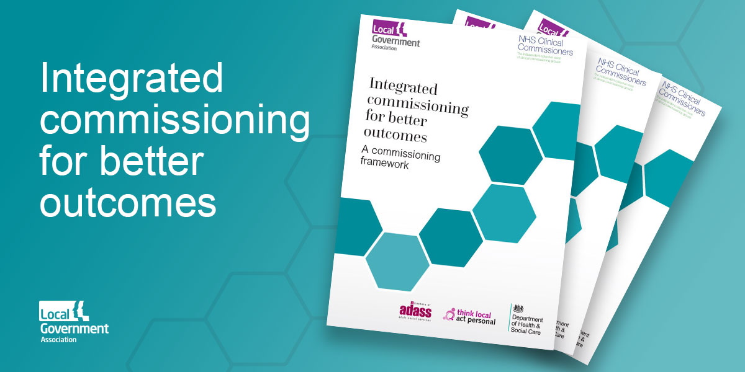
Just published at www.local.gov.uk/icbo

Slide 3
Integrated Commissioning for Better Outcomes - a practical tool
developed from the Commissioning for Better Outcomes Framework 2015
updated to better reflect the changing commissioning landscape - integration and co-production.
produced by the LGA and NHS Commissioners
co-produced with TLAP
tested in workshops across seven NHS/Local Authority areas including London boroughs

Slide 4
Why update and produce a new framework?
University of Birmingham evaluation
Now more integrated arrangements between CCGs and LAs
Legislative and policy changes – Care Act & 5 Year Forward View
Help commissioners find a way through complexity and differences between NHS & ASC
Sustainability and Transformation Partnerships and Better Care Fund – direction of travel towards integration
No common definitions of good integrated commissioning
Need for a common language
Supported by Department of Health and Social Care in policy context of promoting good commissioning
Notes:
Although CBO recognised as a useful tool it needs to stay relevant. Integration is now the major focus for developing CBO. However it requires a substantial rewrite to fit the new world of integration and to reflect NHS commissioning
Changing contexts since 2015 launch particularly as integration is now key driver to be achieved by 2020.
Increasing levels of integration and aligned arrangements, but working together can be hard to achieve given different regulatory frameworks, as well as different focus.
Commissioning at individual level and Personalised approaches in ASC, whereas NHS has larger scale population based approach. Might this produce tensions?
Neither routinely have an outcomes as key focus and can be orientated to time and task/ results and performance.
Working towards a shared view of good practice will hopefully help to focus on outcomes for people plus help joint planning processes and strategic directions.

Slide 5
Who is the framework for?
Primary audience is commissioners working in NHS and Local Government
Leaders across health and social care
Social care and health practitioners
Housing, public health and other commissioners and stakeholders
people managing their personal budgets and providers should be involved

Slide 6
Underlying principles and values
the ‘3 Ps’; People, Places, Populations
the person at the centre
focus on outcomes
tools for improvement, not guidance
practical and useful
improving outcomes by working together
reflect the ‘I’ statements
- integration is a means not an end - what matters is outcomes for people and co-production is crucial

Slide 7
Four areas - co-production is key
The framework covers four areas:
building the foundations
taking a person-centred, place-based and outcomes-focused approach
shaping provision to support people, places and populations
continuously raising the ambition
and includes annexes giving further resources + background on NHS and local authority contexts

Slide 8
Using the Framework
self diagnostic/benchmarking tool
internally or externally facilitated workshop
peer to peer review or challenge
reference and information
drive for local ambition and development
applicable to all levels of commissioners

Slide 9
What the framework will not do
Create positive relationships where they don’t exist
Give answers to local problems
Solve budget problems
Promote a single or simple approach to integration
Provide LA or NHS guidance on discharge of responsibilities
Pretend this is easy!

Slide 10
Contact icbo@local.gov.uk Download link https://www.local.gov.uk/icbo

