Slide 1
How has Tecnology enabled person centered care?

Slide 2
Were we were !

Slide 3
Introducing IT in to a Care Home
Then we decided to really go for it –
MASSIVE CULTURAL CHANGE
Expectation that senior staff would use email/electronic communication to provide audit trail
Use of IT to report maintenance issues and daily reports/handovers
Communication between Social Workers, Hospital and GPs moved towards email
Wifi enabled & computers available throughout building for staff & residents
Every member of staff with internet access
Use of intranet for holding all key policies and procedures

Slide 4
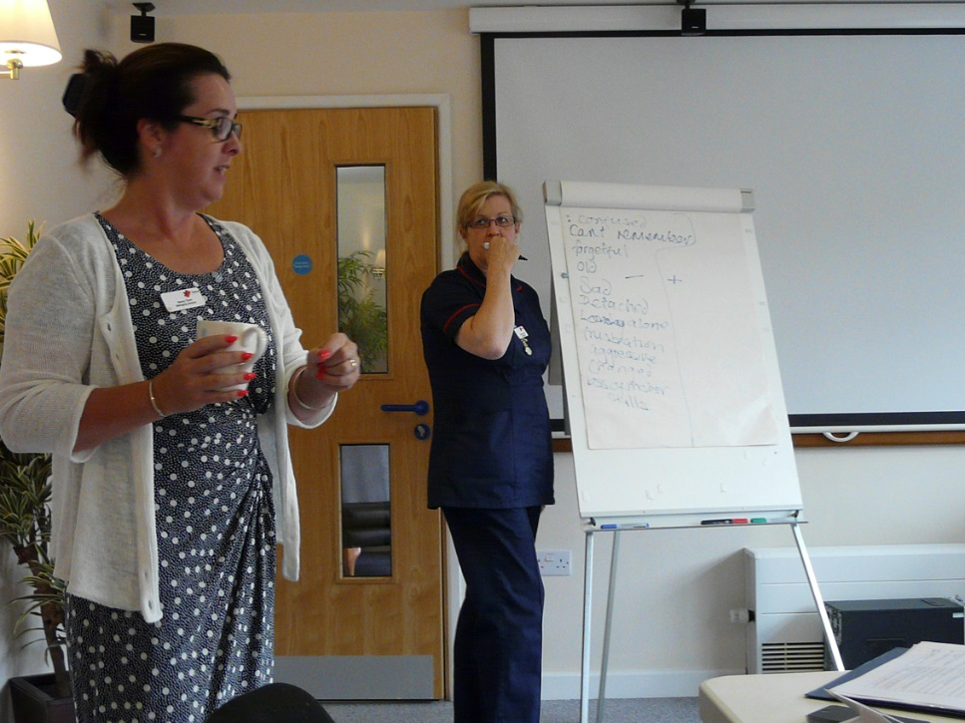
Developing our People
Rolling, personalised training
All levels, all disciplines and skills
Technology
QCF
Student nurses
Care practitioners
IIP
Staff feedback

Slide 5
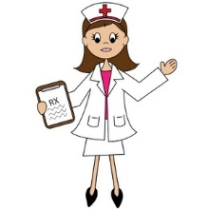
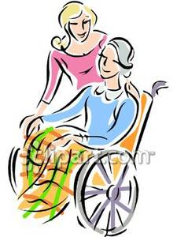
How
IT in the Care Home:
On line audits
GPs able to access EMSYS in the Home
Care planning and medication records all computerised - iCare
QA processes on line, file sharing between managers and directors
Use of NHS Mail to communicate between Care Home and Hospital/GP/Social worker

Slide 6
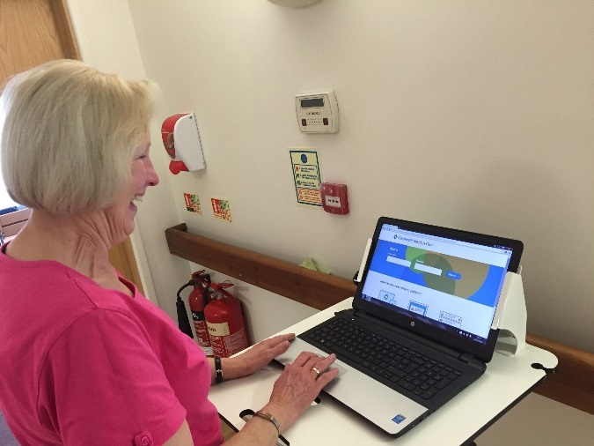
Embracing Technology
NHS Mail

Slide 7
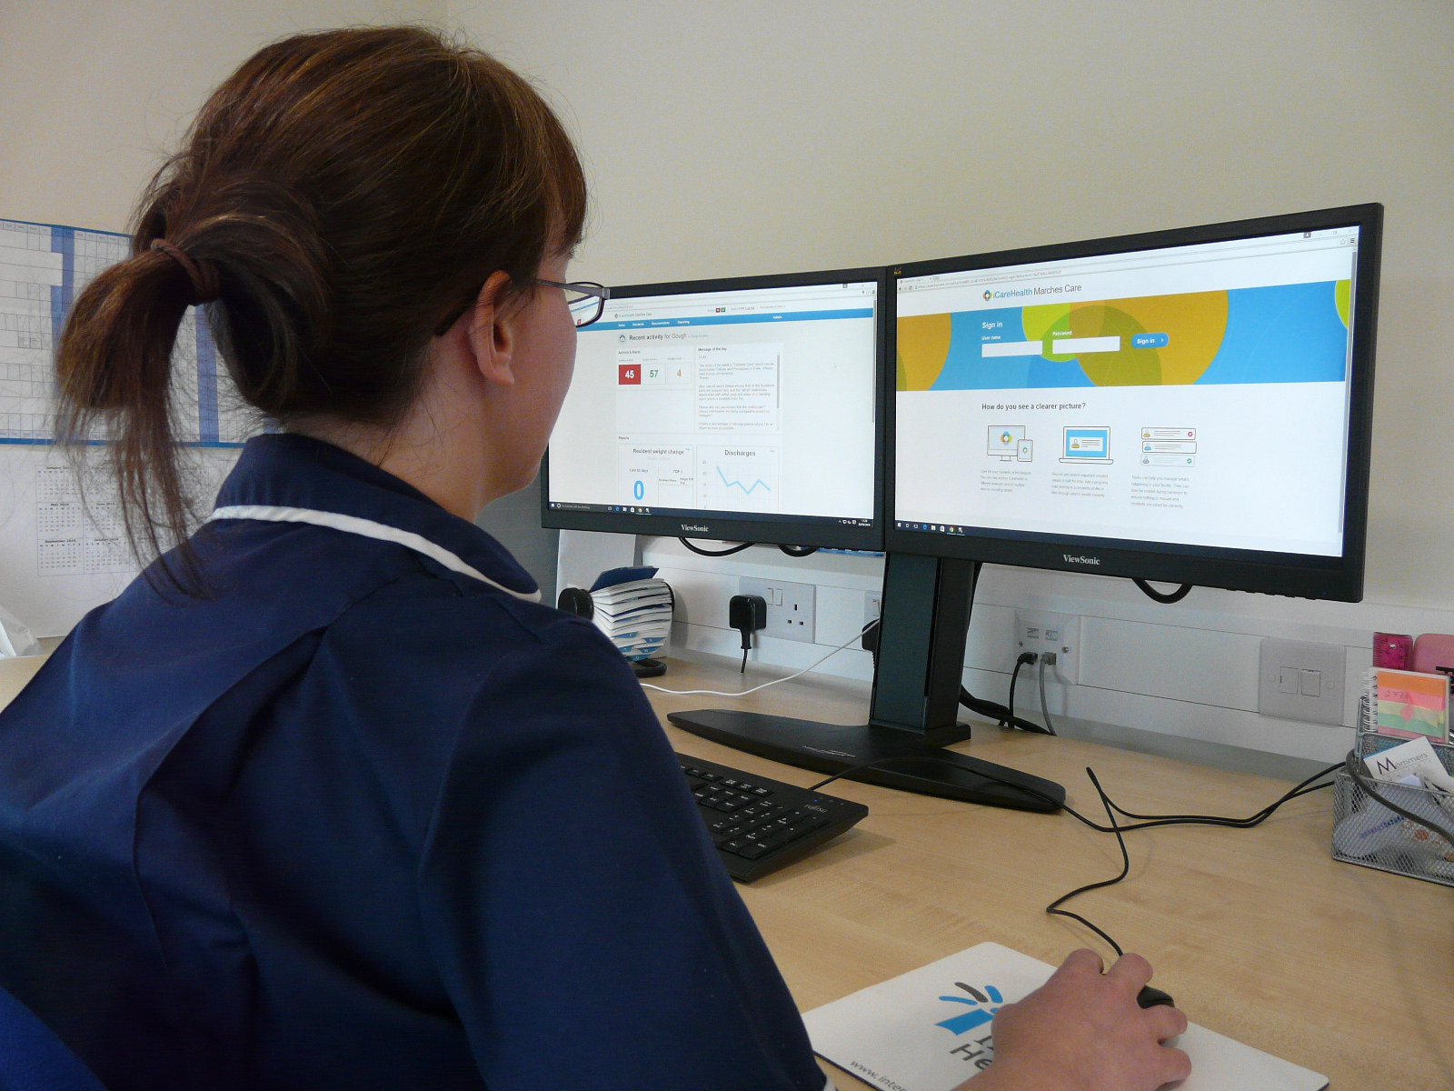

Slide 8
What does this mean for our residents ?
What difference has it made to them ?
This Photo by Unknown Author is licensed under CC BY-SA

Slide 9
Allows for much more of this !

Slide 10
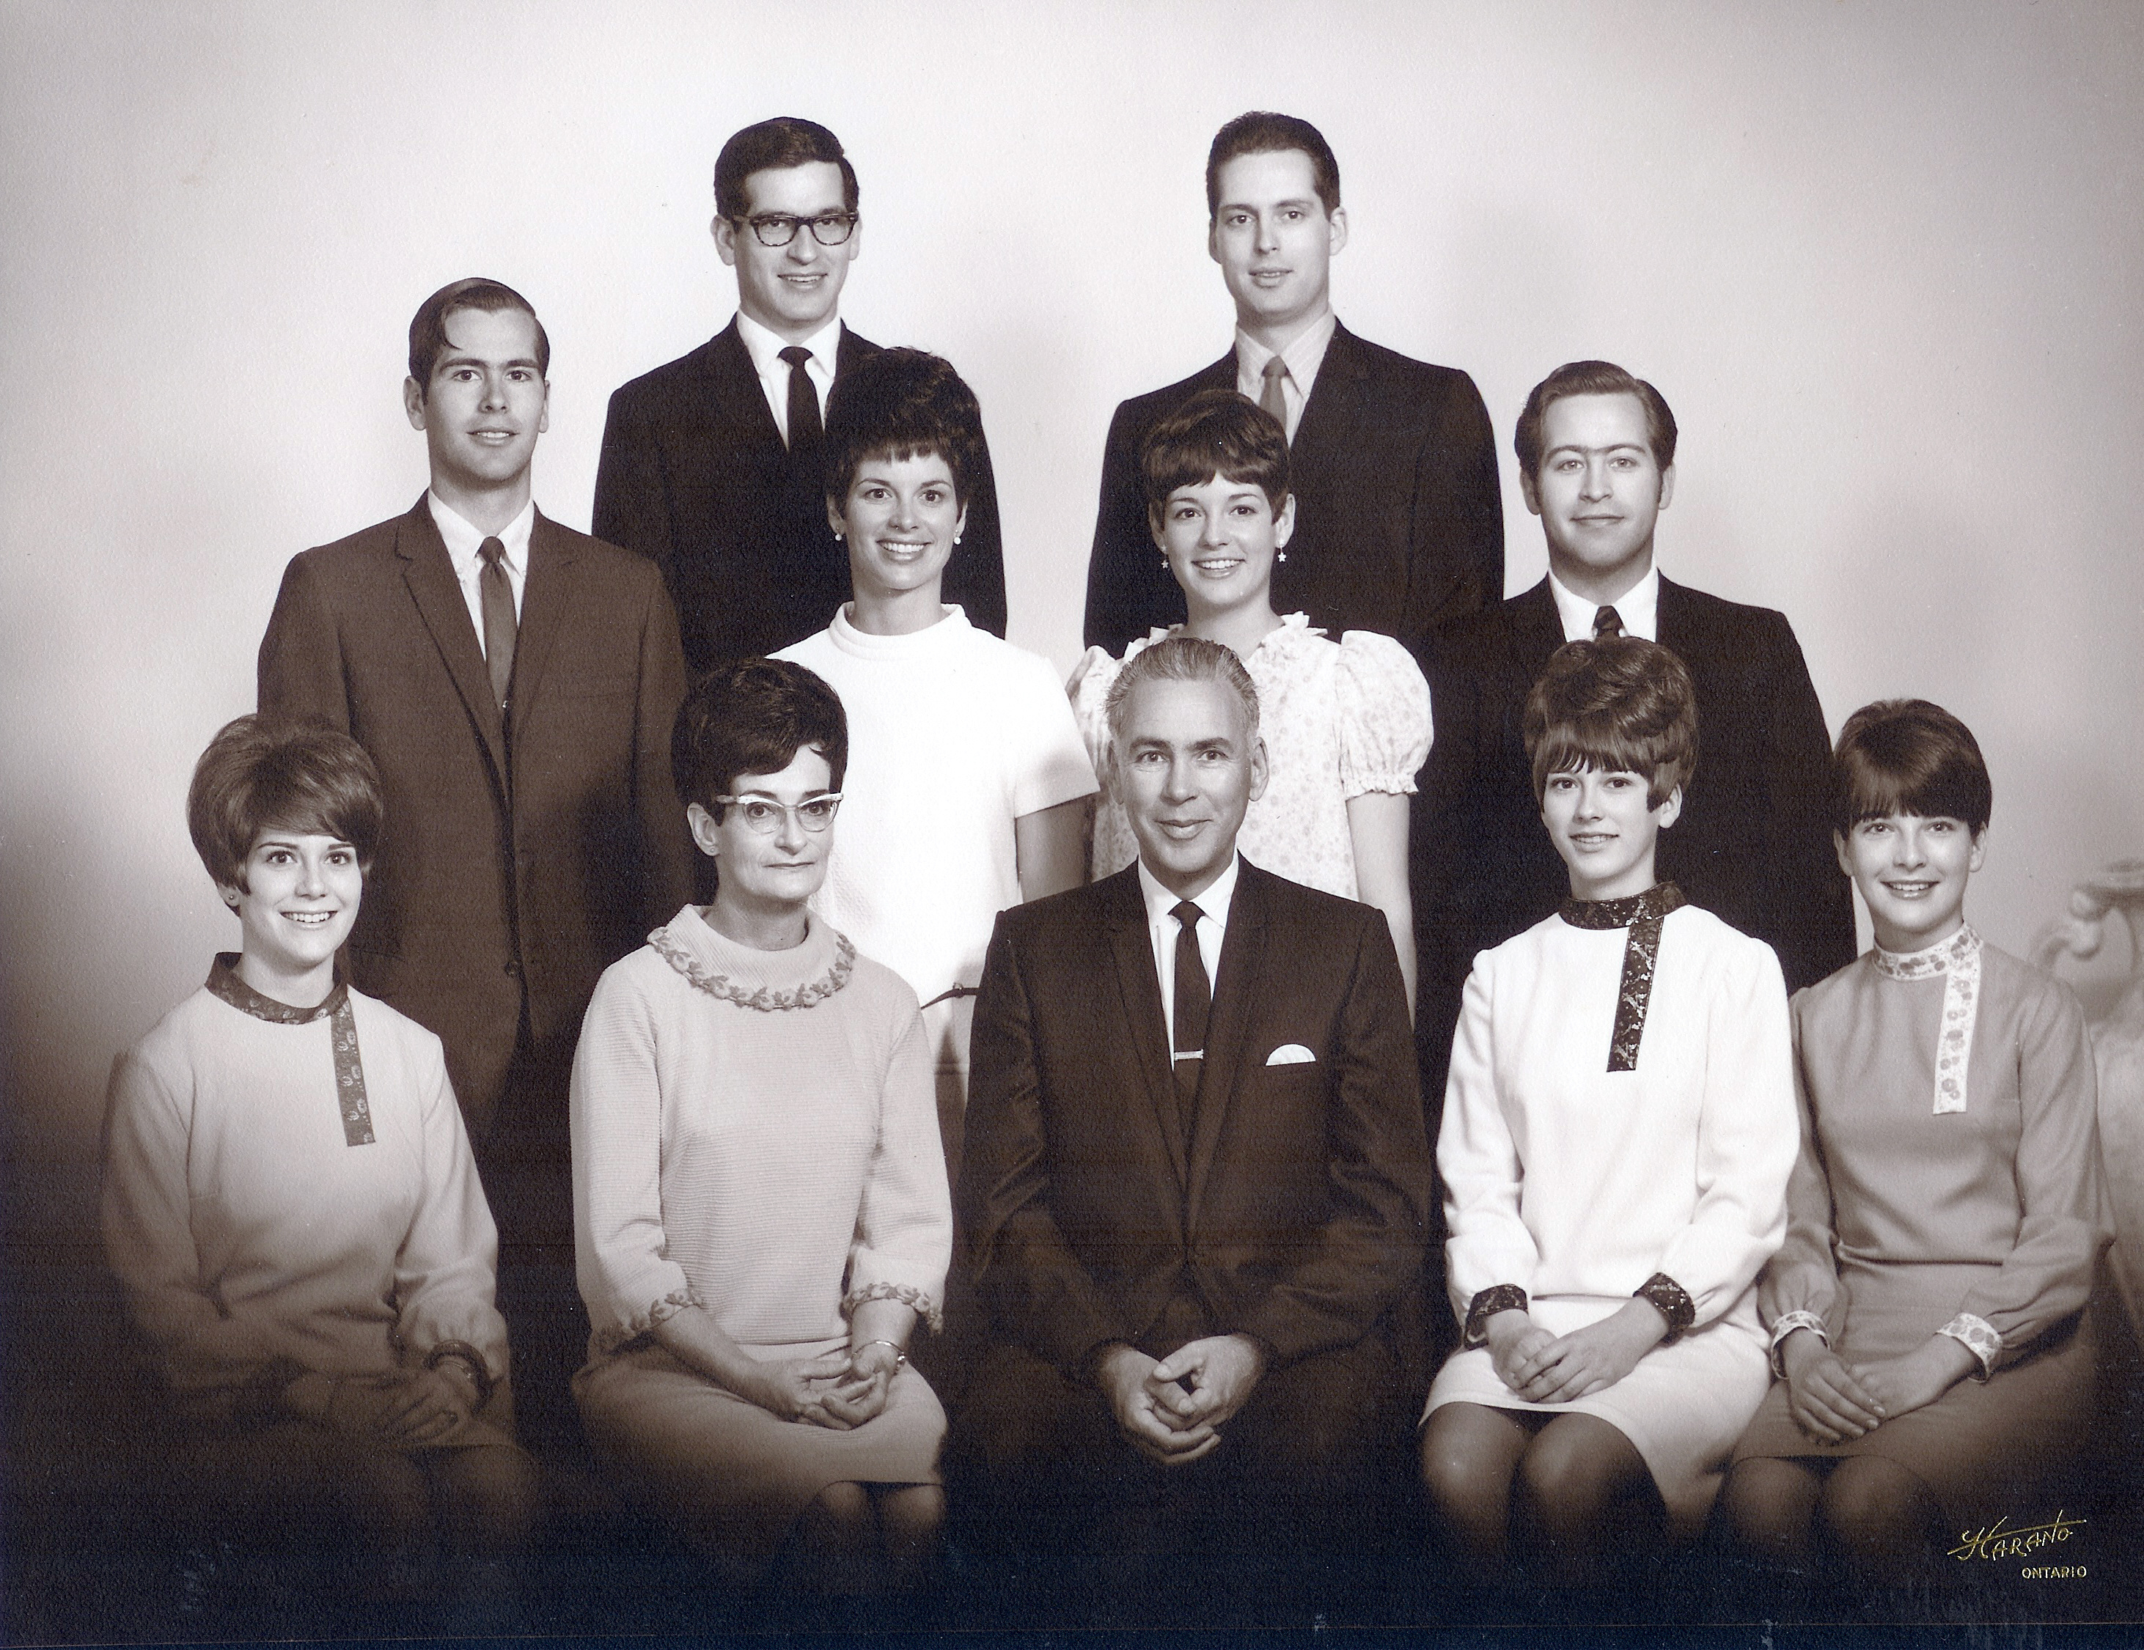
Families

