Slide 1
Social Value in Commissioning
An opportunity to reframe social care
Lucie Stephens,
New Economics Foundation

Slide 2
Overview
Social care as an engine for good local growth – ideas from West Midlands
Research on use of social value act in NHS
Examples of what is already possible - Preston Model and Halton CCG

Slide 3
About NEF
Think tank and charity.
Set up in 1986, out of The other Economic Summit.
Economics as if people and planet matter.
Conduct research and model ideas for a new economy at both local and national scales.
http://neweconomics.org/

Slide 4
West Midlands - Social Care as a Local Economic Solution
Care sector in crisis but more money is only part of the answer
The largest 5 residential care chains take 29p from every £1 for shareholders, debt repayments, etc.
Public money needs to work harder in local economy’s
Care is a major economic sector with potential to deliver inclusive prosperity
Sector needs to be more resilient, so diversity of suppliers essential
Notes:
Social care is on the brink of, if not already in, crisis. Provision is on the cliff edge as a result of national funding cuts, an aging population, and a dysfunctional system dominated by ‘too big to fail’ companies.
More funding is urgently needed, but is only part of the answer. There is an imperative to ‘do more with less’ at the local and regional level: to make every pound of public money work as hard as possible for the achievement of multiple objectives.
Care must be reframed as no longer just a ‘cost,’ but a major economic sector with the potential to deliver inclusive prosperity across the region. Nurturing a diversity of community-scale care providers would make the system as a whole more resilient and person-centred. It could also be the central plank of an economic policy that emerges from the actual needs, everyday lives and assets of the communities within an area – rather than grand, city-centre based strategies that hope to ‘trickle down’ to those on the geographic and demographic periphery.
foundational economy - provides the goods and services taken for granted by all members of the population, estimated to employ 40% of the workforce: for example, local transport and services like health, social care, and education.

Slide 5
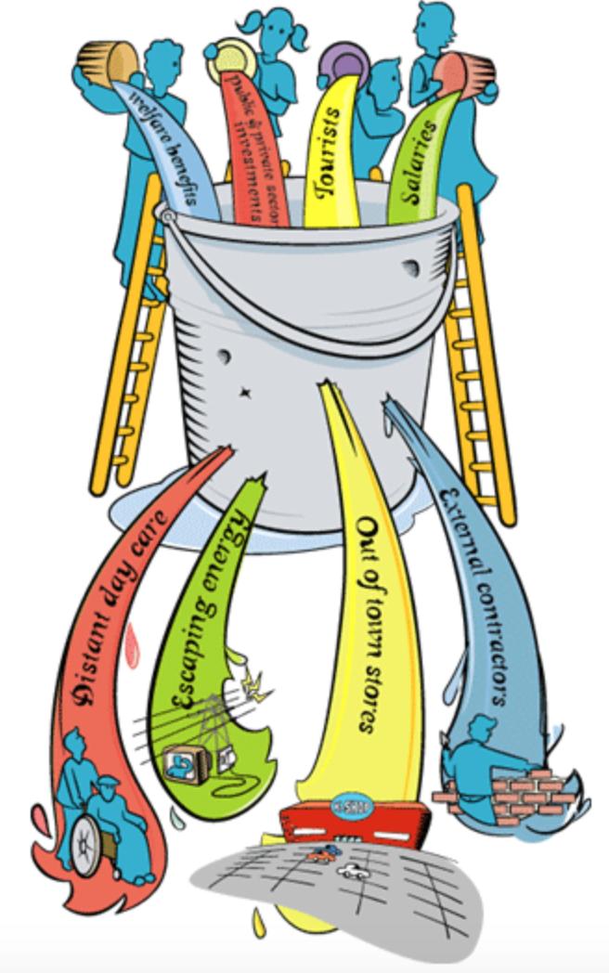

Slide 6
Public Services Social Value Act (2013)
Requires people who commission public services to think about how they can also secure wider social, economic and environmental benefits
Commissioners should think about whether the services they are going to buy, or the way they are going to buy them, could secure these benefits for their area or their stakeholders
Lord Young’s Review (Feb 2015)
Awareness and take up of the Act is a mixed picture
Varying understanding of how to apply the Act can lead to inconsistent practice
Measurement of social value is not fully developed
Notes:
Looking forward there’s a new interest and energy around the Act
Concerns about collapse of outsourcing firms like Carillion
Increased public and press scrutiny of public spending decisions
NHSE
Commissioned research on ‘what good looks like’
Sustainable Development Unit working with Michael Marmott on social value and wider determinants of health
Ongoing interest in area from DCMS
Recent launch of TOM’s framework for measuring social value

Slide 7
‘in some parts of the country there has actually been a fall in life expectancy of a year or more since 2011, particularly affecting post-industrial towns and isolated rural areas’
Simon Stevens, NHS England
Feb 2018
Notes:
As a response NHSE is reviewing
How the NHS behaves as an employer, a polluter and a big spender. How could the NHS better promote social value in it’s own work?
Are CCG’s in deprived areas using their additional funding to address health inequality?
Are STP’s and ICS’s responding to inequality in their emerging plans?

Slide 8
Social Value Act research for NHSE
Key question - How is social value is being embedded in NHS Commissioning?
Headline findings
Framing and language matters
Commissioning is changing
Growth of place based approaches offer opportunities
Importance of Leadership in making things happen
Notes:
Explored through
Interviews with commissioners and policy makers across the NHS
Sourcing best practice examples
Rapid review of STP Plans
Workshop with commissioners, policy makers and practitioners who have an interest in this area - from inside NHS and beyond

Slide 9
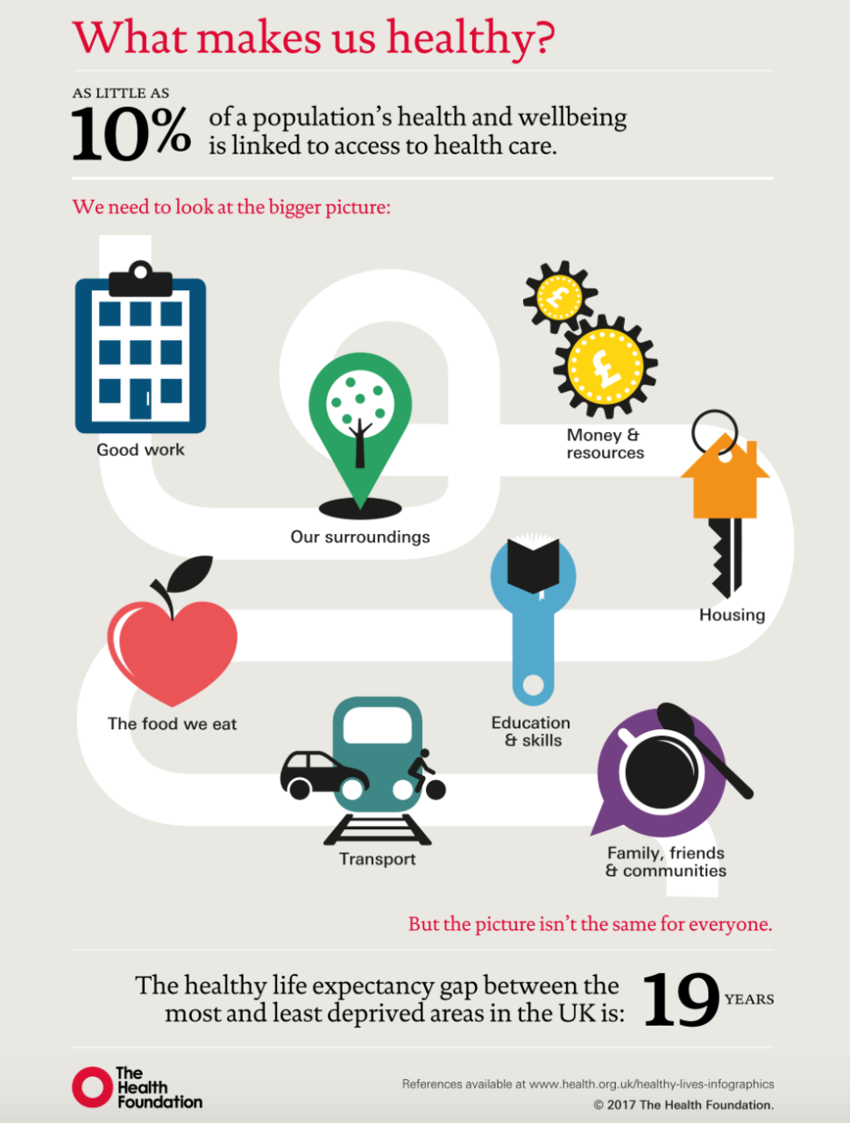
1. Framing and Language
Only 10% of our health comes from access to health care
Things that influence health
Family, friends & communities
Money & resources
Housing
Education & skills
Good Work
Transport
Our surroundings
The food we eat
Notes:
Very few places are using the terminology of ‘social value’, but the use of ‘economic, social and environmental’ outcomes is often captured under the terms of ‘wider determinants of health’ and ‘health inequalities’.
Health inequalities and the Marmot approach have a strong evidence base and existing traction within the NHS so could be more useful as a frame for discussing social value.
BUT Social Value may be more familiar to a local authority / housing audience so helpful when working across a place so there’s a translation job required
Why the wider determinants of health is relevant to all of us
Family, friends & communities - Social isolation and loneliness are associated with a 30% increased risk of heart disease and stroke.
Money and resources - One in five people in the UK live in poverty, and over half of these people live in working households.
Housing - Children living in cold homes are more than twice as likely to suffer from respiratory problems than children living in warm homes. Insecure and overcrowded housing impacts on educational outcomes.
Education & Skills - People with the lowest healthy life expectancy are three times more likely to have no qualifications compared with those with the highest life expectancy.
Good Work - Young adults who are unemployed are more than twice as likely to suffer from mental ill health than those in work.
Transport - There are nine times as many fatal and serious injuries among pedestrians aged 5–9 in the most deprived areas than the least.
Our surroundings - Children in deprived areas are nine times less likely to have access to green space and places to play.
The food we eat - It is harder to buy healthy foods in deprived parts of the UK. There is also a higher density of fast food outlets in these areas.

Slide 10
Social Value Act Wider Determinants
Family, friends and communities
Money and resources
Good Work
Our surroundings
Transport
Social value
Local Economic value
Environmental value
Notes:
Language and framing: Only two of the STP plans I looked at explicitly referenced the term ‘social value’. However, many more of them described aspirations to improve social, environmental and economic outcomes using the language of ‘health inequalities’ and the ‘wider determinants’.
The Marmot framework is also well established and widely recognised (and Coventry is a Marmot City).
The language of value is also not commonly used: ‘financial sustainability’ and reducing cost pressures is used more than ‘generating value’.

Slide 11
2. How Commissioning is Changing
Less frequent commissioning than local government
Structures are still maturing - STPs and ICOs
Mixed approach to outcomes in commissioning
Commissioning support units - closing or merging
Procurement – very varied and often too open
Performance management of the delivery as important as including in procurement phase
Notes:
Is commissioning the right lever for change? The health sector is undergoing rapid change. Commissioning in health hasn’t typically worked in the same way it has in local authorities: it is less frequent; the contracts are often bigger value and last for longer (5 to 10 years is common); contract management is often more common than re-commissioning. In addition, new healthcare models move beyond the traditional purchaser / provider split. The formation of many place based partnerships (e.g. Integrated Care Organisations) is shifting traditional commissioner/provider dynamics. Commissioners may be less inclined to use the ‘stick’ of new commissioning when a premium is being placed on partnership, negotiation and leadership over formal contracting. Some participants in this research suggested that as a result, it might be more effective to embed social value by exercising leadership in these partnership forums, and applying social value outcomes to existing contracts, as well as to an organisation’s own policies, so they are leading by example.
New footprints and structures: there’s a lot of structural change in the health sector at the moment. The formation of STPs presents an opportunity because they bring local authorities around the table, and local authorities tend to lead on the place based, social value agenda.
Defining local outcomes: local areas need to do the work and define the outcomes that matter most to that area. This needs to be a balance between being too high level and overly prescriptive, and it will vary from area to area. (e.g. Lake District may focus on happiness and local economic growth, while air quality and poor housing might be priorities for Tower Hamlets).
There’s a lot of change in Commissioning Support Units (merging and dissolving) so procurement is not necessarily a helpful place to look for leadership on this.
Procurement and local outcomes: where social value is being applied in procurement, there are some examples of bad practice that are becoming common. Some areas are using very generic social value questions: e.g. ‘’how will your project add social value to X area’’. These questions are too high level and generic, and disproportionately benefit large providers that have stock text they can use from other bids. Those assessing the bids also have no way to compare the very different answers that can be the result of these questions.

Slide 12
3. The opportunity of place based approaches
STP structures bring local authorities, providers, health and housing together. This structure could enable a more joined up approach to setting priority social value outcomes, and applying these to the collective spend within an area.
To date local authorities and housing organisations have led on embedding social value in their commissioning / delivery.
Emerging work on health as Anchor Organisations as a route to promoting social value in health is being used more frequently.
Metro Mayors and Devolution also bring a place based focus and new leadership on some key social value outcomes (e.g. work and jobs; environmental outcomes).
Notes:
But, at the moment, it seems as though no leaders within the STP have ‘ownership’ or responsibility for social value.
Particularly important to refocus acute hospital trusts’ contracts on outcomes, rather than activity. This will help re-focus on social value.
Michael Wood: some acute trusts are doing exemplary work in this area, and the formation of new ICOs also brings them to the table. They need to be reminded that they are major economic players in the market.

Slide 13
4. Leadership
Senior level sponsorship: all areas that are embedding social value well have some senior level sponsorship that gives ‘permission’ to those responsible for embedding into daily work.
Relationships and partnerships: many NHS organisations leading on social value have strong relationships with the local authority.
Consistent application: most areas are applying social value to some contracts, but more advanced areas apply consistently and it is a core part of their procurement framework and commissioning approach.
Notes:
Leadership is crucial – but it doesn’t have to be hierarchical: there is currently no mandate to have a named ‘social value’ lead on CCG Governing Bodies or at STP level. In all local areas where ambitious social value efforts have been made, strong leadership has been in place. Having strong leadership also reduces the burden of proof on measurement and costs much less.
Michael Wood – generally places leading on social value have good relationships with the local authority.
Reporting and accountability: best practice would also be for the contract manager responsible for a provider’s performance to assess performance of the social value dimensions of the contract.
Is there a need to nominated leads on social value?
Reporting and accountability: best practice would also be for the contract manager responsible for a provider’s performance to assess performance of the social value dimensions of the contract. So far, only Halton has mentioned that they have a specific tool for this.

Slide 14
The Preston Model – ‘guerilla localism’
Harnessed spending power of seven local anchor institutions to ensure greatest economic, social and environmental benefit for Preston’s economy and it’s residents
In 2012/13 only 5% of total procurement spent was with Preston based suppliers and 39% with Lancashire based suppliers
By 2016/17 this had increased to 18.2% spent with local suppliers and 79.2% spent with Lancashire based suppliers
This equates to an additional £74,750,857.47 for local suppliers and £199,688,679.96 spent with suppliers from Lancashire

Slide 15
Halton CCG
There are a greater proportion of people living with illnesses or health problems that limit their daily activities and higher levels of inequality in Halton than the rest of the country.
CCG, Local Authority and VCSE worked together to understand local assets
Social value part of everything and not an ‘add on’ in contracts
‘social-proofing’ Halton CCG community intentions
Social Value Procurement Framework
Procurement workshops to build local business and voluntary sector capacity

Slide 16
Tools, resources and further reading
National Themes Outcomes and Measures (TOMs) framework
https://socialvalueportal.com/national-toms/
Commissioning for outcomes and co-production
http://b.3cdn.net/nefoundation/974bfd0fd635a9ffcd_j2m6b04bs.pdf
Map the impact of your spend - Local Money Flows
https://www.nefconsulting.com/our-services/evaluation-impact-assessment/local-multiplier-3/
Health Foundation work on Anchor institutions
https://www.health.org.uk/newsletter/nhs-anchor
Institute for Health Equity – toolkit on Social Value Act
https://assets.publishing.service.gov.uk/government/uploads/system/uploads/attachment_data/file/460713/1a_Social_Value_Act-Full.pdf
VODG Social Value toolkit
https://www.vodg.org.uk/wp-content/uploads/2016-VODG-Social-Value-toolkit.pdf

