Slide 1
Johnnie Johnson Housing Digital Engagement - putting people first
Tricia Grierson
Head of Independent Living

Slide 2
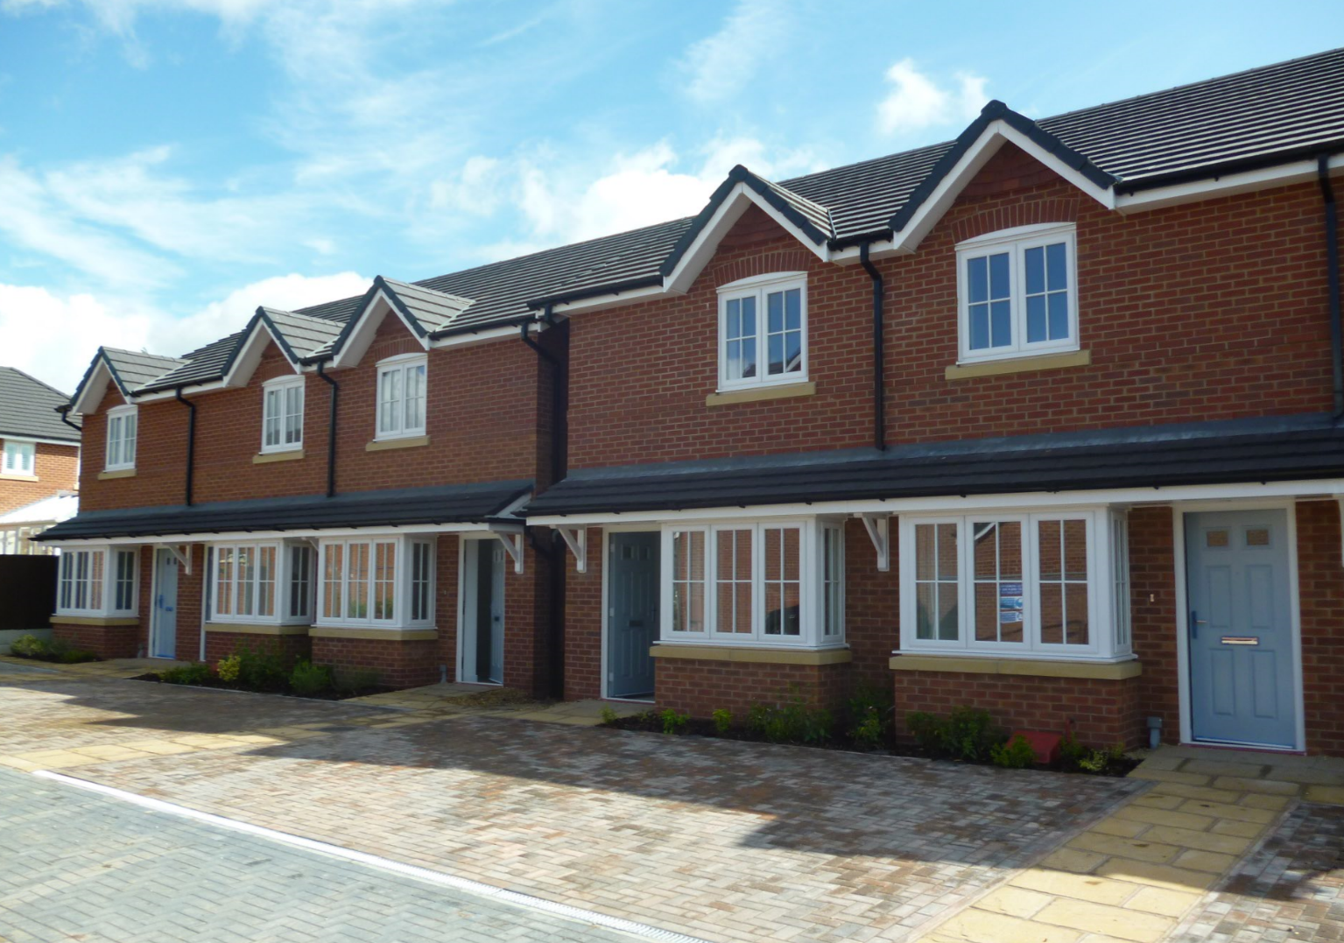
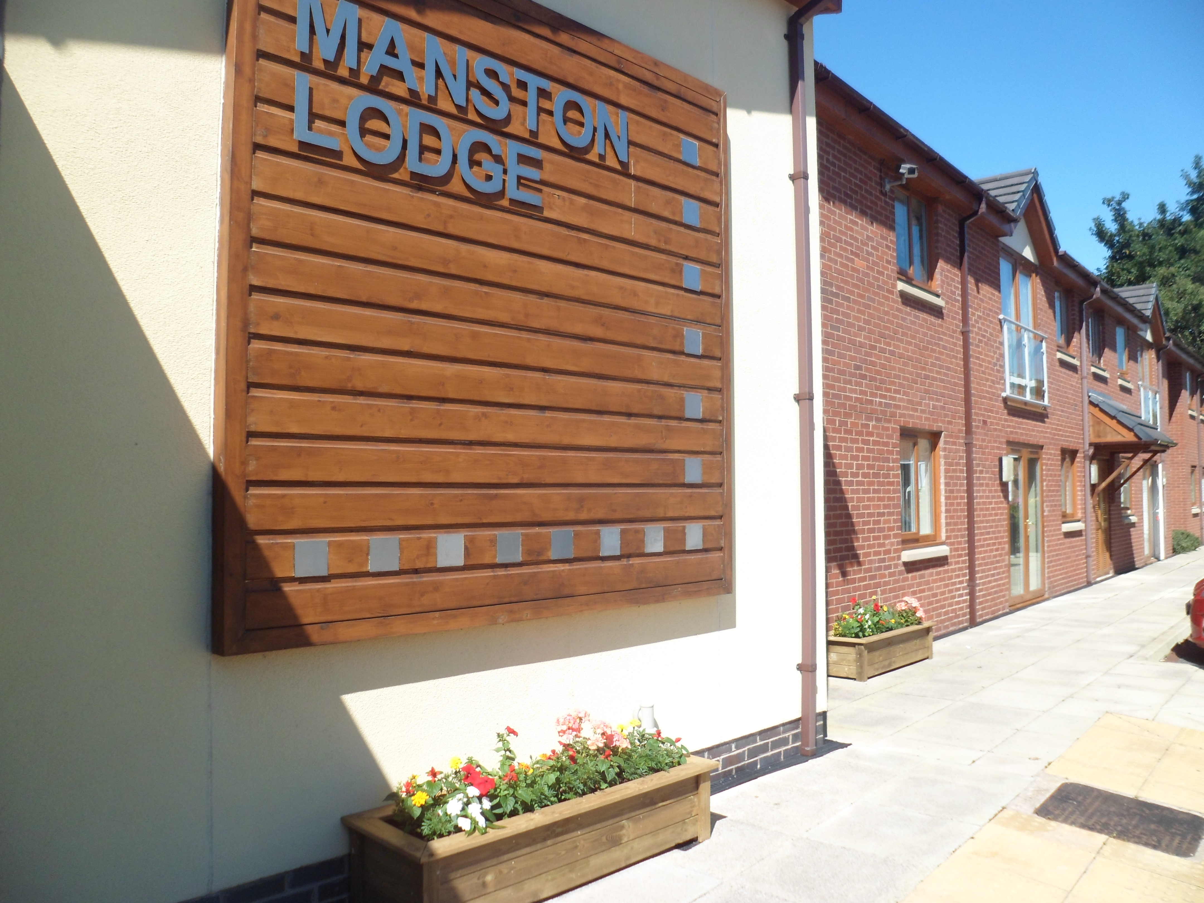
Johnnie Johnson Housing

Slide 4
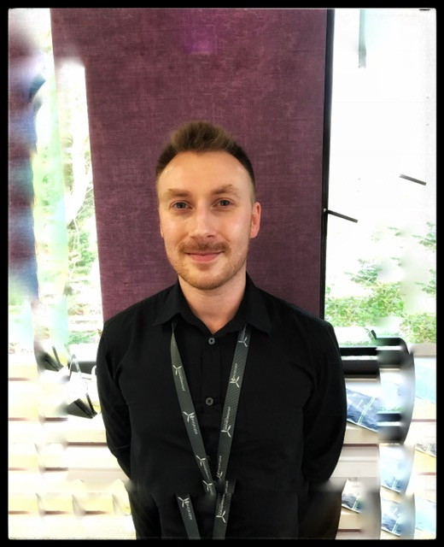
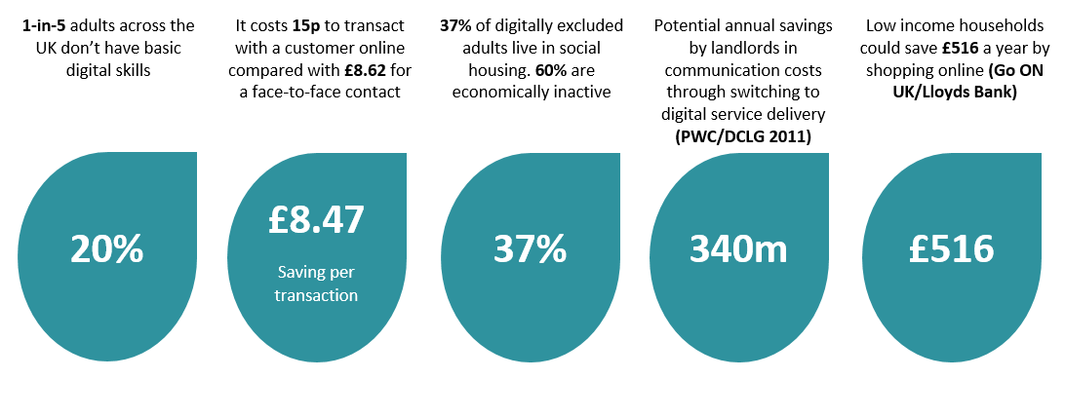
Digital Engagement
Ben our new Digital Coordinator

Slide 5
Digital Usage amongst the 75+
“Whilst we have seen a notable increase across all users in recent years many older & disabled are still not on line; 2/3rds of women over 75 have never used the internet.” Peter Lee, Office for National Statistics 2016
Greatest increase in use of the Internet has been for women 75+ from 24% in 2011 to 35% in 2017
Only 4 on 10 adults 75+ have used the internet in last 3 months
Adults over 75 have highest lapsed use of internet in 2017 7% up from 5% in 2016

Slide 6
Giving residents a choice in how and when they engage!

Slide 7
I’m Ok
 | Woodford Court | Stanmore | St Georges | Park House | Zone
No. of flats | 36 | 37 | 20 | 49
No. of morning calls prior to pilot | 26 | 30 | 17 | 30
% of residents having check calls prior to pilot | 72 | 81 | 85 | 61
No. of calls after introduction of I’m OK button | 7 | 22 | 11 | 4
Reduced by (%) | 19 | 8 | 6 | 26
% of residents having check calls after introduction of I’m OK button | 19 | 59 | 55 | 8
Independent Living Coordinator – Time saved in minutes | 28 | 16 | 12 | 52
Over the working week | 2hr 33 | 1 hr 33 | 1hr | 4 hrs 33
For the Zone per week |  |  |  |  | 9 hr 6
95% of residents said it had a
positive impact on their daily lives
I'm OK

Slide 8
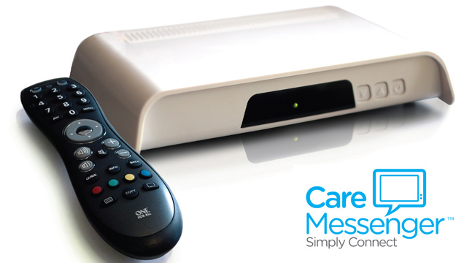
Care messenger
Former BBC presenter of Tomorrow's World, Michael Rodd interviewing elderly user Mary Laidlow

Slide 9
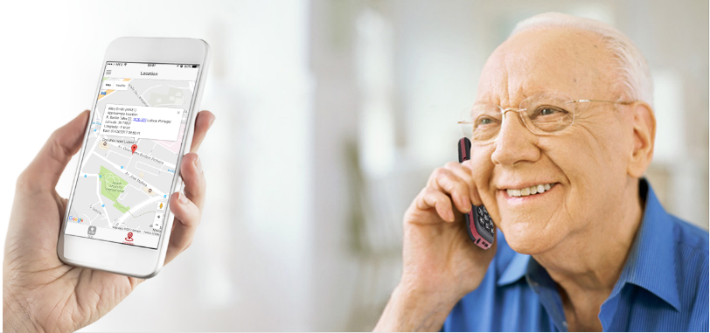
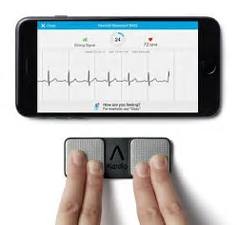
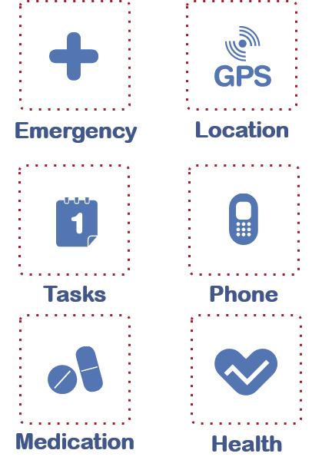
Astraline is developing a comprehensive technology offer that incorporates the best of existing Telecare/health and Next Generation Digital Healthcare

Slide 10
What is your Digital Future?

