Slide 1
Growing community business in health and social care
Susie Finlayson
Carey Bamber
Sian Lockwood
Martin Routledge

Slide 2
Today’s session
Introduction to Power to Change
What is a Community Business?
Context for Community Business in health and social care
The current programme
Developing a support framework: outline
Group work – helping develop the framework

Slide 3
About Power to Change

Slide 4
Power to Change
No one understands a community better than the people who live there.
Work with community businesses to:
Revive local assets
Protect the services people rely on
Address local needs

Slide 5
What is community business?

Slide 6
What is community business?
Community business must be community led

Slide 7
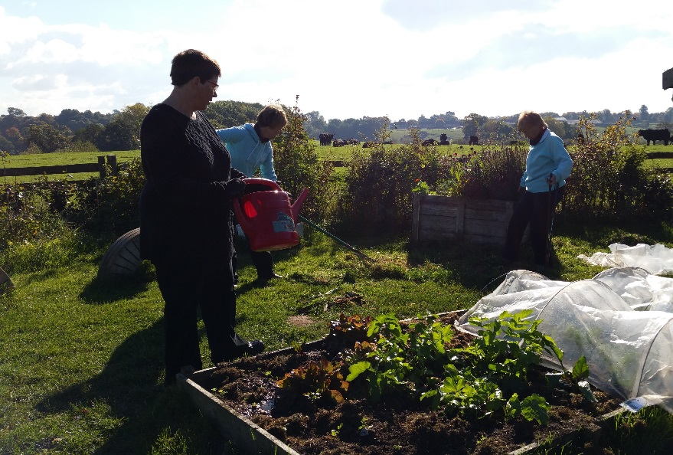
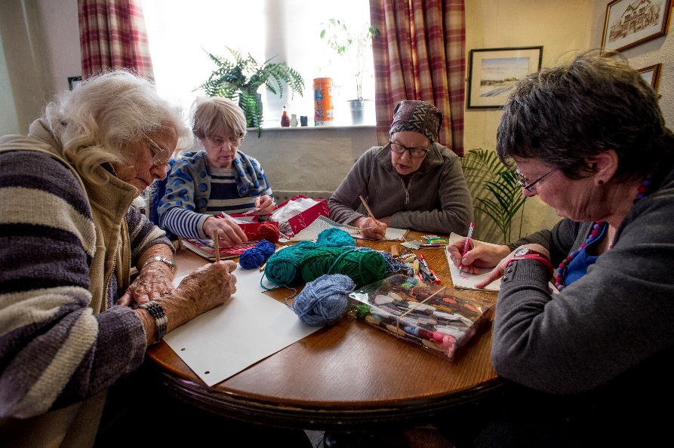
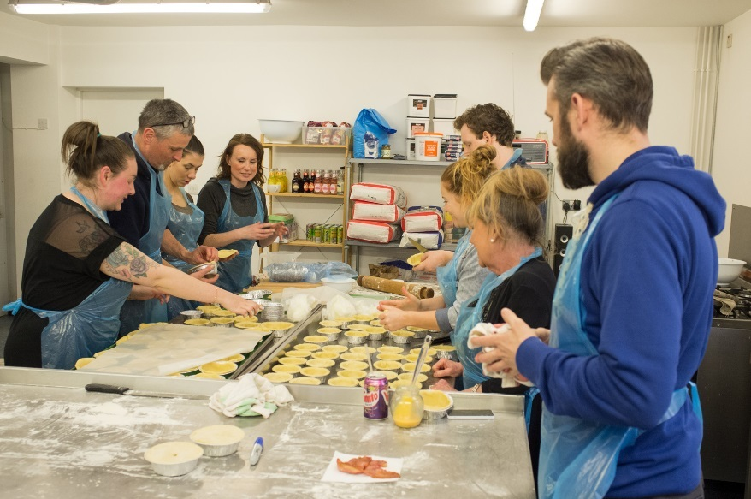
Community business: A business run by local people for local people.
Notes:
Pictured top left clockwise:
Supporting wellbeing through sport at East Lancashire Football Development Association
Therapeutic gardening at Fordhall Farm
Getting creative at Bamford Community pub
Learning how to bake pies at Homebaked in Liverpool
Community businesses are built on the simple idea that while it’s hard to solve problems alone, by working together we can achieve so much more.
A community business is owned and run by your community for your community. They are open to anyone locally who wants to get involved. Their profits are recycled back into the area to enrich local lives.
They succeed because no-one better understands the problems of a community than those who live there. For many years now, people have been coming together to take control and solve for themselves the issues that matter to them, by creating ‘community businesses’. Although they can be from totally different sectors, community businesses have 4 common traits:

Slide 8
Community business
Locally rooted
Community businesses are rooted in place
Accountable to the local community
Local people have a say in what they need and want
Trading
Trading for local benefit
Reinvesting profits in local social impact
Broad community impact
Inclusive and open to all members of the local community

Slide 9
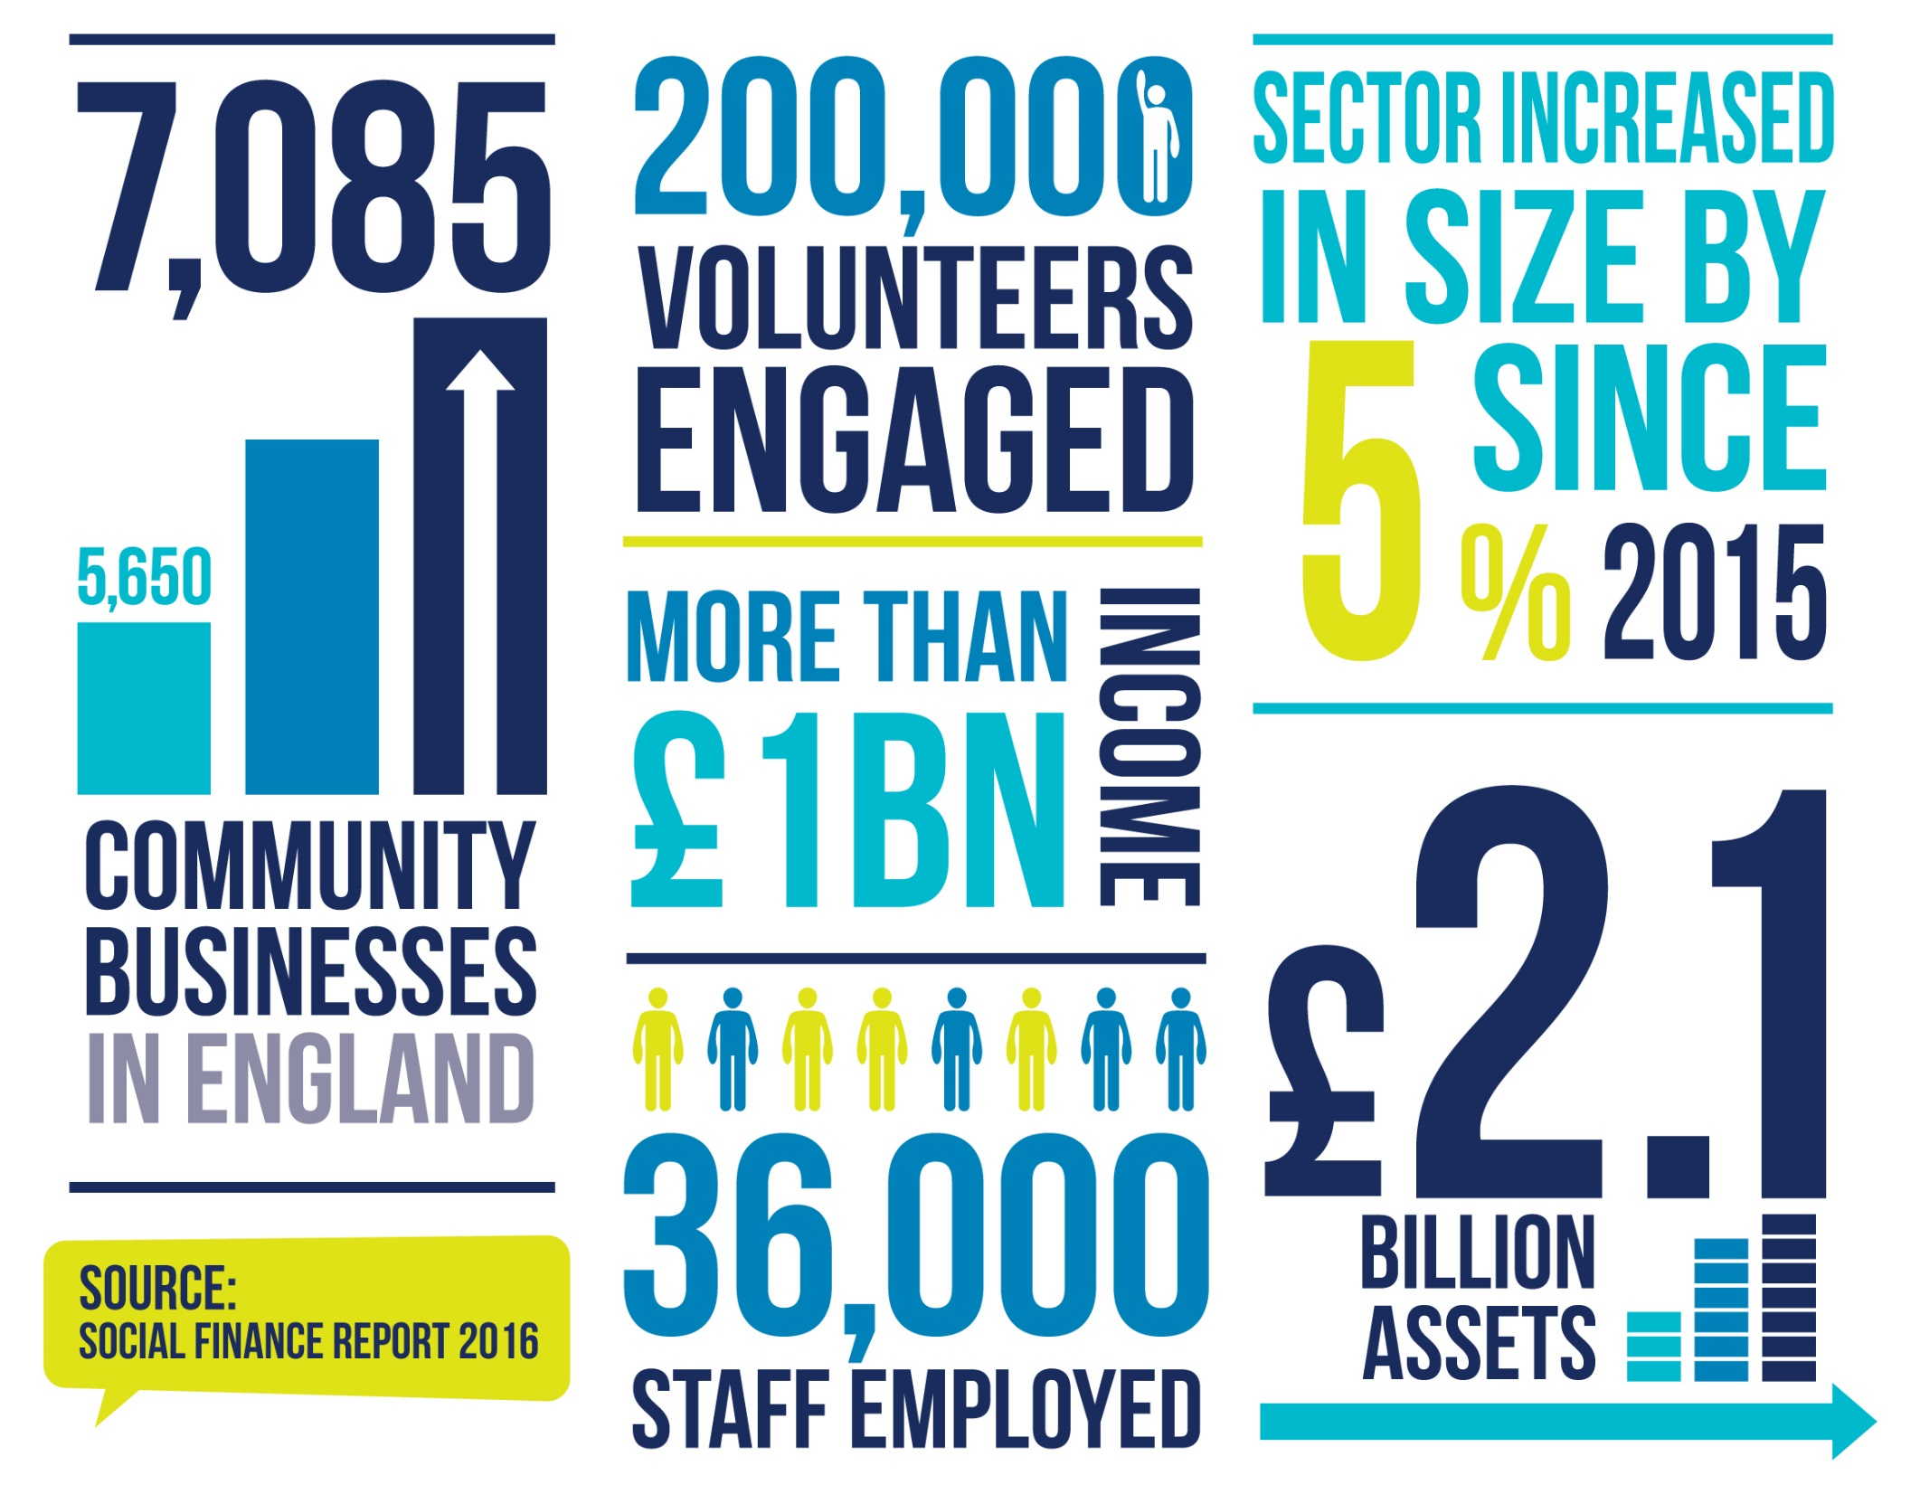
Notes:
The community business sector is growing steadily, as more and more people want to make their own opportunities, and improve the areas they live in by running their own business.

Slide 10
Health and social care

Slide 11
Health and social care
Health and wellbeing is most cited impact area
Reducing loneliness second most cited
PtC is focussing on health and social care for 2018 onwards
Role of CBs in delivering health and social care
Research
Community of practice
‘Exemplar’ grants and/or capacity building

Slide 12
BS3 Community Development
Bristol based community business
Early years nursery education
Drop-in dementia services
Foot health
Weddings, café, reducing isolation

Slide 13
New Wortley community centre
Community business
CBF funded
Refurbish old community centre into health and wellbeing centre
Fund staff time to deliver Mental Health services
Prepare for NHS contracts

Slide 14
Context for Growing Community Business in Social Care and Health
Role of market, particularly in social care but also in some areas of health
Concerns about some aspects of market role and operation
Sustainability challenges
Increasing interest in prevention and asset based approaches
Advocacy for co-production with people and communities
Developing linkage of health and social care and national and local economic and industrial strategy
Policy and legislation – Care Act, Social Value Act etc.
Quality – CQC consistently showing advantages of small, community connected
Range of alternative support and organisational models but varying levels of adoption – social enterprises, co-operatives, mutuals, micros, self-managed teams, community businesses

Slide 15
Growing community business in health and social care – current programme
Researching the barriers and opportunities
Identifying the elements of a framework to support the local growth of community business in health and social care
Supporting a community of practice of CBs to address some elements of the framework
Building a network of interested commissioners to address some elements
Supporting a number of demonstrator localities to put framework solutions into practice (commissioners, CBs and others)
Engaging with key groups and organisations to address system issues

Slide 16
Developing a framework to support community business in health and social care
Identify key barriers and opportunities for the growth of community business in health and social care
Propose solutions and roles to address the barriers and support the opportunities
For testing and use with CB community of practice, commissioner network, demonstrator sites and system organisations and agencies

Slide 17
A draft framework to support community business in social care and health
Elements:
The case and place for community business in health and social care
Structure and operating approaches of CBs
Commissioning environment
Investment and development
Registration and regulation

Slide 18
The case and place for community business in health and social care
Increasing acceptance of need for prevention, good quality home care, community , co-production - CBs can help shift from rhetoric to reality
Concerns about dominance of limited number of larger providers and impact of some forms of ownership - CBs can support diversity
Increasing understanding of the links between care and support and economic and industrial strategies – CBs can contribute and develop workforce, generate local income, grow new business £ local for longer
Interest in some of the things that CBs can offer: dynamism, responsive to local needs, accessing local assets – could rapidly and flexibly support developments such as integrated support

Slide 19
Structure and operating approaches of CBs
Some challenges:
Governance - Right skills? Supporting entrepreneurship and rapid business responses?
Definition of community business – Flexibility to allow access to business opportunity, to attract social enterprises to become CBs
Knowledge of the possibilities of the model/form
Diversification requires infrastructure funding. Many community businesses struggle (time/fund raising skills) to secure that necessary funding.
A compelling narrative for possibilities and opportunities

Slide 20
Structure and operating approaches of CBs
Possible solutions
Possible approach/support
Compelling case, structural flexibility to encourage social enterprises to become CBs and commissioners to include in local strategies
Access to initial/start up funding for paid manager with appropriate skills to build trading income and seek funding for diversification
Access to business and legal advice and “back office” support – HR etc
Develop narrative and strong examples of benefits and solutions CBs can offer
Evolve CB forms that retain key principles while enabling market role and trading success
Existing local providers to support start up and offer back-office functions, access to local markets, advice on sources of funding for diversification

Slide 21
Commissioning environment
Some barriers:
Limited knowledge of community business and what distinguishes them from other provider types, and not recognising their added value
Barriers to market entry for CBs (linked to tendering processes and impact of commissioning capacity challenges)
Lack of good information about options for personal budget holders or self-funders
Restrictions on “flows” of £ including via DP/ISF etc.
Limited funding for prevention, reducing budgets all round

Slide 22
Commissioning environment
Possible solutions
Greater and more flexible use of direct payments and ISFs
Commissioning and procurement policy and practice that allows/supports diversity
Targeted funding to support prevention/niche/local provision
Effective information approaches for CB customers
Possible approach/support
Help commissioners diagnose system barriers and model and support system adaptions
Provide examples of policies and strategies that facilitate desired market development
Provide practical tools and approaches (information, DP/ISF etc.)

Slide 23
Investment and development
Some barriers:
Need funding for infrastructure
Need upfront funding/investment to diversify and run the social care/health
Regulation costs
Limitations on access to some forms of investment and development support
Need for business support and skills

Slide 24
Investment and development
Possible solutions
Up-front funding provided to support business development and diversification
Access to skills and knowledge re sources of development funding
Availability of local training and skills development support
Access to national sources of support
Possible approach/support
Social Finance/council/CCG partnerships
Specialist help re sources of funding
Local business investment or innovation funds
Access to employer training/funding e.g. Skills for Care

Slide 25
Registration and regulation
Some challenges (for usually very small organisations):
Costs and requirements of registration and regulation
CQC registration where personal care
Manager qualifications
Compliance frameworks
Necessary knowledge
Restrictive requirements

Slide 26
Registration and regulation
Possible solutions
Support with up front costs
Advice and assistance with elements of process
Business advice to support entrepreneurial approach with regulatory environment
And …….national representation to liaise with regulators on approaches to regulation that are proportionate and appropriate
Possible approach/support
Local up front investment or other source of investment
Specialist business advice on trading as a small organisation in a regulatory context provided via organisation like Community Catalysts
Support via existing local providers or co-operative/collective of community businesses

Slide 27
Questions, Group work
Table discussions and initial questions
Then:
Divide up into 4 self-selecting groups covering:
The case for CBs in social care and health
Structure and operating approaches of CBs
Commissioning environment
Investment, development, system
Each group will have a facilitator and recorder – The task is to offer advice and ideas on strengthening the framework
Each group will then feedback its top 3 ideas.

