Slide 1

National Market Development and Quality Forum - March 22nd 2017
Better Conversation for Better Outcomes
Mark Burkin, Peer Support Worker - Take Off
Chris Coffey, Head of Communities – Porchlight
Catronia Toms, Head of Health & Wellbeing
Emma Hanson, Head of Commissioning – KCC

Slide 2
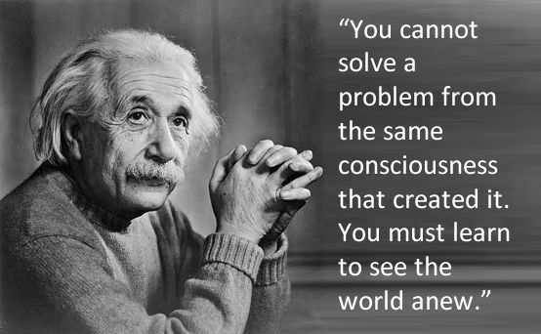

Slide 3

We have a duty to promote well-being
The Care Act:
Places well-being at its heart: and makes it the primary responsibility of local authorities to promote the wellbeing of both those with care needs and carers
It shifts responsibility from providing services to meeting needs
Focuses on the need for services to be preventative, and stresses the importance of using the existing strengths and assets of individuals and communities an assets based approach

Slide 4
Deficit Approach | Asset Approach
Identifies problems | Identifies strengths
Sees people as service users or patients | Sees that people have lots to offer and contribute
Does to or Fixes people | Supports people to take control of their lives and develop their potential
Focuses on individuals | Focus on relationships, communities and neighbourhoods

Slide 5
A Life not a Service !
What does a good life look like to you and your family?
How can we work together to achieve it?

Slide 6




Slide 7

Thank you….

