Slide 1
The NICE approach to evidence
What is evidence and how do we use it?

Slide 2
NICE guidelines
Are sets of evidence based recommendations
Cover a wide range of topics, from preventing and managing specific conditions, improving health, and managing medicines in different settings, to providing social care and support to adults and children, and planning broader services and interventions to improve the health of communities
Based on the best available evidence of what works, and what it costs
Are not mandatory, but intended to guide practice

Slide 3
Overview of evidence process
Recommendations
Evidence review
Review questions
Evidence search

Slide 4
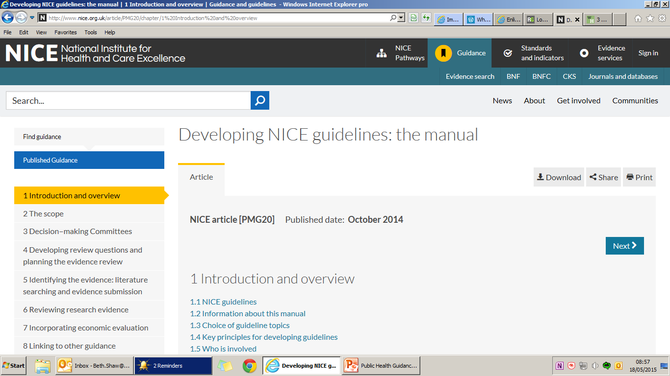
https://www.nice.org.uk/article/pmg6/chapter/1%20introduction

Slide 5
Published social care guidelines
Guidelines cover a range of topic areas across health and social care and child and adult services – published social care guidelines to date are:
Managing medicines in care homes (2014)
Home care: delivering personal care and practical support to older people living in their own homes (2015)
Social care for older people with multiple long-term conditions (2015)
Transition between inpatient hospital settings and community or care home settings for adults with social care needs (2015)
Transition from children’s to adult services (2016)
Transition between inpatient mental health settings and community or care home settings (2016)

Slide 6
Social care guidelines in development
Child abuse and neglect (consultation Feb 2017, publication Sept 2017)
Intermediate care including reablement (consultation April 2017, publication Oct 2017)
Learning disability and behaviour that challenges - service guidance (consultation Oct 2017, publication March 2018)
Care and support of older people with learning disabilities (consultation Nov 2017, publication May 2018)
People's experience in adult social care services: improving the experience of care for people using adult social care services (consultation Aug 2017, publication Feb 2018)
Decision-making and mental capacity (consultation Feb 2018, publication July 2018)
Supporting adult carers (started March 2017)

Slide 7
Future social care guidelines
New topics referred
Adults with hearing and visual impairment
Advocacy for adults with health and social care needs
Children and young people with complex needs
Safeguarding adults in care homes
Supporting independent living and preventing isolation in adults of working age
Advocacy for adults with health and social care needs
Notes:
Justine

Slide 8
What do we mean by evidence?
Manual describes two types of evidence
Scientific – “explicit, transparent and replicable”
Colloquial – “values (including political judgement), practical considerations (such as resources, professional experience or expertise and habits or traditions, the experience of people using services) and the interests of specific groups (views of lobbyists and pressure groups)”
“In order to formulate recommendations, the guideline Committee needs to consider a range of evidence about what works generally, why it works, and what might work (and how) in specific circumstances. The Committee needs evidence from multiple sources, extracted for different purposes and by different methods.”

Slide 9
Why do we need different types of evidence?
 | Pros | Cons
Scientific
Colloquial

Slide 10
Why do we need different types of evidence?
 | Pros | Cons
Scientific | Methodologically robust
 | Replicable
 | Able to assess quality or certainty
 | Free of bias
Colloquial | Direct experience
 | Information that is not easily ‘measurable’
 | Early in the ‘evidence’ pathway
 | Context sensitive

Slide 11
Why do we need different types of evidence?
 | Pros | Cons
Scientific | Methodologically robust | Focus on easily measurable aspects
 | Replicable | Late in the ‘evidence’ pathway
 | Able to assess quality or certainty | More rigid
 | Free of bias | Free from context
Colloquial | Direct experience | Not ‘testable’
 | Information that is not easily ‘measurable’ | Difficult to capture and report
 | Early in the ‘evidence’ pathway | Early in the ‘evidence’ pathway
 | Context sensitive | Difficult to assess certainty

Slide 12
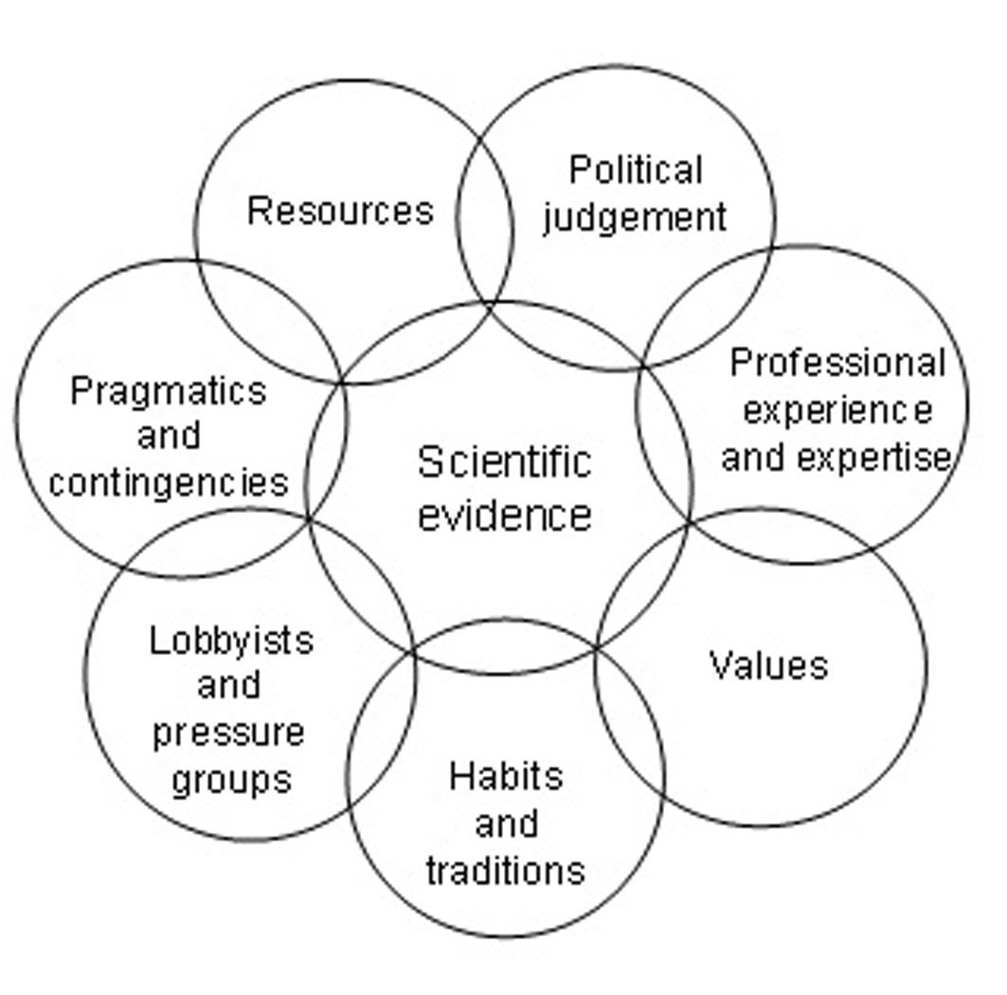
What is evidence, or knowledge?
Balance between scientific and colloquial evidence
NICE favours scientific…

Slide 13
Evidence in practice
NICE NG21 Home care: delivering personal care and practical support to older people living in their own homes
1.4.2 Home care visits shorter than half an hour should be made only if:
the home care worker is known to the person, and
the visit is part of a wider package of support, and
it allows enough time to complete specific, time limited tasks or to check if someone is safe and well.

Slide 14
Evidence in practice
Scientific: no effectiveness data

Slide 15
Evidence in practice
Scientific: no effectiveness data
Scientific: lived experience

Slide 16
Evidence in practice
Colloquial: societal values
Scientific: no effectiveness data
Scientific: lived experience

Slide 17
Evidence in practice
Colloquial: societal values
Colloquial: experience of increasing length of home care visit
Scientific: no effectiveness data
Scientific: lived experience

Slide 18
Evidence in practice
Colloquial: societal values
Colloquial: experience of increasing length of home care visit
RECOMMENDATION
Scientific: no effectiveness data
Scientific: lived experience

Slide 19
Review questions
Intermediate care – including reablement
What is the effectiveness and cost effectiveness of reablement?
What are the views and experiences of people using services and their carers in relation to reablement?
What are the views and experiences of health, social care and other practitioners about reablement?
Learning disability and challenging behaviour service guidance
What is the appropriate community-based service capacity for people with learning disabilities and behaviour that challenges?
What is the appropriate inpatient bed capacity for people with learning disabilities and behaviour that challenges?
Community engagement
How effective are community engagement approaches at improving health and wellbeing and reducing health inequalities?
Across disadvantaged groups, how effective are community engagement approaches at encouraging people to participate in activities to improve their health and wellbeing and realise their capabilities?
What processes and methods facilitate the realisation of community and individual capabilities and assets amongst disadvantaged groups?

Slide 20
The evidence problem?
In guidelines, the key question is often ‘does this intervention work?’
We may also wish to know
When, how, in whom does this work?
Or indeed does not work?
What might help this intervention to work better?
Can, and should we use other evidence?

Slide 21
Assessing impact of community based approaches to care and support
Key aim is to assess effectiveness – ‘what works’
Randomised controlled trial considered ‘best’ approach to evaluation

Slide 22
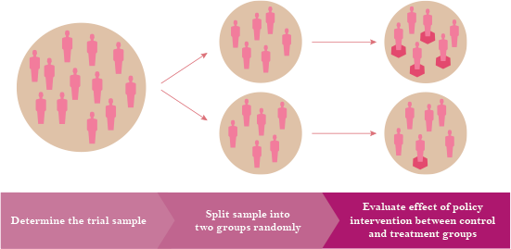
RCT process
www.cscollege.gov.sg/knowledge/ethos/ethos%20issue%2012%20june%202013/pages/randomised%20controlled%20trials%20in%20policymaking.aspx

Slide 23
Assessing impact of community based approaches to care and support
Randomised controlled trial
Système de Soins Intégrés pour Personnes Âgées (SIPA), Canada
Community-based, primary-care-led, case-managed health system for the frail elderly operating out of local community service centres
Maintain and promote autonomy of frail elderly people; and promote optimal utilisation of community-based services as a substitute for hospital and nursing home care
Outcomes included
Increased access to home- and community-based services
Reduced hospitalisation of alternate level of care patients (i.e. ‘bed blockers’)
Increased satisfaction for SIPA caregivers with no increase in caregiver burden or out-of-pocket costs
Kodner, D. L. (2006), Whole-system approaches to health and social care partnerships for the frail elderly: an exploration of North American models and lessons. Health & Social Care in the Community, 14: 384–390. doi:10.1111/j.1365-2524.2006.00655.x

Slide 24
Assessing impact of community based approaches to care and support
Advantages with RCTs
Can be clear and credible evidence of effect or impact
Can capture a range of outcomes – but need to be measurable
Can give some information on the experience of people delivering or using the intervention

Slide 25
Assessing impact of community based approaches to care and support
Challenges with RCTs
May not capture all that is important
May not help [well] with information on how the intervention works
May not tell us [well] about the experience of people delivering or using the intervention
Can be expensive
Need to be designed and conducted well
Take time and may be behind current practice…
Increasingly, move towards mixed methods

Slide 26
Assessing impact of community based approaches to care and support
Much is written about ‘what is good evaluation’
In education for example….
educationendowmentfoundation.org.uk/resources/diy-guide/getting-started/
Focus here on effectiveness not efficacy – real life impact vs experimental impact
Different approaches serve different aims

Slide 27
Assessing impact of community based approaches to care and support – and NICE?
‘Good’ evaluation would
Give us confidence in the results seen
Help us to make [more or better] recommendations for wider use
Address existing gaps in the evidence

Slide 28
Assessing impact of community based approaches to care and support – and you?
Is evaluation important to you?
Is it important to other people?
Would a guide similar to that for education and teachers be of value for you?

Slide 29
Learning to date
‘Good’ evaluation depends on the specific question you are trying to answer and may depend on who you are
Social care guidelines are not just about effectiveness, but also acceptability of interventions, experience, aspects of service delivery
This requires consideration of a wide range of evidence to answer these questions

