Slide 1


The National Market Development and Quality Forum
Better Conversations for Better Outcomes
Nick Dixon, Lead Practitioner Healthy Communities, Stockport Together New Care Model, and ASC Commissioner

Slide 2
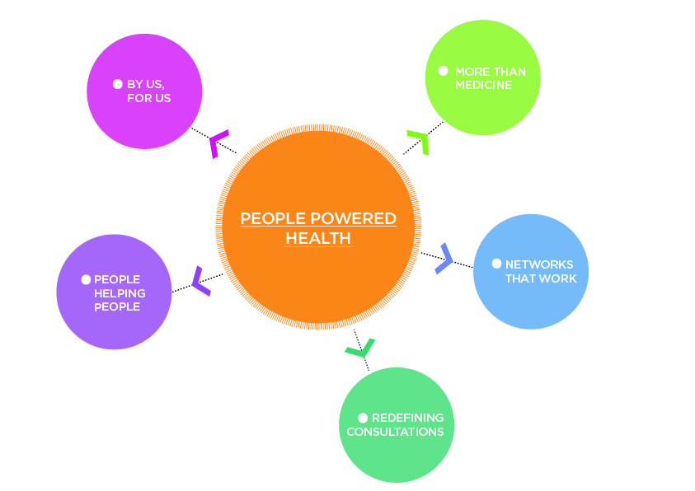
http://www.nesta.org.uk/what-we-have-learnt-people-powered-health
“This is an ambitious programme to `hard-wire’ social action into a transformed health and care system, and build co-production with people living with long term health conditions”- Nesta
http://www.stockport-together.co.uk/download_file/109/160

Slide 3
System Level Change in Stockport
What we have learnt in our communities
Need to shift from service silos to system outcomes, from vertical silos of health and care to horizontal place-based systems
Culture and behavioural change is needed for transformation- both within services and communities/ citizens
Neither people nor places are seen as assets, we tend not to leverage in people’s capacity and local resources
Health and care systems determine service delivery in isolation of people and in response to national policy and drivers
Notes:
Common language and understanding is missing between services and citizens
There is enormous untapped goodwill in communities

Slide 4
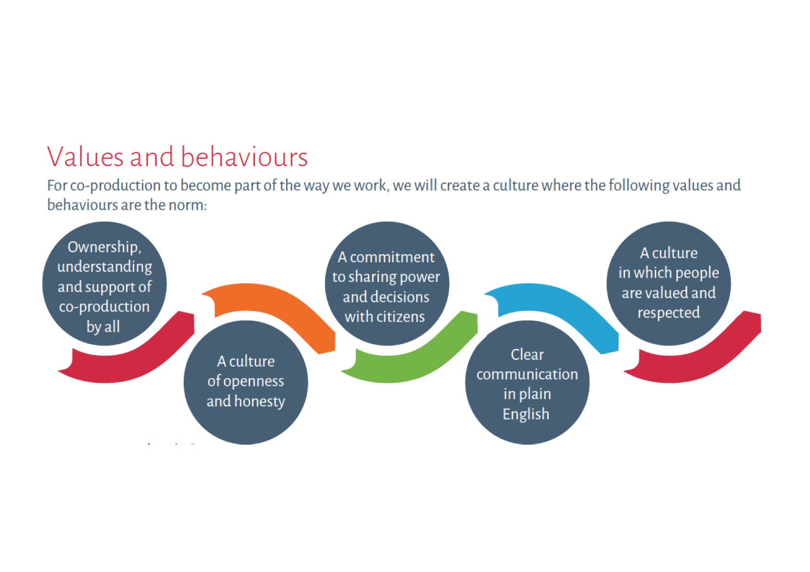


Notes:
Ownership and shared understanding of what everyone is trying to do crucial.
Sharing decision making/power must be honest and a real commitment made by everyone.
Communication jargon free which can be alienating for people & model tested with Youth ambassador.

Slide 5
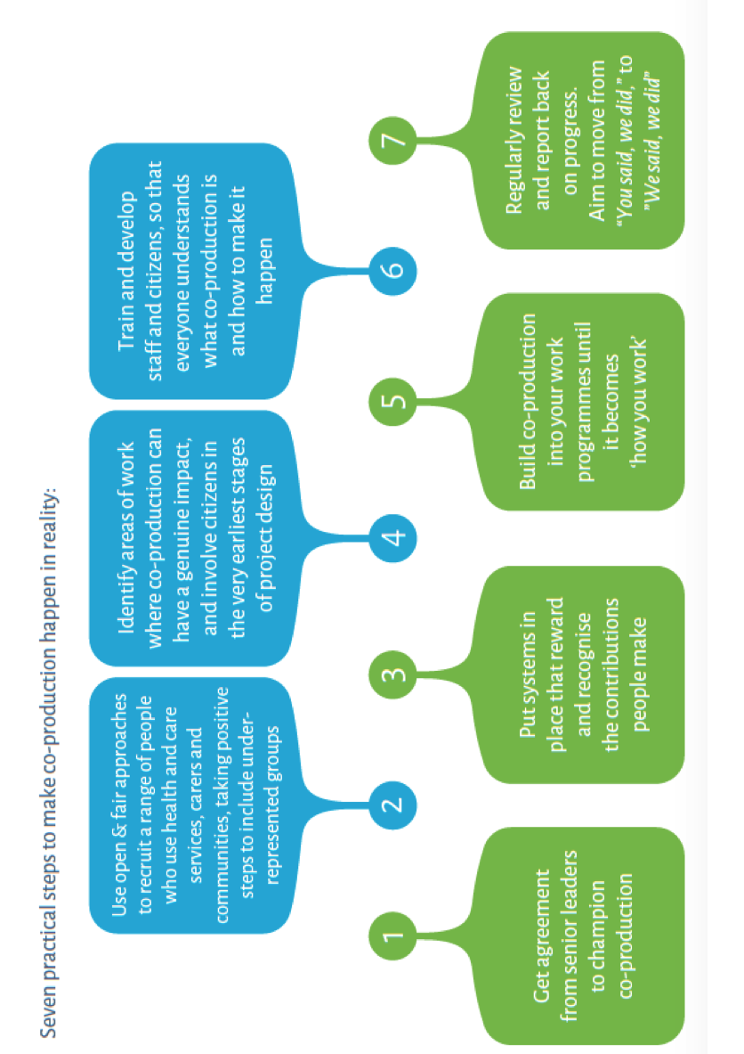
7 Practical steps
Notes:
Senior leader buy in, understanding & modeling key to success- Vanguards feedback
Recruitment- be clear who you actually want in terms of skills, knowledge & experience etc Where does this sit in your engagement plan with people in your communities?
Make no assumptions that everyone knows and understands how to work this way – but don’t think it has to be perfect from day 1 – just get going with some willing people & try it out.

Slide 6
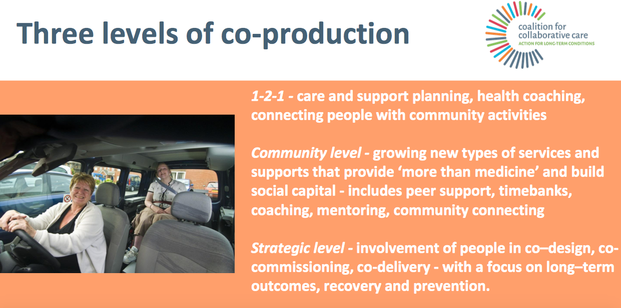

Slide 7
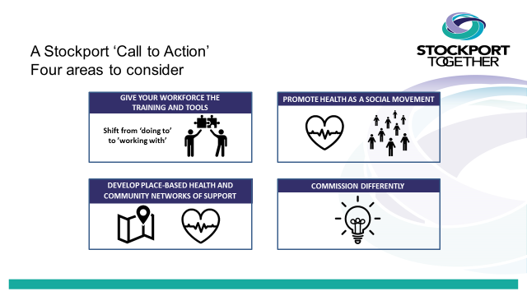
Application of Learning

Slide 8

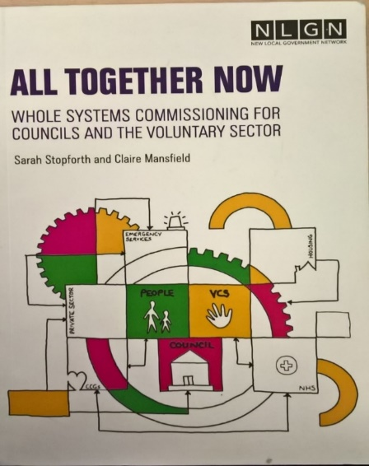

Commission differently
Coproduction built in
Commission for outcomes including social capital
Alliance Contracting
Asset based commissioning across age and label
Creative use of the resources available
Commitment Devices
Investment Funds
COMMISSION DIFFERENTLY

Slide 9

The Prevention Alliance
www.stockporttpa.org.uk
COMMISSION DIFFERENTLY

Slide 10

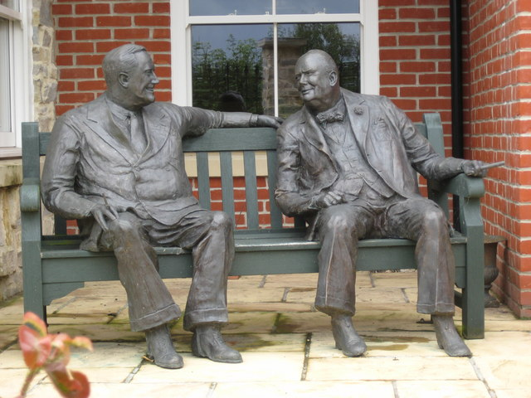
Workforce Training and Tools
We need workforce development and tools that go beyond training to seek to embed culture change in the way pubic services work with individuals and communities
We need to encourage attitudes and behaviours amongst colleagues to build on the assets in our communities and unlock capacity
GIVE YOUR WORKFORCE THE
TRAINING AND TOOLS
Shift from ‘doing to’ to ’working with’
Who are your workforce?
Relationships matter so much
Resistance- understand why
Single OD Strategy with agreed vision
Leaders set the culture
Identify and use your System Translators
The relationship, the conversation between clinicians and patients, is key.
“We hired workers but human beings came instead”
“Transformational change can only go at the speed of trust”
Notes:
We need workforce development and tools that go beyond training to seek to embed culture change in the way pubic services work with individuals and communities
We need to encourage attitudes and behaviours amongst colleagues to build on the assets in our communities and unlock capacity

Slide 11



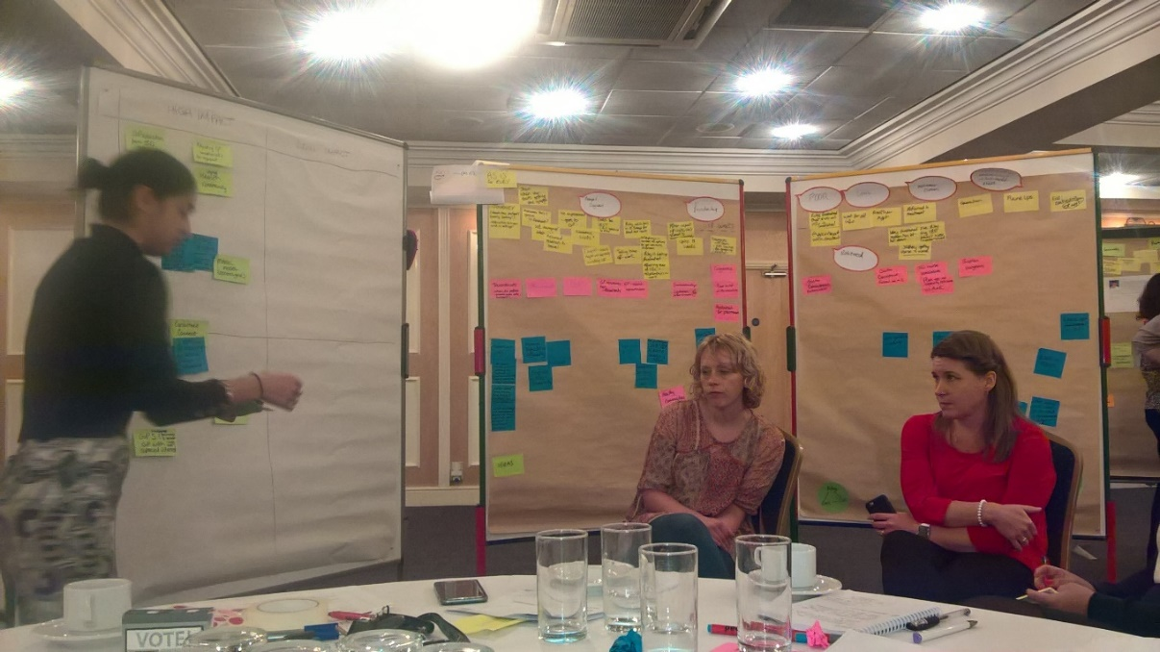





https://www.youtube.com/watch?v=dQqJFVJMbiU&feature=youtu.be
GIVE YOUR WORKFORCE THE
TRAINING AND TOOLS
Shift from ‘doing to’ to ’working with’
100 Day Challenges

Slide 12
To realise our objectives to build different relationships in and with our communities
A group of leaders from across many organisations wanted to see if we can have a common narrative, a common set of principles to reflect our collective commitment to working together in a positive collaborative way
Stockport Systems Leadership Group formed, May 2016
“Through the decisions we make together and the examples we set we give visible leadership to work aimed at shifting the balance of power and responsibility from public bodies to communities and citizens”
‘The Stockport Way’
Success means
“An ensemble of thriving, self sustaining community groups which means wet Sundays are no longer lonely days” Dr Donna Sager, DPH, Stockport Together

Slide 13
Breaking free from the Vertical Change Debate acknowledge the Solace Group
TOP DOWN
OUTSIDE IN
BOTTOM UP
Must see beyond established practice, away from the service prism through which we conceive the problem, and admit disruption into the system

Slide 14
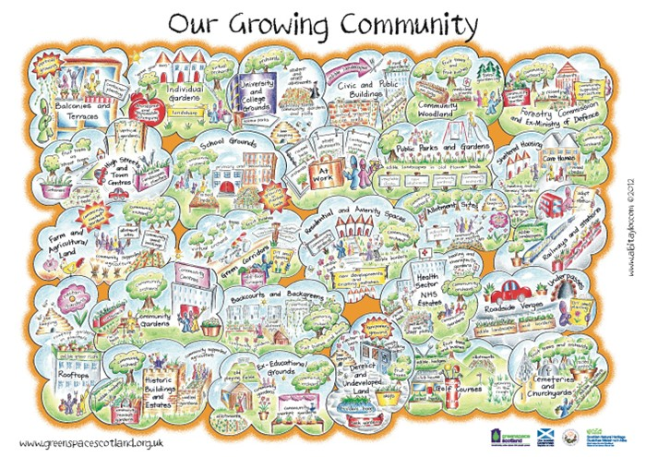
Communities are complicated!
Communities of :
interest,
place,
action,
practice
circumstance
Services tend not
to understand
Not always benign
Many faceted
Notes:
Interest. Communities of people who share the same interest or passion.
Action. Communities of people trying to bring about change.
Place. Communities of people brought together by geographic boundaries.
Practice. Communities of people in the same profession or undertake the same activities.
Circumstance. Communities of people brought together by external events/situations.

Slide 15
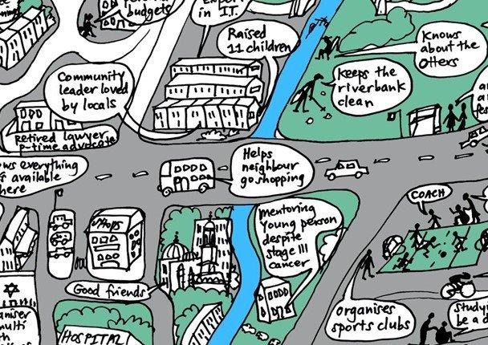

Slide 16
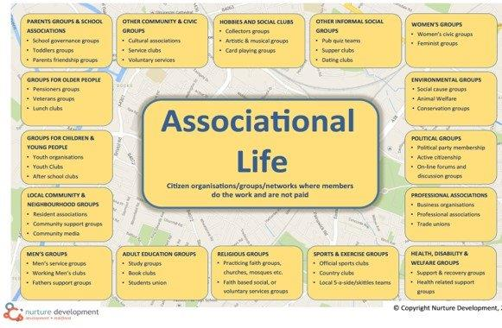

Slide 17
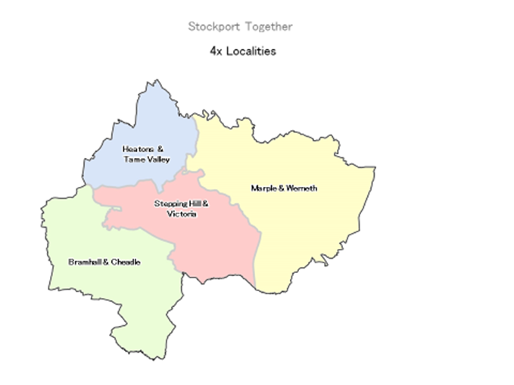
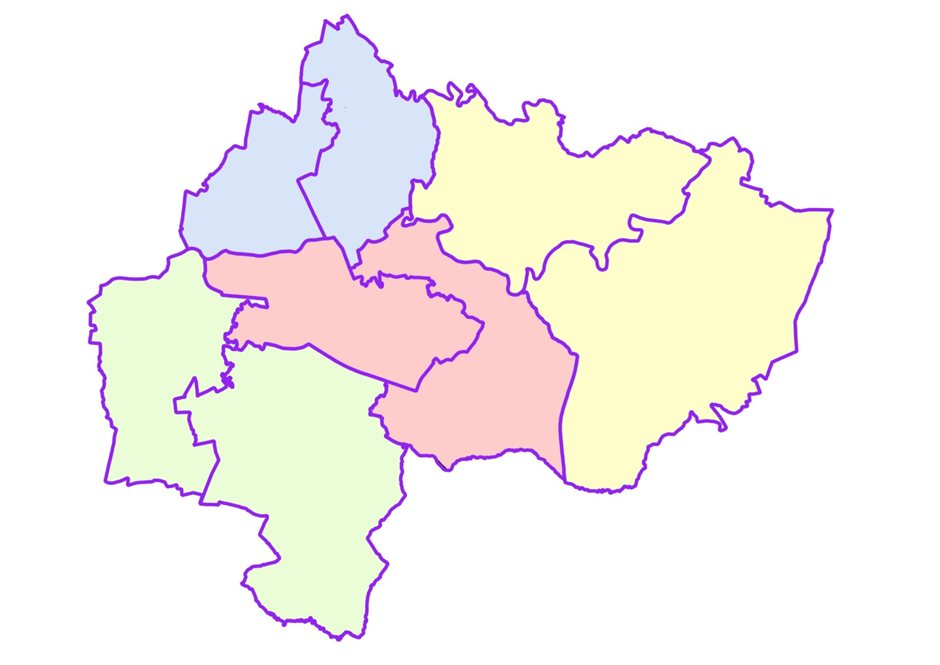
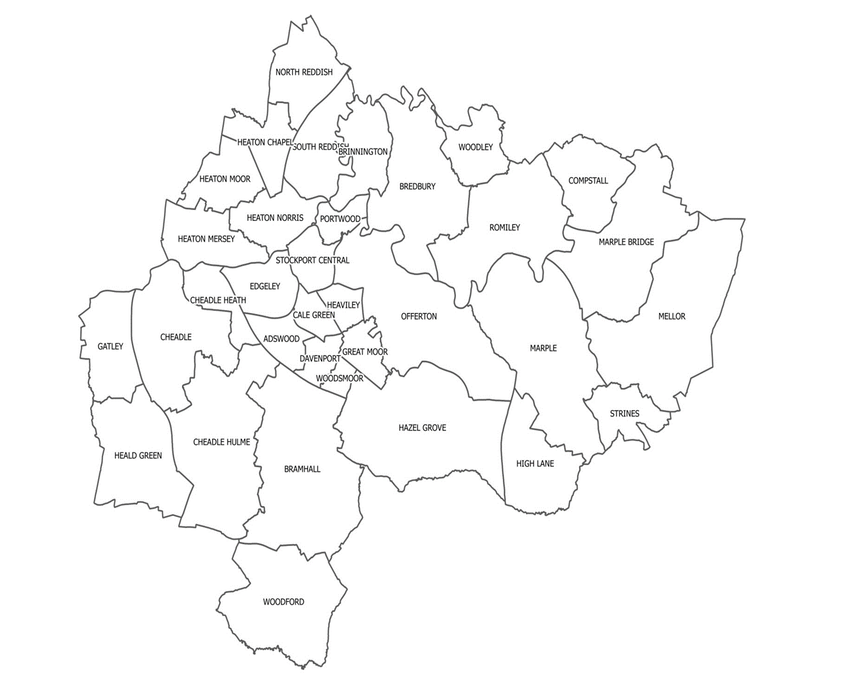
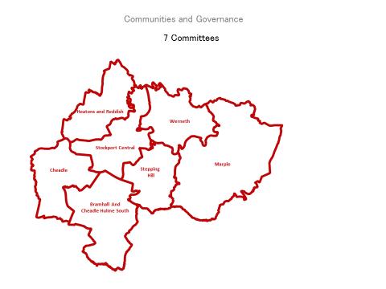
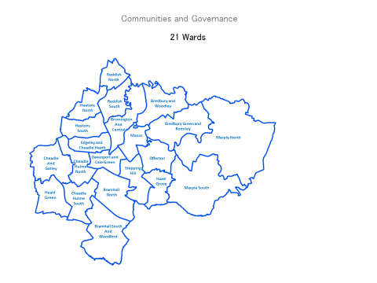
How services divide Stockport
What makes sense to people

Slide 18

The Liminal Space (acknowledge Altogether Better)
Between the ‘Life World’ and the ‘System World’, the land and the sea, the world of people and the world of the NHS and care
The great divide- language, behaviours, priorities, custom and practice, relevance
We must bridge the divide, come together on the beach and design together the solutions to the loneliness and distress which is overwhelming the system

Slide 19

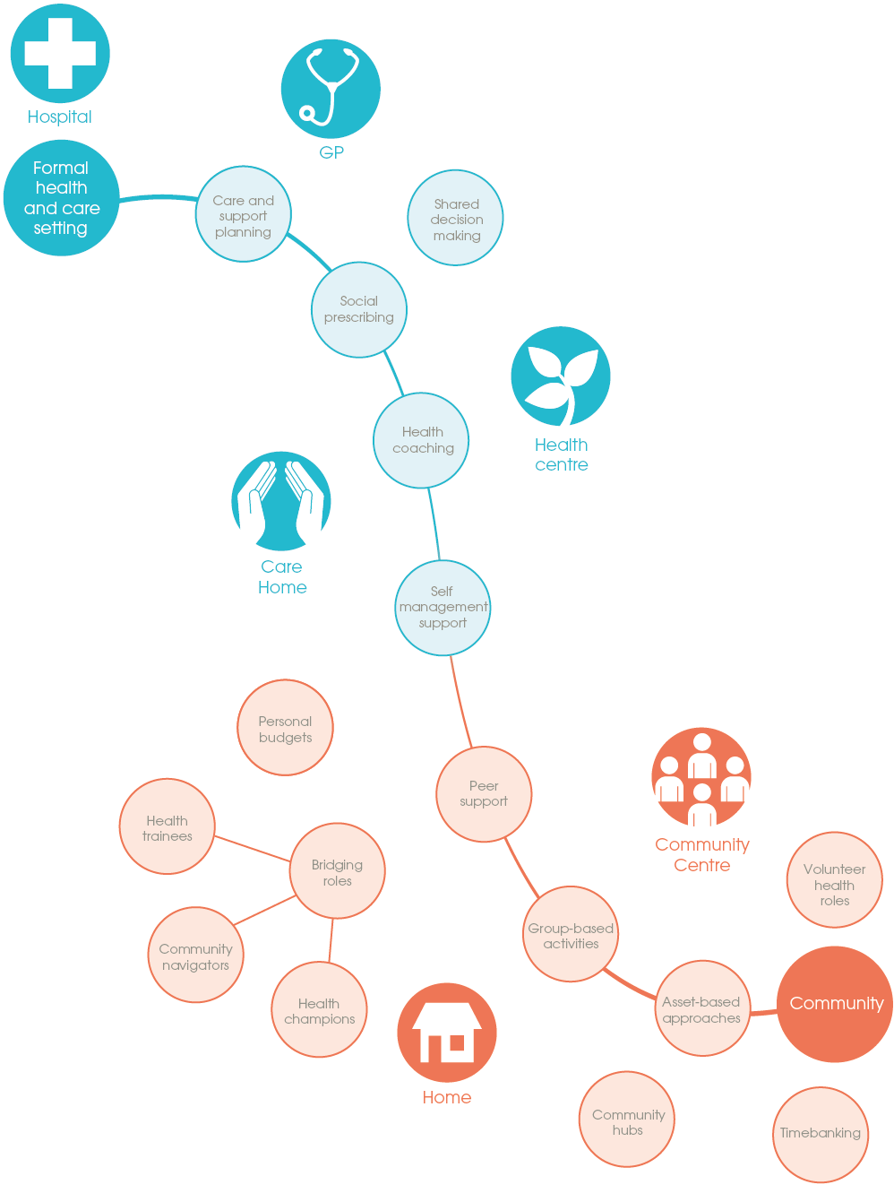
Some examples
of our person- and
community-centred
approaches
The Collaborative Practice (Altogether Better)
Community Anchors and Local Area Community Connectors
Give2GainTimebank
The Gossip Girls
The Good Gym
Realising the Value: Ten key actions to put people and communities at the heart of health and well-being: p 14
Notes:
FAT

Slide 20

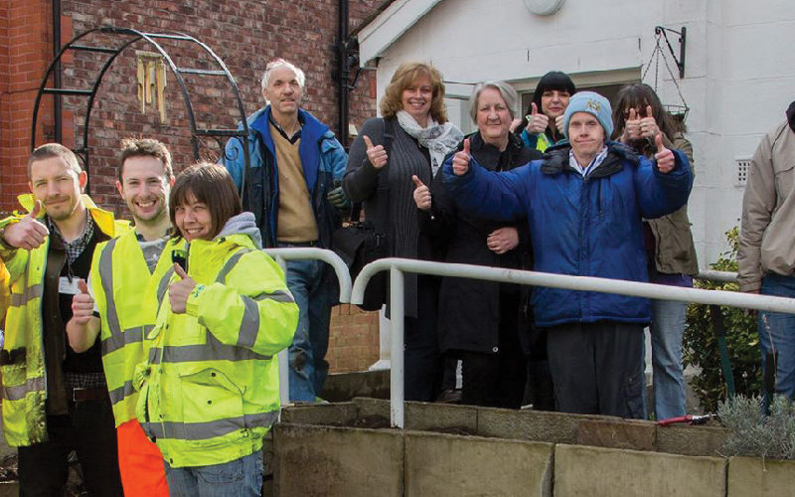
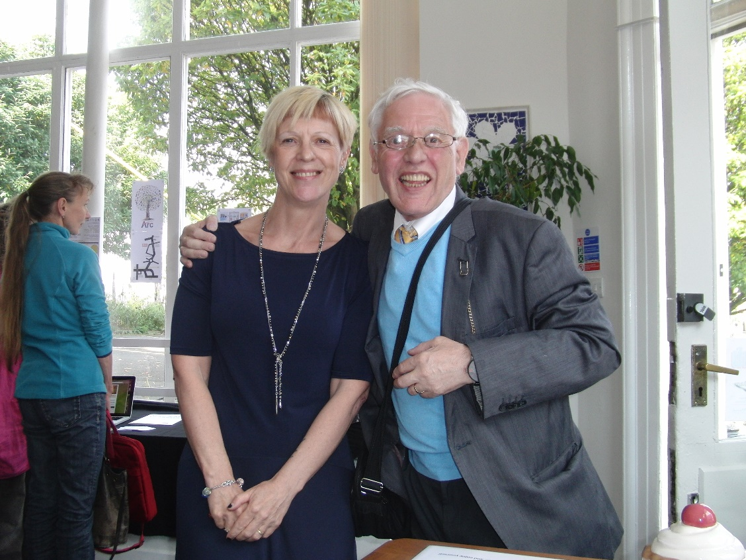

Slide 21



Place based health and community networks
Bridge Place and Health: connect to primary care and the Integrated Neighbourhood Team
Rich resource in the Community and the Voluntary sector
Go where the fires are burning
Use the community hubs which exist- understand the community
Hold community conversations brokered by others “the Council kills it”
Faith Groups, Businesses, Arts, Housing, Leisure, Fire
DEVELOP PLACE-BASED HEALTH AND COMMUNITY NETWORKS OF SUPPORT

Slide 22
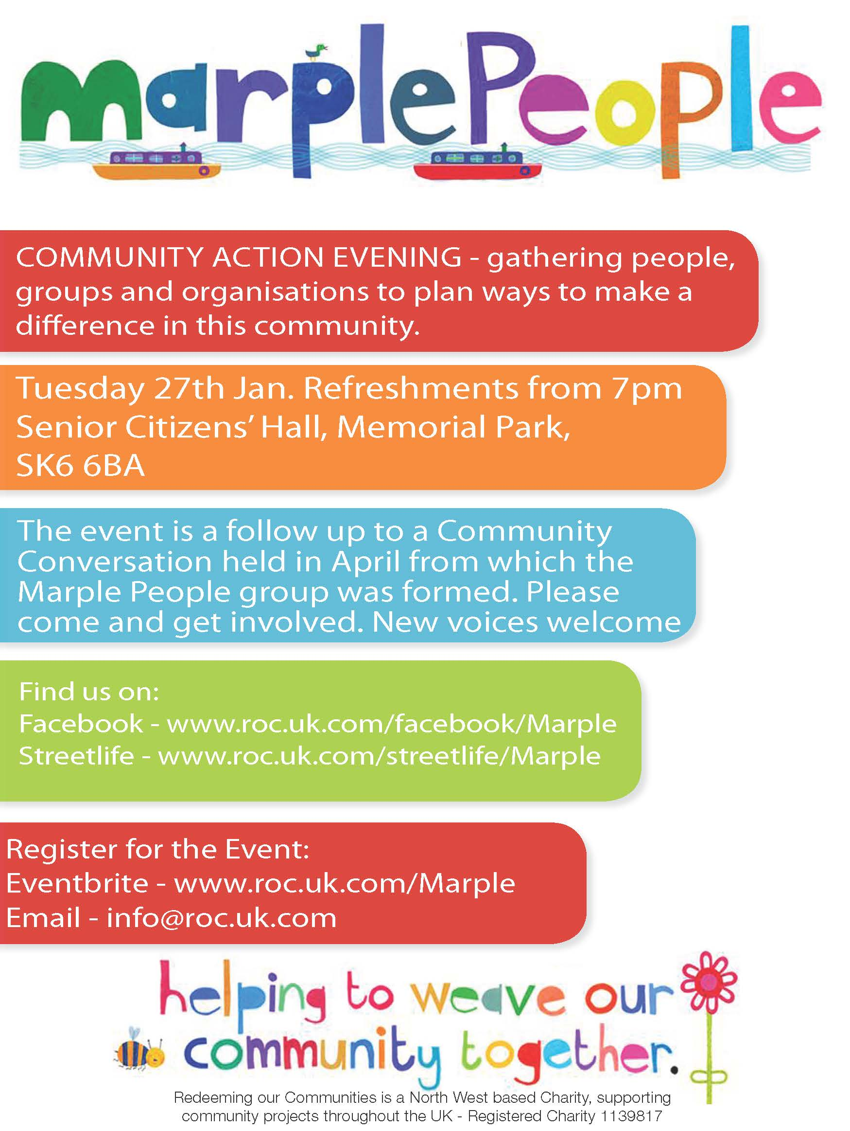
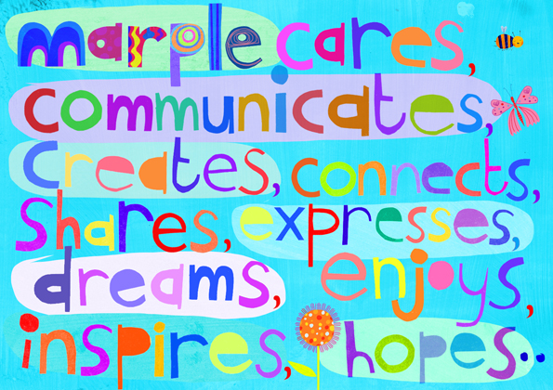
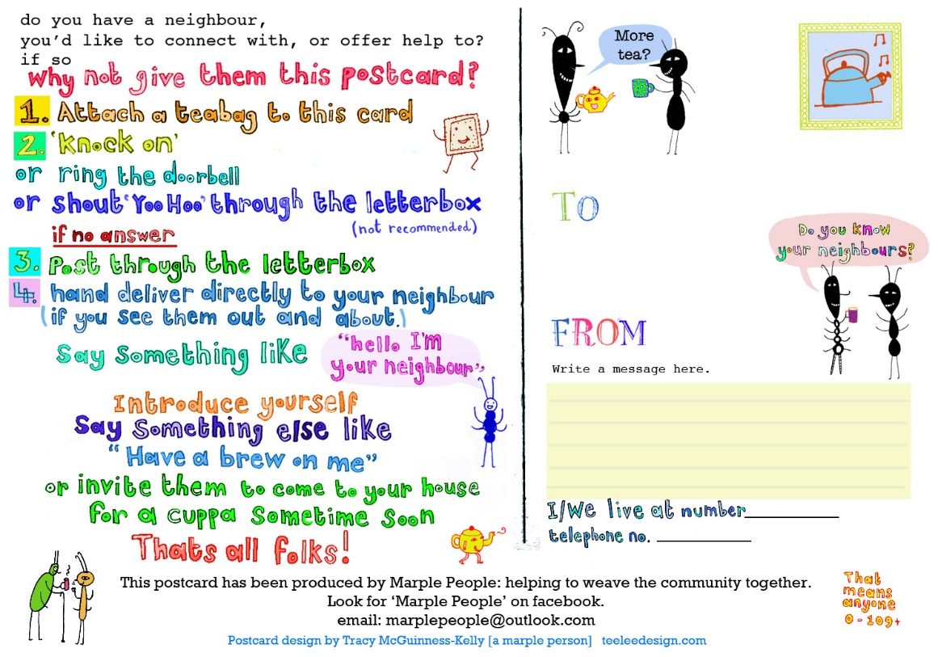

Slide 23
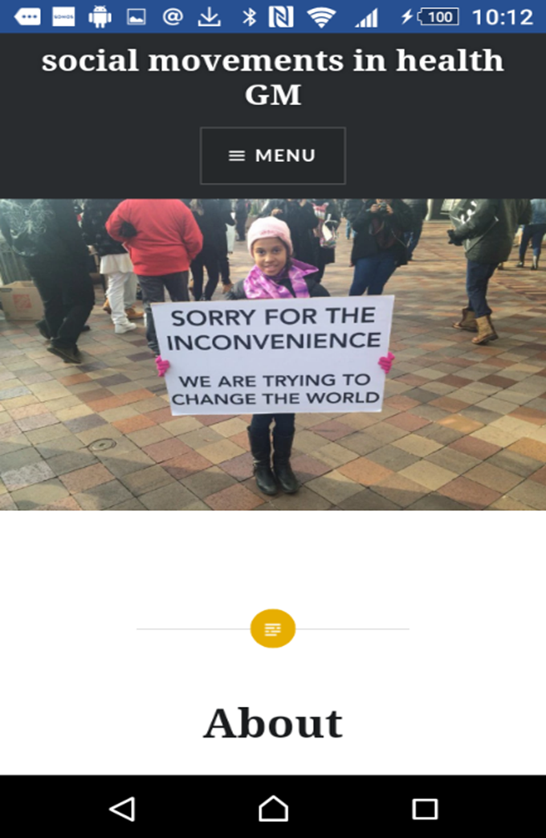

Health as a social movement https://socialmovementsinhealthgm.com
Activated patients taking more responsibility
People who are confident, empowered and knowledgeable can lead, direct and be involved in change.
More aware citizens wanting change
Community champions and conversations
Tap into the passion and compassion inherent in communities; loneliness- an unnatural disaster
PROMOTE HEALTH AS A SOCIAL MOVEMENT
PROMOTE HEALTH AS A SOCIAL MOVEMENT

Slide 24

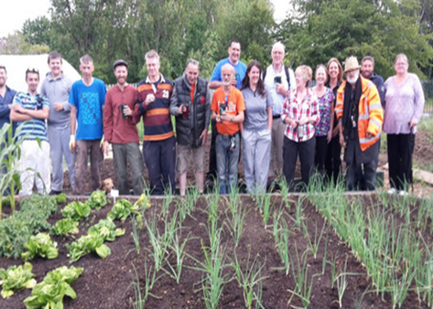

Stockport Together – social movement building
Working out of Stockport and linking across the GM boroughs of Tameside and Oldham (with strategic leadership support)
Focusing on loneliness and isolation
Exploring and stimulating Arts and Food movement activity
Supported by Small Sparks grants facilitated through Action Together

Slide 25
An illustrative person and community centred model

Slide 26
Heatons Place Based Integration Pilot
One of the eight identified Health and Care Neighbourhoods
4 very bespoke communities
Immerse in the communities, use an appreciative inquiry approach
Build relationships and codesign around improving health and wellbeing
Small sparks funding
Local neighbourhood connectors and community anchors
Celebrate outcomes

Slide 27
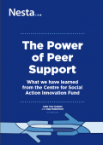

In conclusion: our strategy
Develop the formal and the informal access offer
Map and understand the neighbourhoods, build relationships
Identify who are our ‘Community Builders’ in each neighbourhood
Build trust with the community activists and beyond
Small sparks funding to enable the community offer to grow- seek a ‘thick participatory culture’
https://www.theguardian.com/commentisfree/2017/feb/08/take-back-control-bottom-up-communities
Grow peer support, self management, primary care prevention
Provide information and advice, signposting, digital hubs, link to the VS prevention services
Link identified need to the clinical system when appropriate
Connect back to community to grow resilience
George Monbiot

