Slide 1
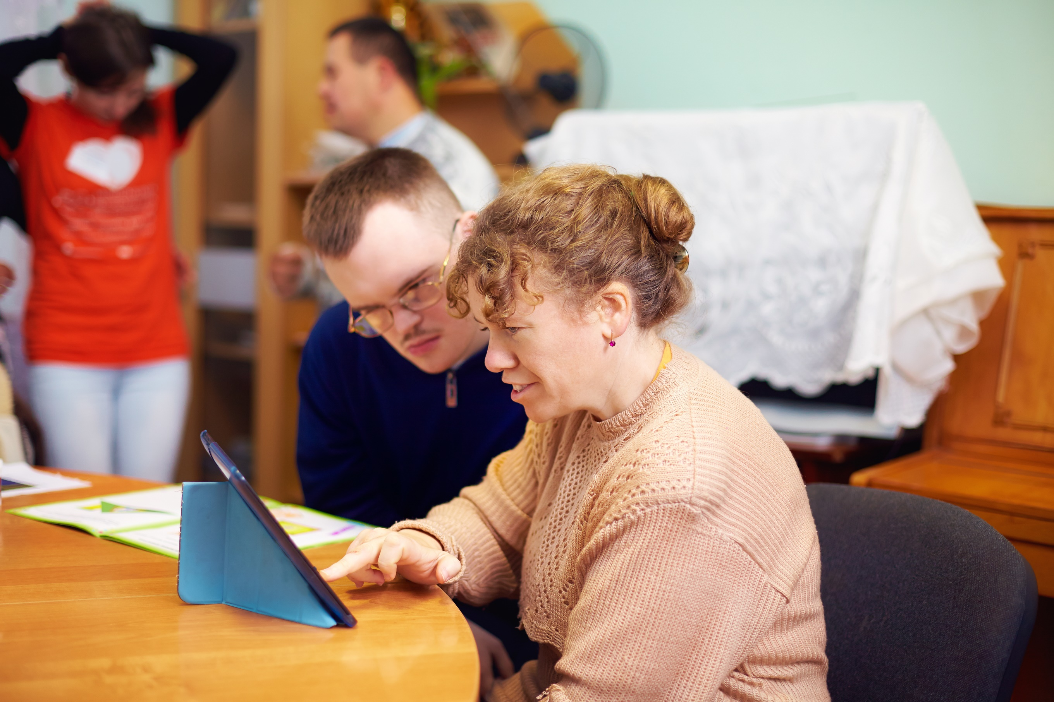

How do we measure wellbeing and what do we know?
Ingrid Abreu Scherer
TLAP - 6 September 2018

Slide 2
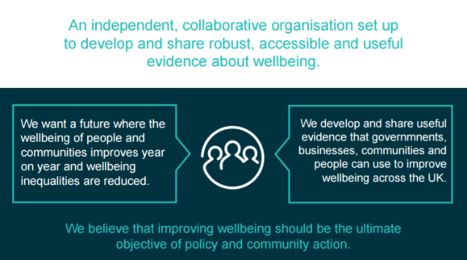




What Works Wellbeing | Volunteering
What Works Centre for Wellbeing

Slide 3
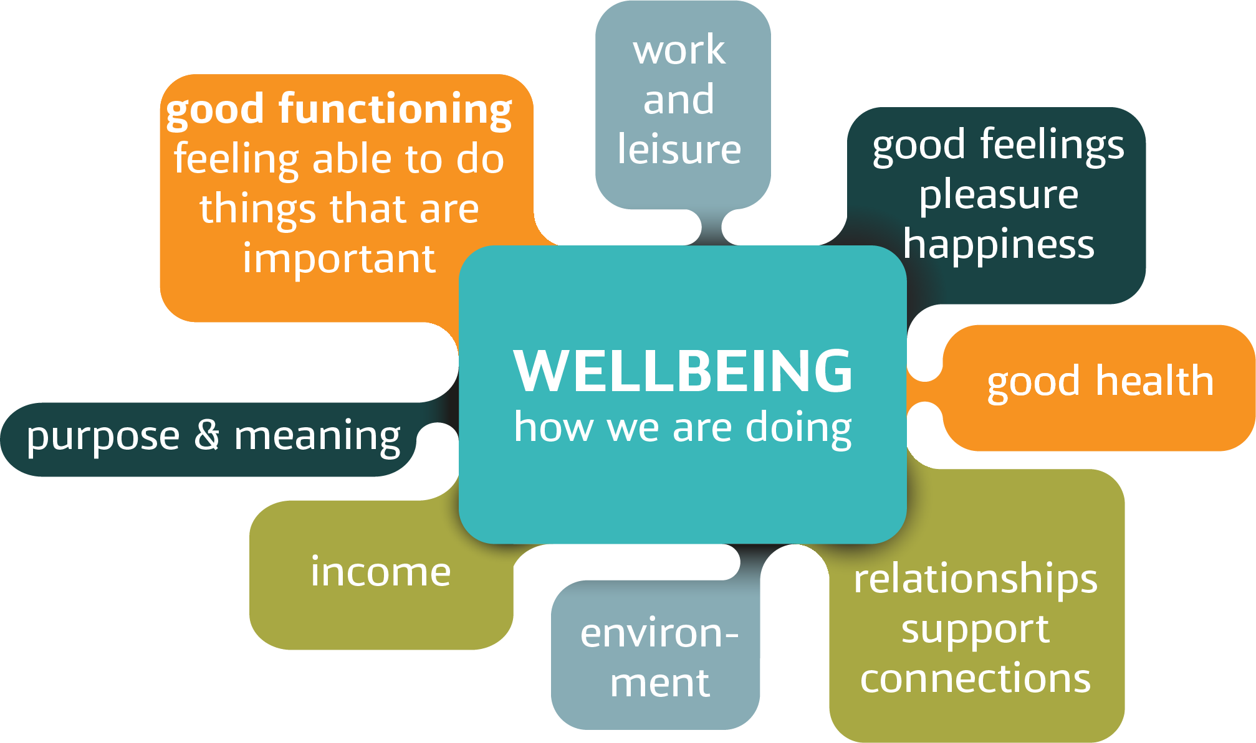
What is wellbeing?
What is wellbeing?
not just about how things look from the outside, but how we feel in ourselves
how we experience life – quality of life, good physical and mental health, and being part of our communities
how external conditions affect our lives and how we function in society
should be measured using both
objective and subjective measures
Notes:
Wellbeing is ‘how we’re doing’
It’s how we experience life as a whole.
It’s about how external conditions affect our lives and how we function in society.
Everything in our lives can affect our wellbeing, but some important aspects are income, work, the things we do, our health, relationships, environment, and communities.
What affects wellbeing is different for everyone. So, no matter how many positive things we have in our lives, if we don’t feel or experience our lives going well, we can’t describe them as truly going well.
We should ask people directly how they think their lives are going, not just try to measure what we can observe.

Slide 4

What matters for wellbeing?

Slide 5
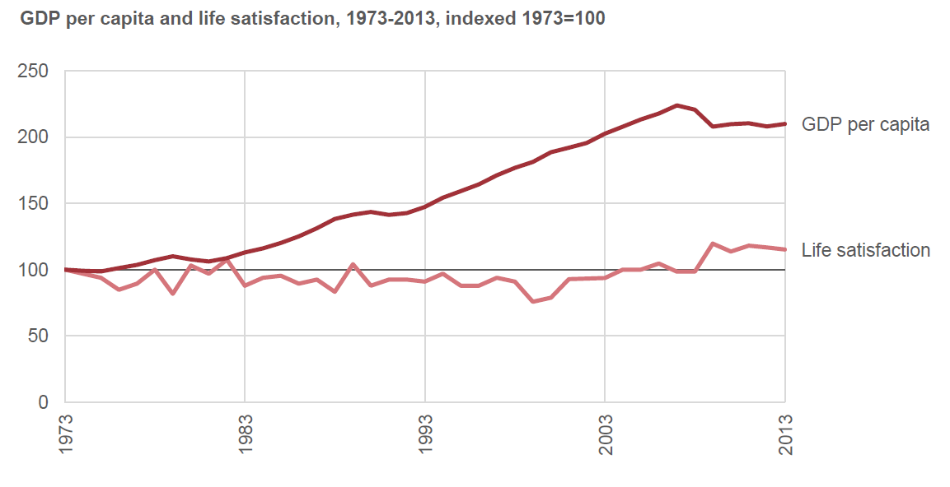
What Works Centre for Wellbeing
Money – but only to a certain degree

Slide 6
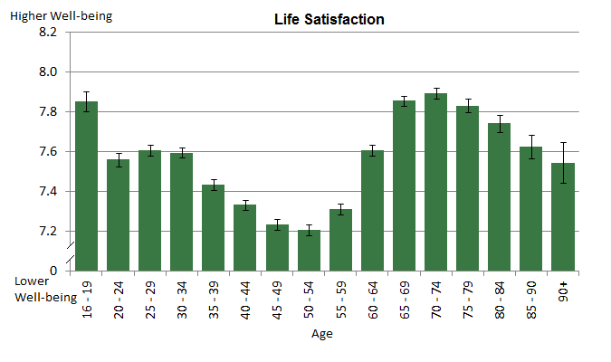
What Works Centre for Wellbeing
Changing circumstances/priorities over life
Notes:
Average life sat 2012-2015, UK
ONS

Slide 7
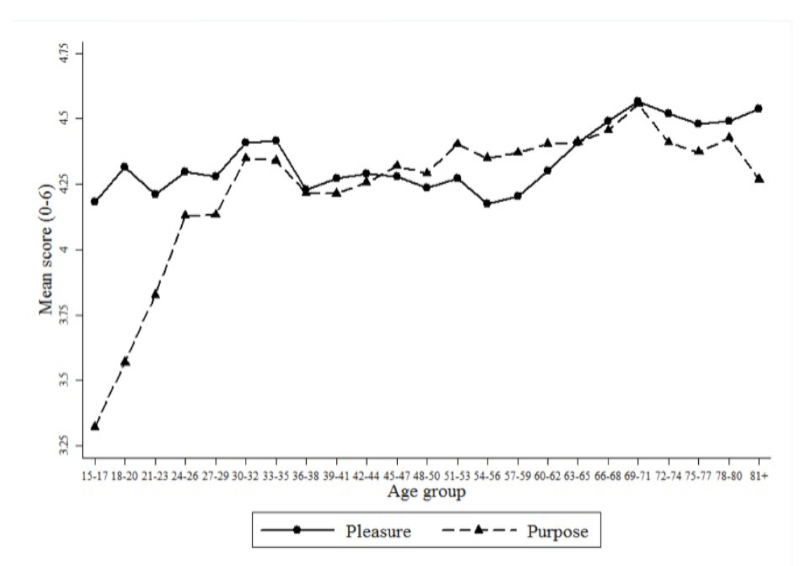
What Works Centre for Wellbeing
Pleasure and purpose
Feelings of pleasure and purpose are important to wellbeing
But the balance of those dimensions varies across our lives
For teenagers, pleasure seems to be more important to wellbeing than purpose
For people in middle age, the opposite is true
Feeling that our lives have meaning, and that the things we do are worthwhile is important in middle and later life
Notes:
Dolan, P. and Kudrna, L. (2016). Sentimental Hedonism: Pleasure, purpose, and public policy. In Vittersø, J. Handbook of Eudaimonic Wellbeing. Springer.
Figure 3: ‘Pleasure’ and ‘purpose’ ratings by age in the American Time Use Survey
---
Different activities – diaries

Slide 8

What Works Centre for Wellbeing
What else matters, and how much?
Selected factors and link with Life Satisfaction
But it depends on the characteristics of the job. Those with greater stability, clarity and social relations tend to be best for wellbeing
Greater positive link with wellbeing
Partner relationship
Trust
Employed
S’one to rely on
Greater positive link with wellbeing
Music
Physical activity
Green Space
High qual work
Smaller positive link with wellbeing
Smaller positive link with wellbeing
Personal
Having a child
Wider environment and play
Years of Educat’n
Work
Mixed evidence or no effect
Noise pollution
Air pollution
Longer Commute
Low-qual work
Smaller negative link with wellbeing
Poor health
Loneliness
Basic needs
Smaller negative link with wellbeing
Unemployed
Greater negative link with wellbeing
Greater negative link with wellbeing
Note that this is not a meta-analysis, but rather a selection of independent variables from selected studies.
Greater +ve and -ve effect demonstrate where selected studies have shown a greater than +/- 5% link with overall wellbeing.
Smaller +ve and -ve effect shows a 1-5% link with overall wellbeing
Notes:
Different conditions have different effects on wellbeing. We know that employment, strong relationships, and trust are key to good wellbeing,
while bad health, a lack of basic needs and unemployment are bad.

Slide 9
What Works Centre for Wellbeing
What else matters?
Relationships
Relationships are important for both individual and community wellbeing
For individuals - having a partner is as good for you as being made unemployed is bad for you
On a national level - social support is a big factor in explaining the variation between countries
In communities, relationships protect people from the effects of shocks
Genes: we can trace between 30% and 50% of the variation in our happiness to our genetic make-up
Childhood experiences including emotional health, family conditions & schooling affect us throughout our lives
Health: mental and physical health, disability and resilience to changes in health
Security: including financial security, feelings of safety, and if we have networks of support
Autonomy, participation and control: the ability to influence the things that matter to us
Growth: a feeling of progression throughout life may be acquired through learning new skills or progress in the workplace
Daily experiences in our lives: beauty, culture, art; positive moments of connection; moments of 'flow' (being deeply absorbed in an activity)

Slide 10

How do we measure wellbeing?

Slide 11
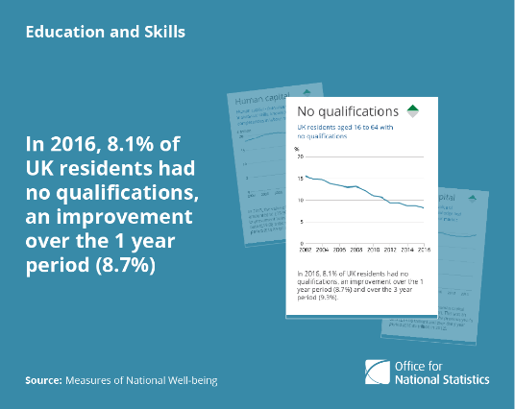
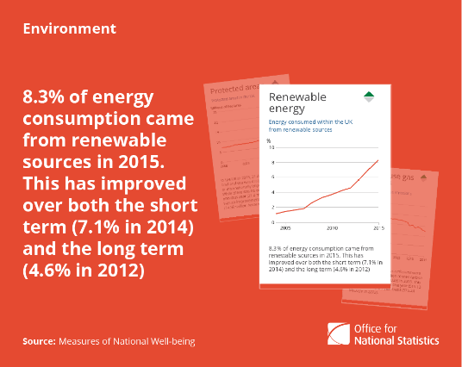
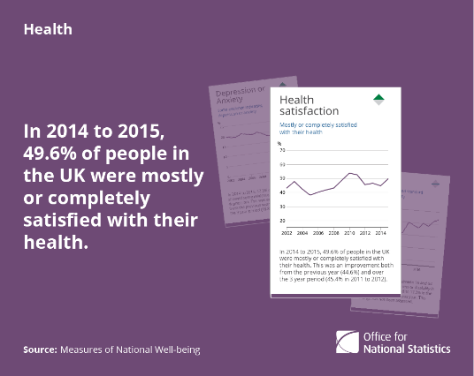
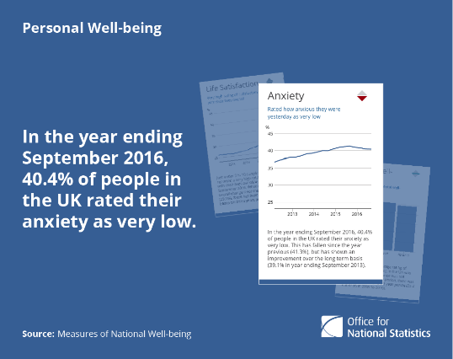
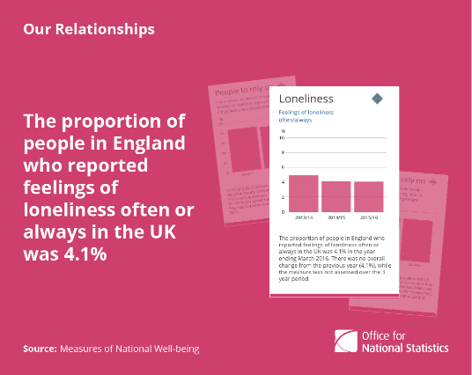
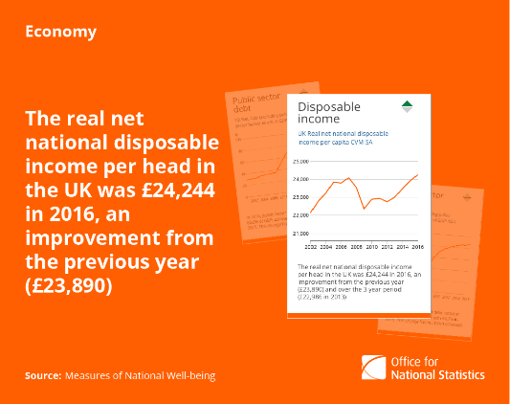
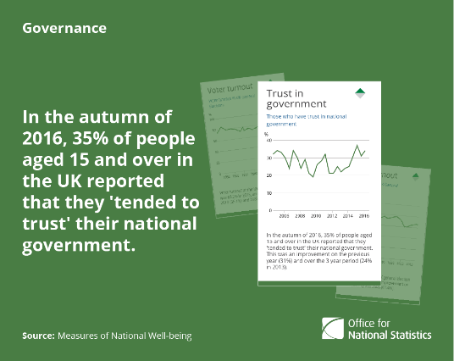
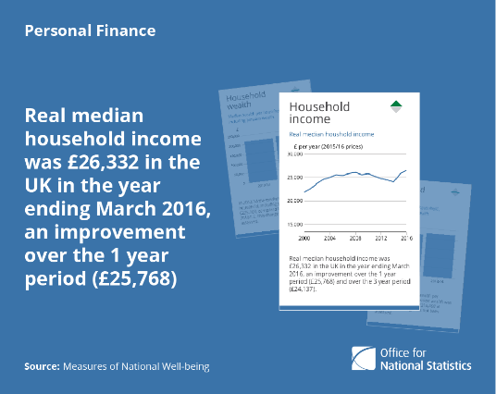
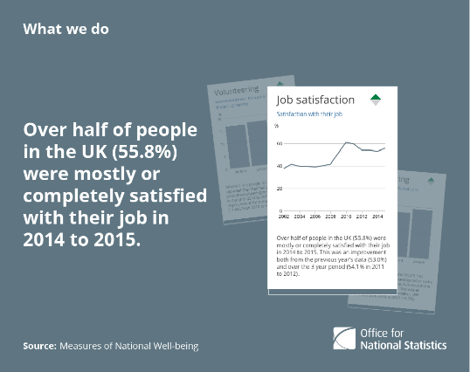
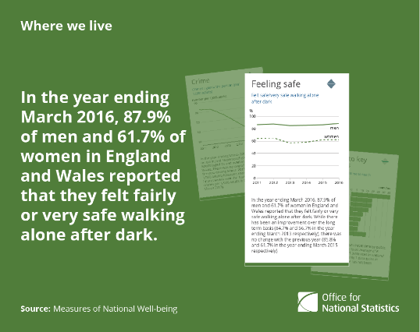
What is wellbeing?
ONS Wellbeing Framework – informed by public debate
‘how we are doing’
as individuals, communities and as a nation
and how sustainable this is for the future
Notes:
The work of the Centre builds on the National Debate from 2010 and the subsequent measurement by ONS.
41 indicators – 4 subjective experience of wellbeing

Slide 12
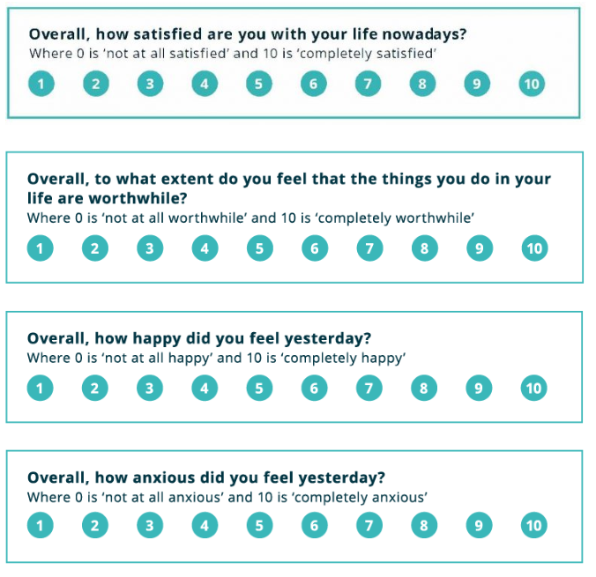
What is wellbeing?
How do we measure wellbeing?
Measures overall evaluative perspective
Measures positive feelings and experiences (affect)
Measures purpose and functioning (eudemonia)
Measures negative feelings and experiences (affect)
Notes:
“I would like to ask you questions about your feelings on aspects of your life. There are no right or wrong answers.”
4 questions measuring key domains
Subjective well-being can be thought of as a positive state of mind in which a person feels good about life as a whole and its constituent parts, such as their relationships with others, the environments that they inhabit and how they see themselves.
2 reasons why measuring wellbeing of people directly is really important.
It’s just better to ask people themselves, they are the best judge of their own experience. Both as a principle in and of itself, but also because it gives us a better sense of what is actually meaningful for people.
Ultimately - Objective circumstances don’t always match subjective experience. Crime vs fear of crime, Growth vs feeling better off, Employment vs job satisfaction, Health vs satisfaction with health, Isolation vs loneliness.
Also because we have more than 41 indicators, many of which are at the community level, how can we identify vulnerable groups? People feel differently about different aspects of their lives – and yet we have no way of ‘weighting’ the different indicators for different people – however people can do this internally, with subjective wellbeing questions reflecting that internal weighting.
We have been asking these questions in our national surveys since 2012. The sample size is now approximately 320,000 respondents. It has the largest coverage of any household survey and allows the generation of statistics for small geographical areas. Uses data from the Labour Force Survey (LFS) the data sets consist of 12 months of survey data and are broken down on a quarterly basis the first APS data set was published for the period January to December 2004. The APS is not a stand-alone survey; it uses data combined from 2 waves of the main Labour Force Survey (LFS), collected on a local sample boost. These boosts are sponsored by the Department for Pensions (DWP), Department for Business, Innovation and Skills (BIS), the Welsh Government and the Scottish Government. There are also many other central and local government users of the APS data.

Slide 13
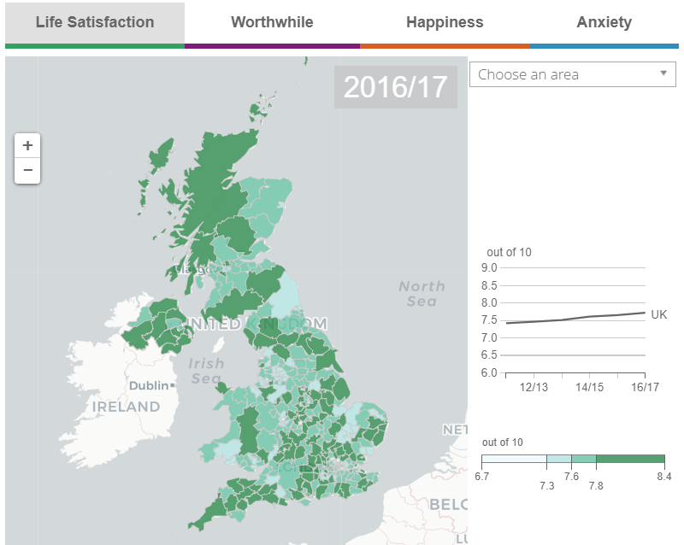
National wellbeing
How are we doing?
Continued, but small, improvements in life satisfaction, feelings of purpose, and happiness; no change in reported anxiety levels.
England driving wellbeing increase: only UK country with any changes in average wellbeing over this period.
Low wellbeing remains proportionally same: proportion of people reporting low ratings unchanged since September 2016
Women higher wellbeing but also anxiety
Specific age groups seeing continual improvements: Improvements for all measures of personal wellbeing for those aged 30 to 34, 40 to 59 and 65 to 69 years, since we began measuring personal wellbeing in 2011.
Notes:
https://www.ons.gov.uk/peoplepopulationandcommunity/wellbeing/bulletins/measuringnationalwellbeing/april2016tomarch2017
--
Sept 2016 – Sept 2017
Life satisfaction
How satisfied are you with your life nowadays?
Where 0 is not at all and 10 is completely
London lower average ratings of life satisfaction, anxiety & feeling things in life are worthwhile / purpose
Northern Ireland higher average ratings all personal wellbeing measures except anxiety,

Slide 14
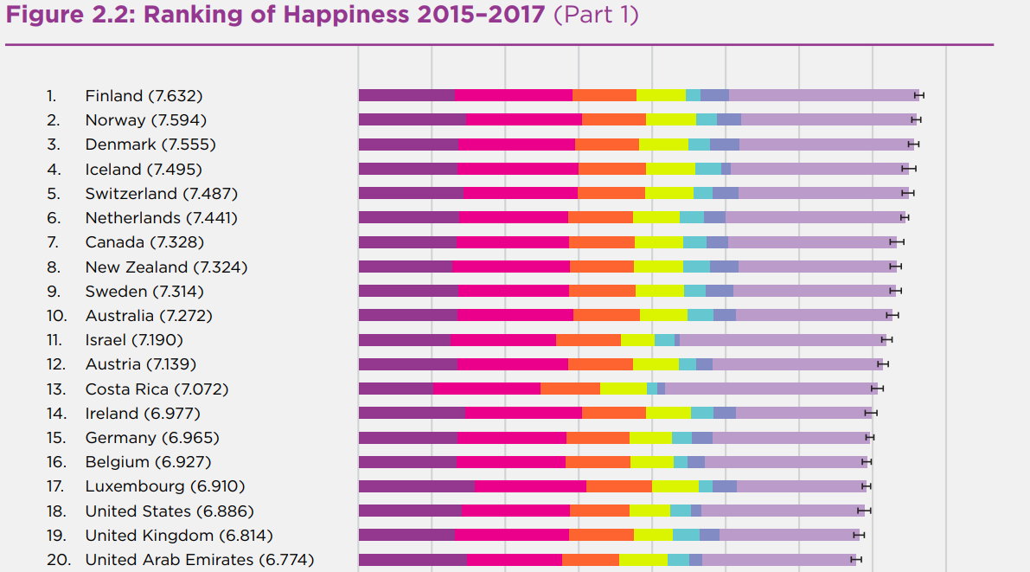
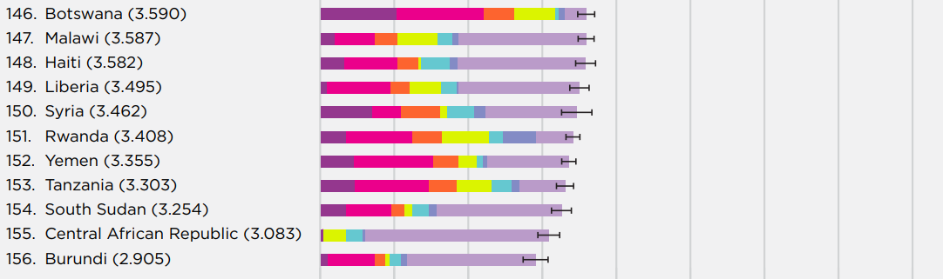

International picture
Notes:
World Happiness Report 2018
Each of these bars is divided into seven segments, showing our research efforts to find possible sources for the ladder levels.
The first six sub-bars show how much each of the six key variables is calculated to contribute to that country’s ladder score, relative to that in a hypothetical country called Dystopia, so named because it has values equal to the world’s lowest national averages for 2015-2017 for each of the six key variables used in Table 2.1.
We use Dystopia as a benchmark against which to compare each other country’s performance in terms of each of the six factors. This choice of benchmark permits every real country to have a non-negative contribution from each of the six factors.
We calculate, based on the estimates in the first column of Table 2.1, that Dystopia had a 2015- 2017 ladder score equal to 1.92 on the 0 to 10 scale.
The final sub-bar is the sum of two components: the calculated average 2015-2017 life evaluation in Dystopia (=1.92) and each country’s own prediction error, which measures the extent to which life evaluations are higher or lower than predicted by our equation in the first column of Table 2.1. These residuals are as likely to be negative as positive.

Slide 15
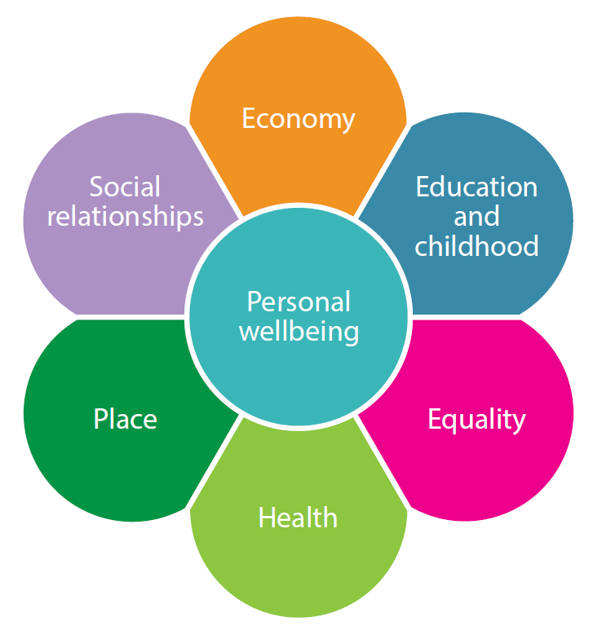
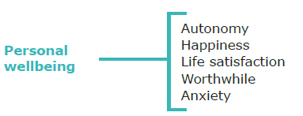

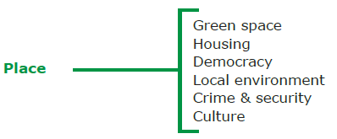
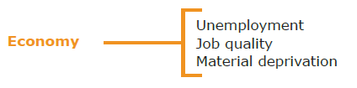

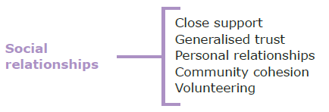

Local Wellbeing Indicators
Refining recommendations and indicator sets
Domains and subdomains
Notes:
Criteria
Potential individual indicators were assessed against the following
criteria, to determine whether to include them in the core set:
1. BROAD: each indicator should cover a large conceptual space and not be
too specific.
2. AMENABLE TO LOCAL ACTION: the indicators should measure
something that local actors, particularly local government, can aspire to
influence.
3. UNDERSTANDABLE: it should be easy for non-specialists to be able to
understand the indicator, and interpret results.
4. VALID: the indicator should accurately measure the thing it claims to
measure.
5. RELATED TO SUBJECTIVE WELLBEING: in most cases, the
indicator should measure something which is known to be associated with
subjective wellbeing.
6. MATTER TO PEOPLE: the indicator should measure something which
consultation has suggested matters to the public.
We used four further criteria for assessing the set as a whole:
7. AVAILABILITY: there should be a good number of indicators for which
data is already available at the local level.
8. COVERAGE: indicators selected for each domain should cover the main
elements of that domain satisfactorily. Key elements should not be missed.
9. ASSETS VS. DEFICITS: there should be an appropriate balance
between a distinctly ‘wellbeing’ and positive number of indicators, and
recognising that a deficit indicator can be more appropriate for some subdomains.
10. SUBJECTIVE VS. OBJECTIVE: there should be a good mix of both
subjective and objective measures.

Slide 16
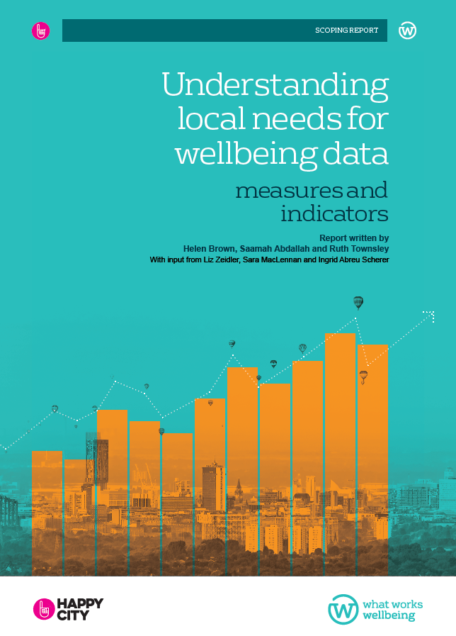
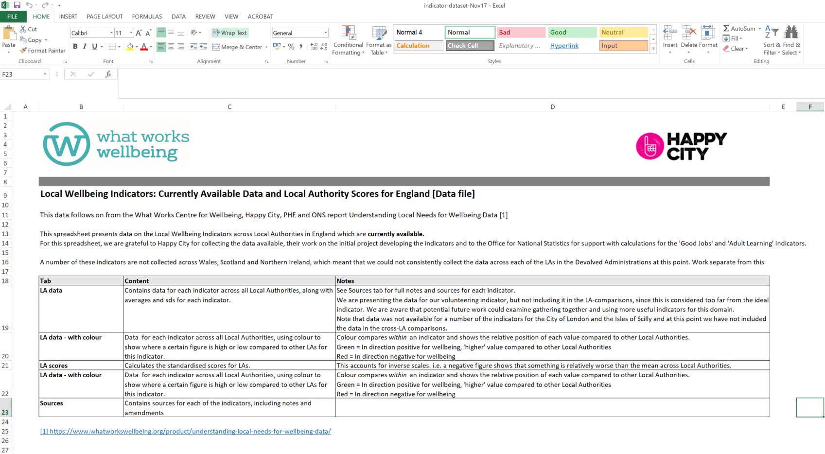
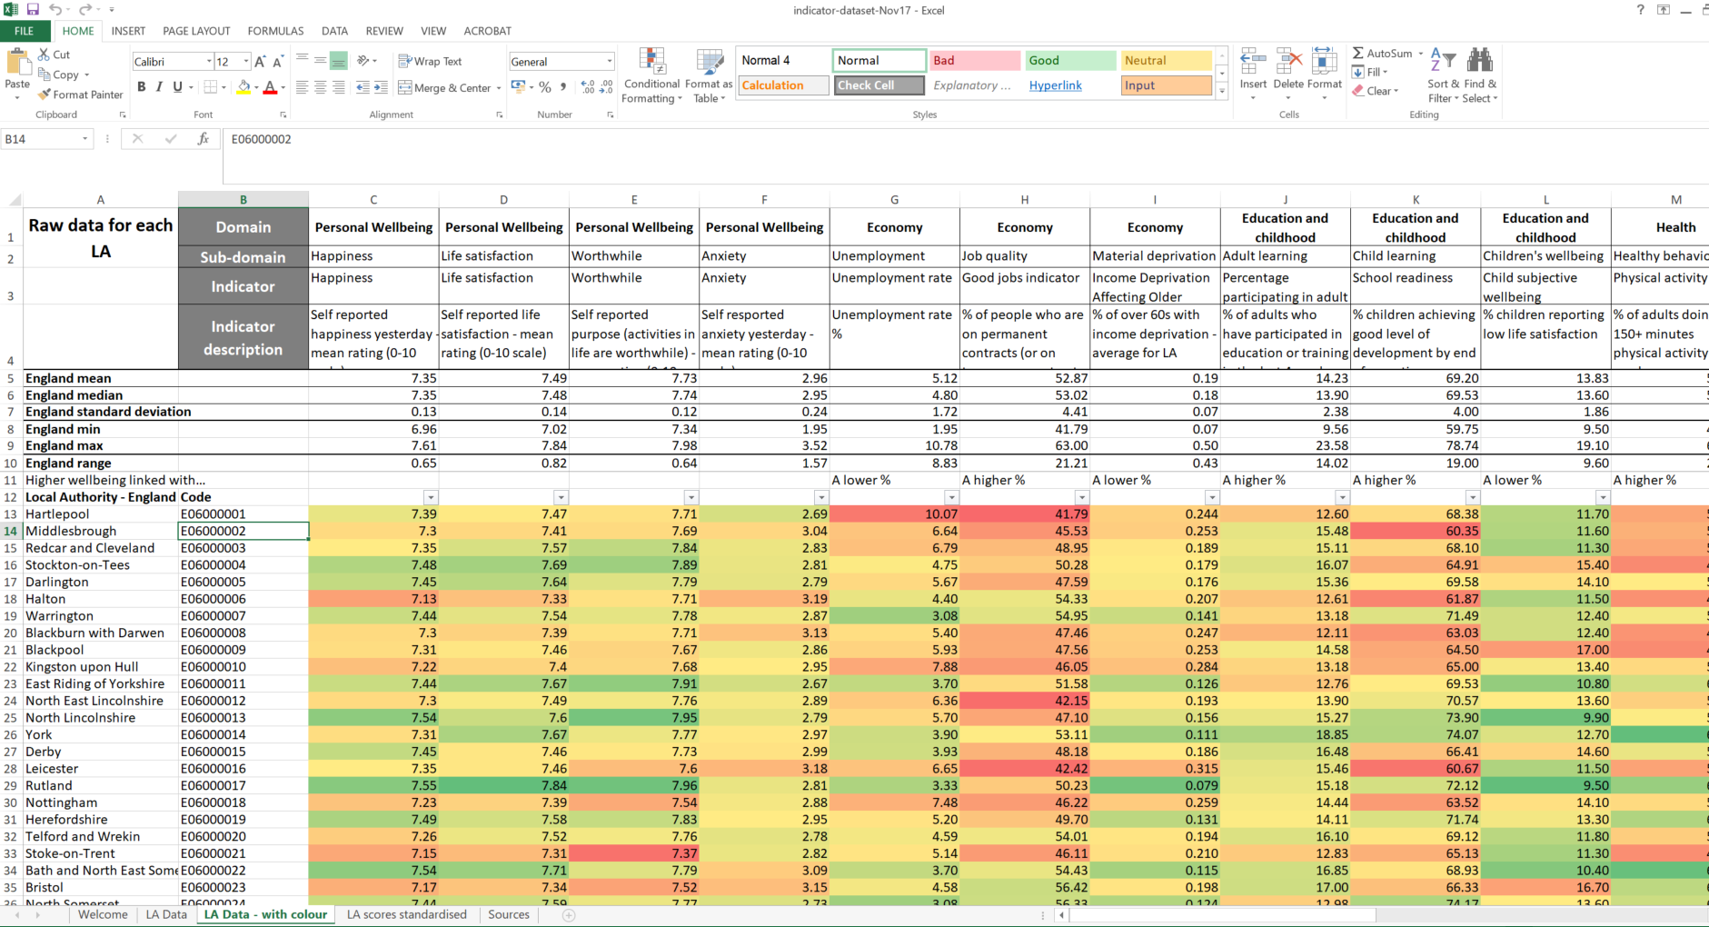
Local Wellbeing Indicators
Download the report and data
https://whatworkswellbeing.org/product/understanding-local-needs-for-wellbeing-data

Slide 17

Section | title
What is community wellbeing? | Community wellbeing
Community wellbeing
“the combination of social, economic, environmental, cultural, and political conditions identified by individuals and their communities as essential for them to flourish and fulfil their potential.”
[Wiseman and Brasher, 2008: 358]
Notes:
It’s more than just adding up the individual wellbeing scored of people in a community

Slide 18



Section | title
Community wellbeing framework
A framework for community wellbeing
Close relationships and friendships
Strong networks of support to meet different needs
Feelings of trust and belonging
People
Conditions that enable people to flourish – access to services, assets, facilities
Opportunities to enable people to flourish – jobs, education, leisure
Intangible cultural heritage, shared practices or history
Sense of safety in the community
Place
Voice and representation
A sense of control or influence over things which are important
Inclusive communities where nobody feels excluded
Power

Slide 19


Section | title
Community wellbeing framework
Two important elements
Inequality
Sustainability
The spread of individual wellbeing in a community, and the people and groups most
at risk of having low wellbeing
Sustaining wellbeing over time requires preserving natural, economic, human, and social capital
Related concept: community resilience

Slide 20

What do we know so far?

Slide 21

What we know
Volunteering wellbeing
Volunteering is linked with increased happiness – especially for those who are unhappy
Sports volunteering may be linked to stronger social connections, and social capital for young volunteers
Volunteering can give older people a sense of purpose and role identity which can lead to wellbeing
Volunteering is associated with higher life satisfaction, but not for everybody
Notes:
Binder, M. and Freytag, A Volunteering, subjective well-being and public policy. Journal of Economic Psychology Volume 34, February 2013, Pages 97-119
BRADBURY, S. and KAY, T., 2008. Stepping into community? The impact of youth volunteering on young people's social capital. IN: Nicholson, M. and Hoye, R. (eds). Sport and Social Capital. Abingdon, UK: Routledge (Taylor & Francis Group), pp.285-317
Greenfield E. and Marks N. Formal Volunteering as a Protective Factor for Older Adults' Psychological Well-being. The Journals of Gerontology; Sep 2004; 59B, 5; pg. S258
Van Willigen, M. Differential Benefits of Volunteering Across the Life Course. Journal of Gerontology: 2000, Vol. 55B, No. 5, S308–S318
---
The body of evidence points to links between volunteering and a number of other outcomes associated with wellbeing: happiness, life satisfaction, purpose and identity, social connections and social capital.
There is still work to be done to identify the causal links between these things.

Slide 22
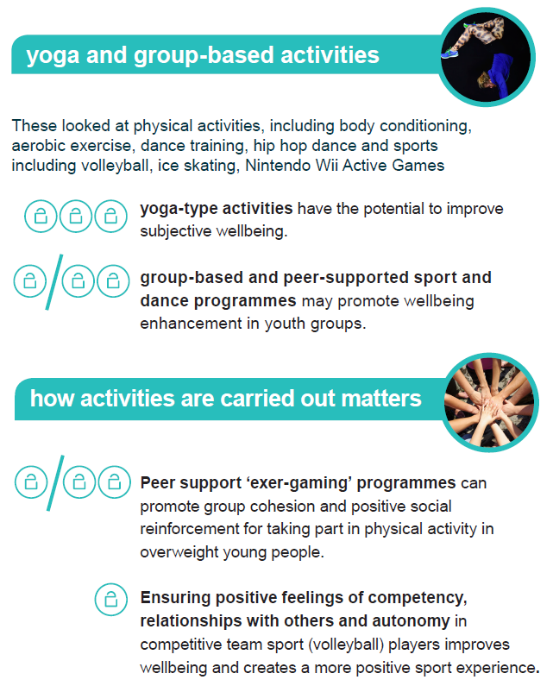

Community wellbeing | Findings

Slide 23
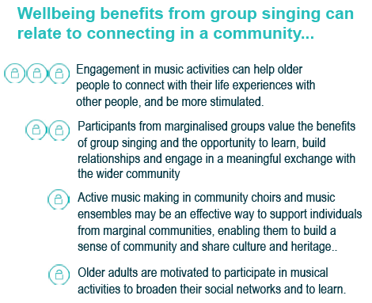

Community wellbeing | Findings

Slide 24

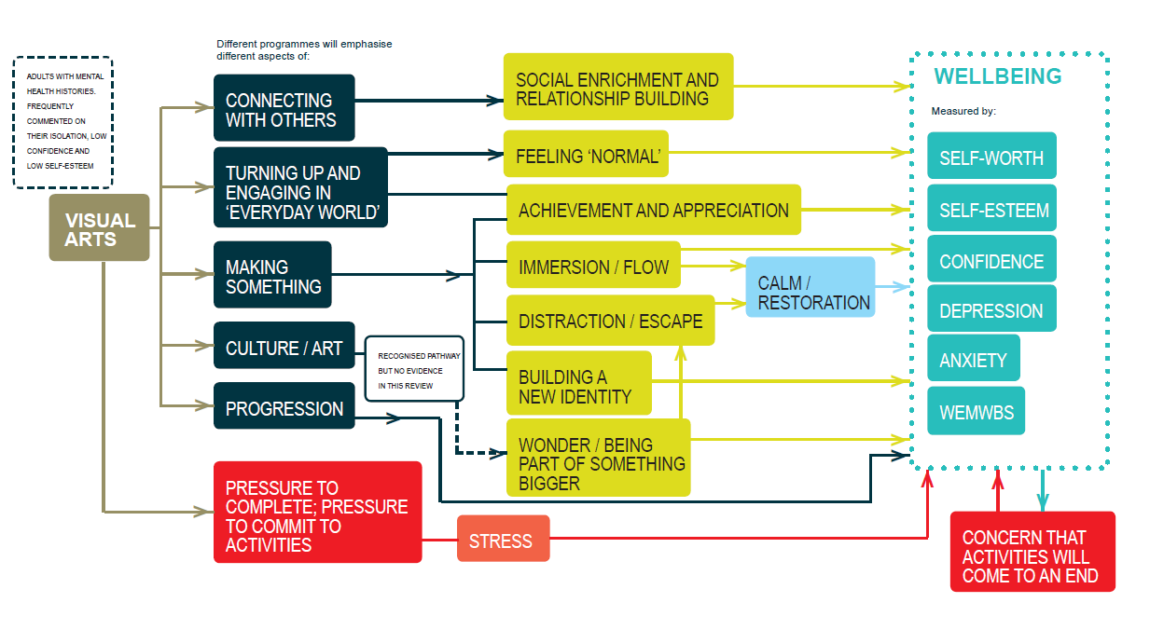
Visual Arts
Mechanisms for wellbeing
How does participating in visual art projects impact the wellbeing of adults with mental health issues?

Slide 25
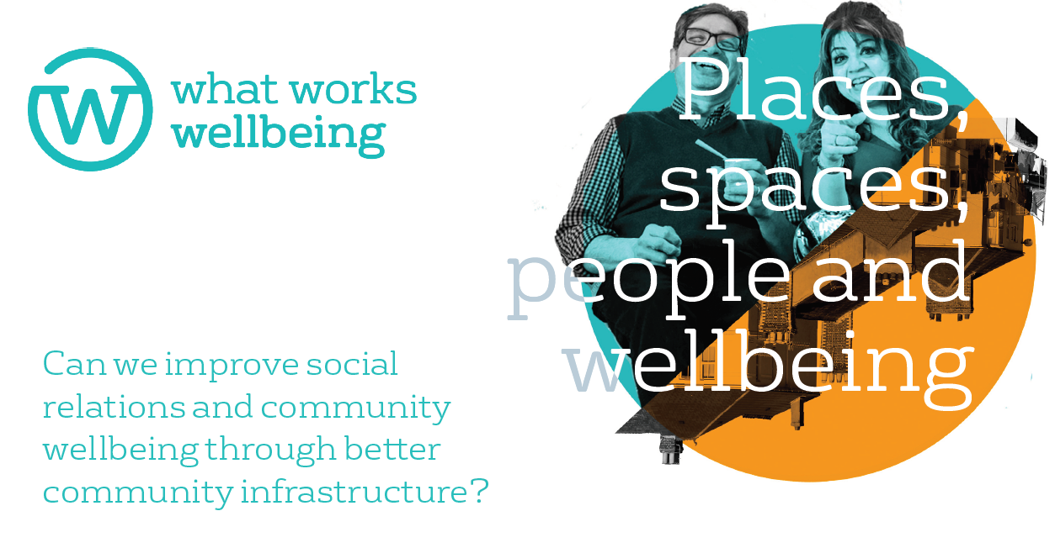

Slide 26
Key findings from scoping review of interventions
that affect social relations (2017)
Improve social relations by:
Creating good neighbourhood design and maintenance of physical spaces such as good meeting places, public parks and other spaces, public seating, and local amenities.
Increasing the number of local events such as car boot sales, markets, and street parties.
Creating ways for local people to share information such as notice boards or email groups.
Providing greater opportunities for residents to influence decisions affecting their neighbourhoods and encouraging engagement.
But:
It’s not easy to improve neighbourliness through large-scale policies. Better to encourage local understanding and action.
Gap: how does community infrastructure fit?
We sifted through 11,257 studies
and 34 were included
Notes:
Promising evidence – mostly qualitative

Slide 27
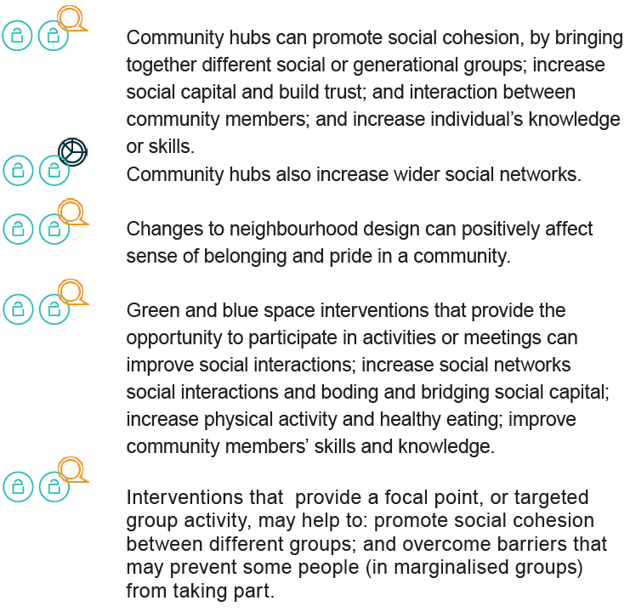
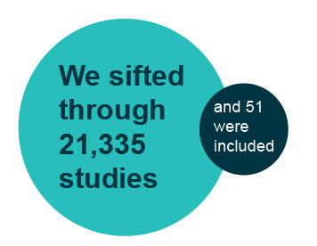
Key findings from systematic review of community infrastructure interventions (2018)
Notes:
Promising evidence – mostly qualitative

Slide 28
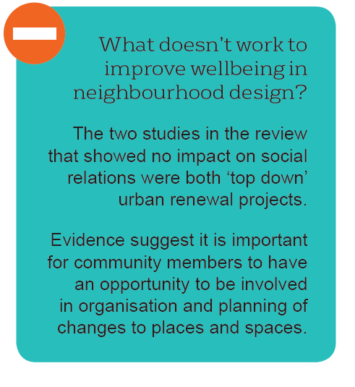
But…
Notes:
Promising evidence – mostly qualitative

Slide 29
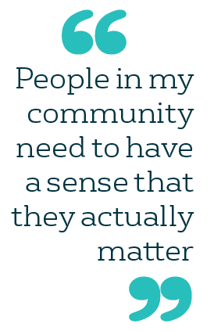
Community wellbeing | Findings
Community groups, leaders and members should
Provide an accessible, comfortable, safe, and friendly environment.
Remove barriers to inclusion, and actively reach out to the wider community, particularly when changes are designed to celebrate a particular section of the community.
Involve skilled community facilitators to ensure that all sectors of the community are represented and consensus can be reached.
Consider involving volunteers as a way of boosting long-term sustainability.

Slide 30
Community wellbeing | Findings
Funders need to keep in mind
Accessibility - Changes to places and spaces should be accessible in terms of ability, attitude, culture, finance, transport and location.
Involvement - Community members should have the opportunity to be involved in planning of changes to places and spaces.
Potential exclusion - Some changes, particularly those intended to celebrate a local community, may have the potential to leave some community members feeling excluded.
Sustainability - It is important to look at outcomes in the long-term, and sustainability.
Marginalised groups - Changes which involve a group-based activity or other reason to interact may be more successful at removing barriers to participation for marginalised groups

Slide 31
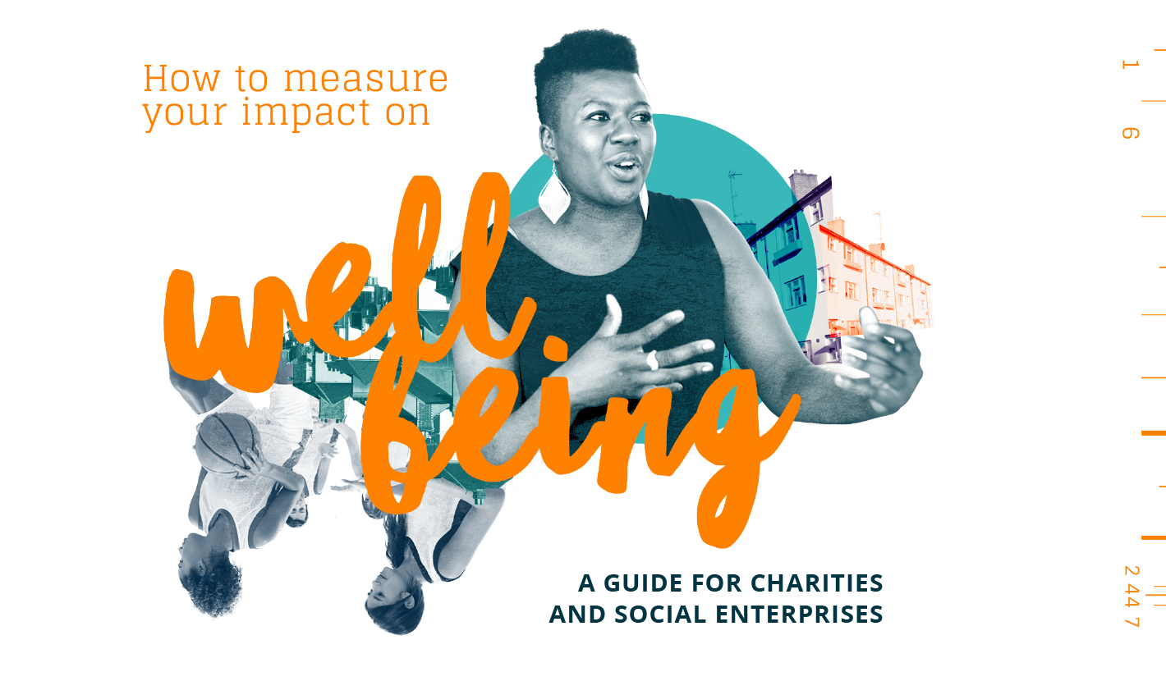
Tools and resources
Online toolkit for voluntary sector
Wellbeing explained
Measuring wellbeing
  Planning and designing evaluations
  Practical considerations
Wellbeing survey questions
  Personal wellbeing questions
  Social capital questions
  Writing your own & open questions
Survey Builder
Analysing results
whatworkswellbeing.org/measure

Slide 32


Thank you!
^{ingrid@whatworkswellbeing.org}
^{www.whatworkswellbeing.org}
^{@whatworksWB}

Slide 33
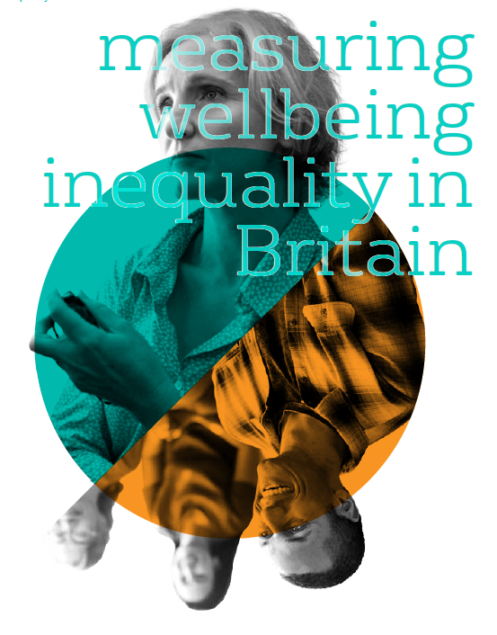
Wellbeing inequality
Measuring wellbeing inequality
Measure
average standard deviation of ONS4 ‘personal wellbeing’ questions: life satisfaction, happiness, purpose and anxiety.
Average wellbeing
Lambeth = 7.33
Sunderland = 7.36
Wellbeing inequality
Lambeth = 1.9 (top 10)
Sunderland = 2.4 (bottom 10)
Notes:
Measures are ONS4 ‘personal wellbeing’ questions: life satisfaction, happiness, purpose and anxiety.
Note that we are looking at inequality within local authorities, not between local authorities.
For example, Lambeth’s average wellbeing score is 7.33, compared to Sunderland’s 7.36.11
However, using our overall wellbeing inequality measure (average standard deviation of four wellbeing questions), Lambeth scores 1.9, placing it in the top 10 most equal local authorities and Sunderland scores 2.4, placing it in the bottom 10 least equal.
We are comparing local authorities’ internal wellbeing inequality.
---
Methodology: For each of the four ONS wellbeing questions, we calculated the standard deviation for each local authority. This is the average difference
between the wellbeing score of any individual in a local authority and the mean for that local authority.
We also averaged the standard deviations for the four questions to create an overall wellbeing inequality measure.

Slide 34
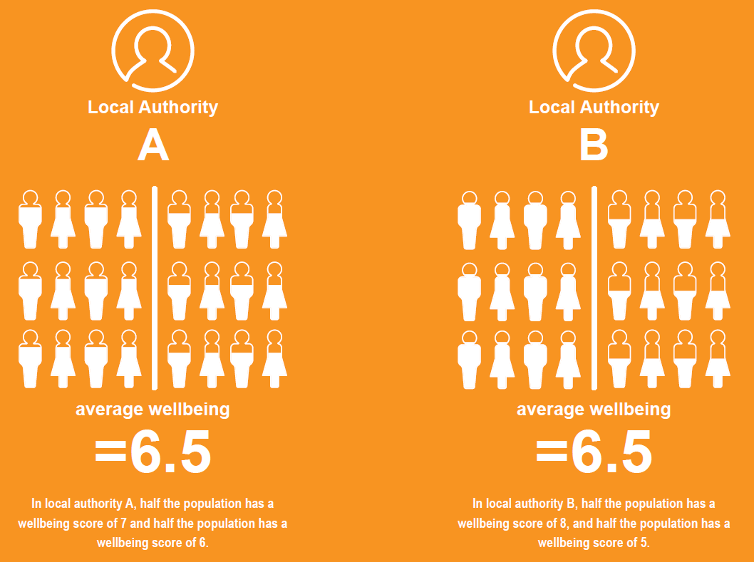
Wellbeing inequality
Why measure wellbeing inequality?
What matters more: the average wellbeing or the wellbeing of the greatest number?
wb=7
wb=6
wb=8
wb=5
Looking at average wellbeing hides the different life experiences of people and populations in an area
Knowing the level of inequality – and the drivers that affect it – allows for better targeting of resources
Where would
you rather live?
Notes:
For example, consider two hypothetical local authorities: in local authority A, half the population has a wellbeing score of 7 and half the population has a wellbeing score of 6. In local authority B, half the population has a wellbeing score of 8, and half the population has a wellbeing score of 5. In both places, the average wellbeing score would be 6.5. But political philosophers such as John Rawls and economists such as Anthony Atkinson have long argued that ‘social welfare’ is dependent on the distribution of an outcome, not just the average. Rawls’ logic is simple – imagine you are not yet born and you get to choose which of the two local authorities you get to be born into. The only catch is that you don’t know which half of the population you’ll be part of. Most people would prefer local authority A – where there is less uncertainty of the outcome, because there is less inequality.

