Slide 1
Outcome Based Services – Promise and Progress
National Market Development Quality Forum
Doug Sheperdigian
Atlantic Customer Solutions
22nd March, 2017

Slide 2
Our Agenda
Current Situation
The Promise – why do it?
The Evidence
The Challenges
What are Atlantic doing?
What can you do?

Slide 3
Outcome Based Services
Most of our social services are delivered on a “time and task” basis
Outcome Based Service:
Specifying a desired, measurable outcome
Paying for the achievement of the outcome

Slide 4
In Social Care Context --Three Types of Outcomes
Personal outcomes (eg, “Outcomes that matter to the individual”)
Independence and Wellbeing Outcomes (eg, able to dress, feed and transfer, social inclusion)
Population Level outcomes (eg, number of falls, emergency hospital visits, overall cost or cost per head)

Slide 5
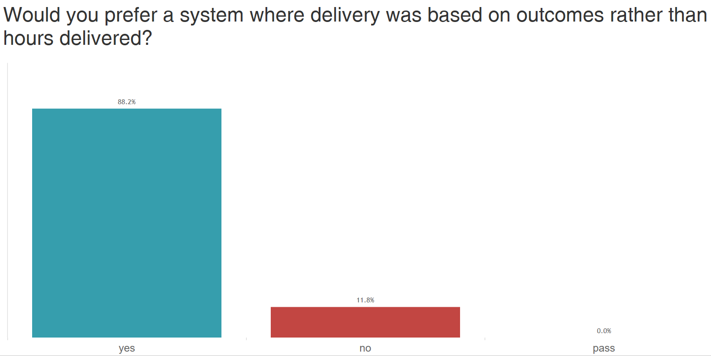
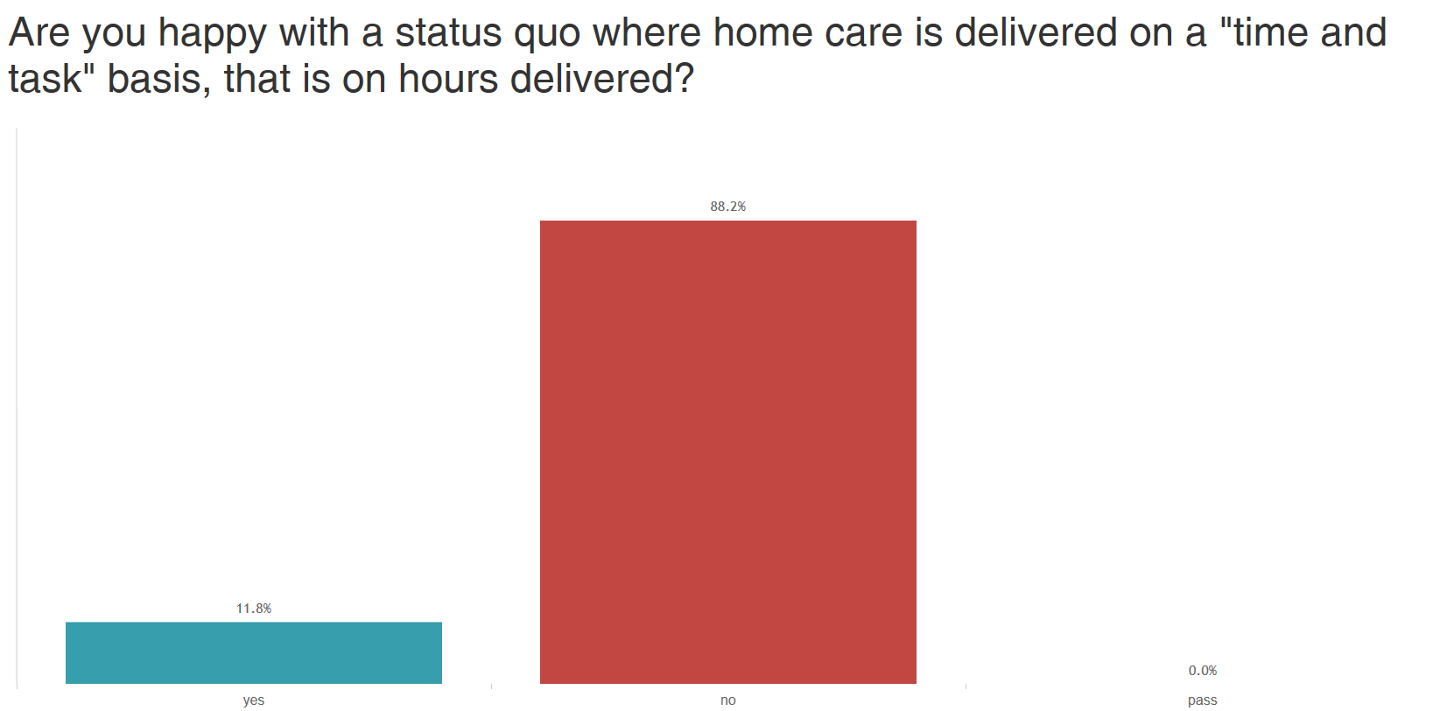
Happy with Time and Task?
Responses from Home Care provider managers - March 2017

Slide 6
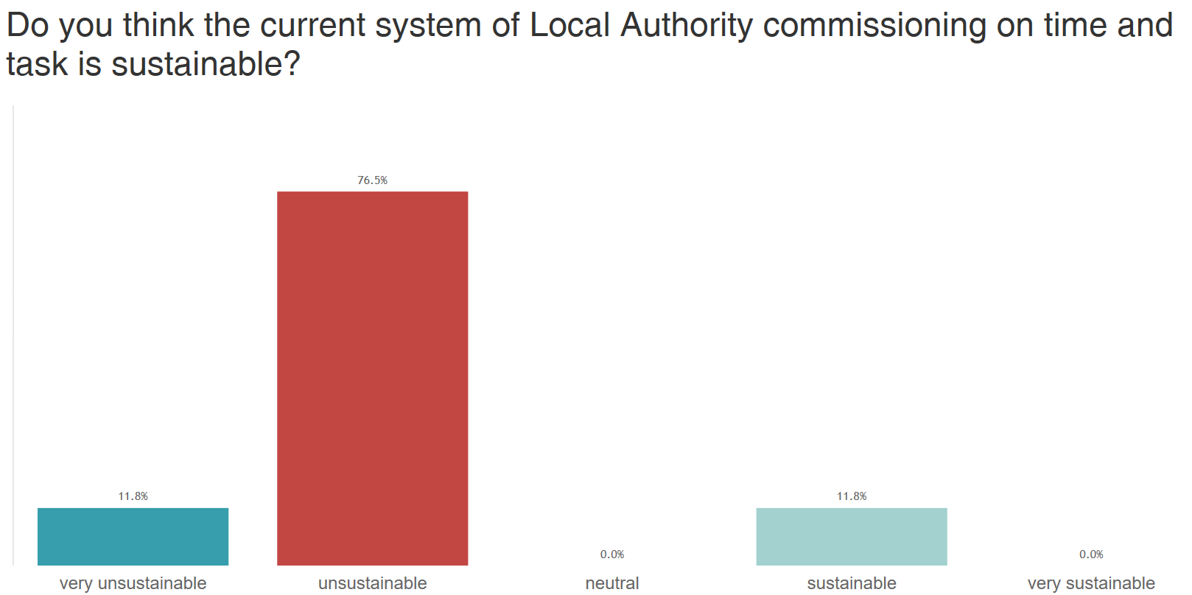
Is the Current System Sustainable?
Responses from Home Care provider managers - March 2017

Slide 7
A County Council
How would you rank the state of home care in your Council?
Very Unsustainable
Unsustainable
Neutral
Sustainable
Very Sustainable

Slide 8
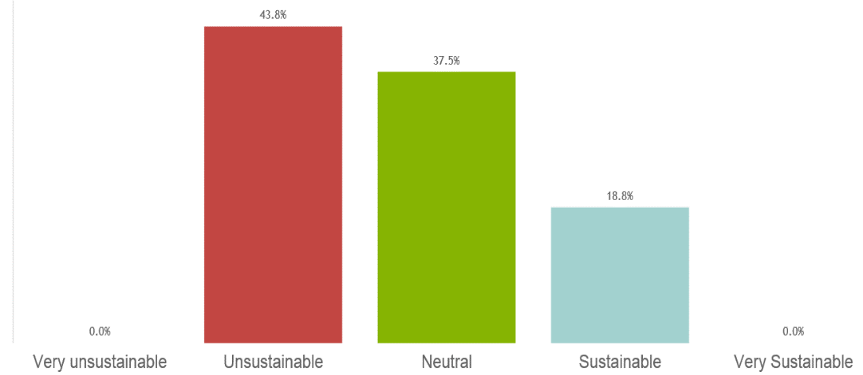
A London Borough
How would you rank the state of home care in your Council?

Slide 9
Market for Outcome Based Home Care Services is still nascent and developmental
Activity…
2012 – Wiltshire
“Help to Live at Home”
2015 – Windsor & Maidenhead
“Care & Support @ Home”
2015 – Hampshire (developmental) “Support to Stay at Home”
2016 – London Borough of Greenwich – Greenwich Home Support
Lewisham -- Richmond
Buckinghamshire -- Tower Hamlets
Nottinghamshire
Warwickshire
2017 – Expecting more to come!

Slide 10
Reality – what we are seeing…
Activity…
Many contracts being let with an Outcome Based requirement
“Developmental” – Delivery of Outcomes to be implemented during the course of the contract.
Payment mechanism to be determined
Implementation is Slow

Slide 11
Status Quo – Flat Packages for a period of time
The Promise…
Standard Support Package
Level of Support Needed
Time

Slide 12
Outcome Based Services – Investment followed by Improvement
The Promise…
Standard Support Package
Level of Support Needed
If Outcomes are Met
Time

Slide 13
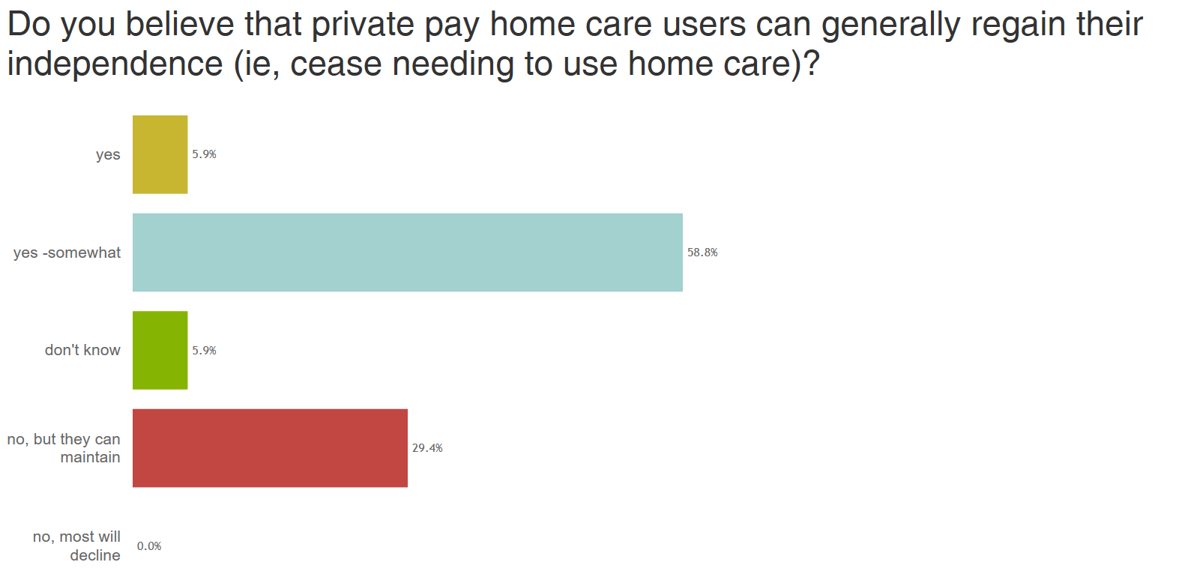
Do you Believe Independence can be Achieved?
The Promise…
Responses from Home Care provider managers - March 2017
In order for an Outcome based service to be effective, we must believe that it is possible to improve the capabilities of our customers

Slide 14
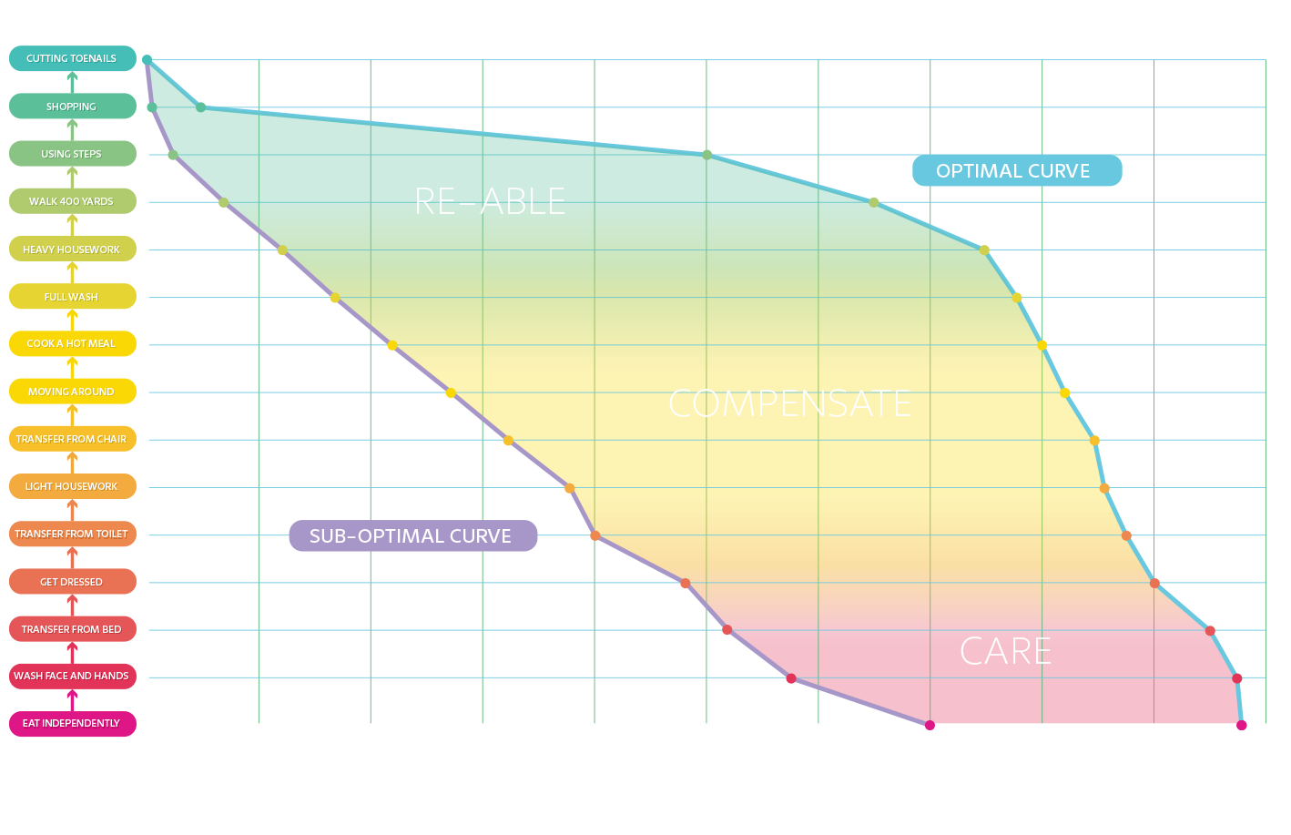
The Newcastle institute for Ageing is laying a foundation based on research
The Evidence…
Re-able
Acitivies of Daily Life Hierarchy
Compensate
Care
Time since starting on ‘curve’

Slide 15
The Challenges
Current Challenges
Transferring Current cases
Recruiting staff
Establishing a Payment Mechanism
Managing tight Budgets
To come:
Retaining Staff
Training in new techniques
Shift in expectations from people (service users, customers, informal carers)

Slide 16
Outcome Based services are one of the few win-win-win-win-win’s
The Customer (and their carer)
Wants to be Independent
The Commissioner
Wants to Deliver Personalised, Safe, Quality, Cost-effective Care
The Provider
Wants to deliver excellent care at a fair price
The Care Worker
Wants to deliver excellent care for a living wage
The Health Service
Wants to relieve the burden on Acute Services

Slide 17
What are Atlantic doing
OBC Workshop series in Cambridge
Exploring the concept
Working the challenges
Includes a reference group from the UKHCA
Working with the Department of Health
Promoting the concept of a generic, co-produced Outcome Based Payment mechanism (needs funding)
Outcome Based Commissioning Master Class (designed for local government and CCGs)
Delivering Co-Production with Staff, Providers, Service Users
Co-Production with Providers
Offering seminars to the industry

Slide 18
What can you do?
Embrace the Concept
Co-Production approach
Local Dialogue
Include Health!

Slide 19
For further information …
Contact us:
info@atl-cs.com
doug.sheperdigian@atl-cs.com

