Slide 1
System Transformation
Living Well Network
Network of support and services in communities to help support people with mental health problems
Approve small personal budgets
Integrated Personalised Support Alliance
Support people with severe and enduring mental health problems and complex life issues. Agrees and manages funds for those assessed as needing funded personalised packages of care and support and Personal Budgets
Work with wider system to create appropriate services and support
New Rules - Care package and personal budget funding only approved if
User owned integrated assessment
User owned recovery and support plan
Commissioned service identified or rationale given for not using commissioned service
No residential care placements
Short intense interventions if needed
Adult MH Services
Improve ‘easy in’
Reduce reliance on bed based services
Reduce relapse rates
Transfer patients to primary care
Identify appropriate personalised care packages (see below)
Early intervention and person centred support prevents crisis
In reach to plan discharges and co-design personalised support
Approve and manage care packages

Slide 2
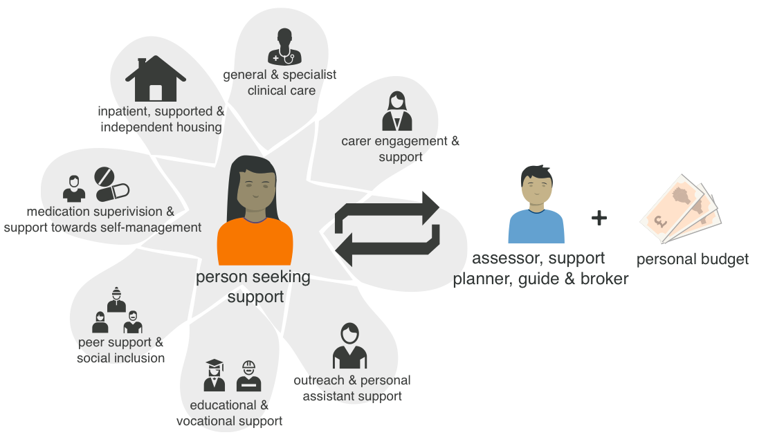
A new model of care and support

Slide 3
Living Well Network – Provider Alliance Group)

Slide 4
Our Alliance Contract involving all parties
Lambeth CCG and LBL Commissioners
(with s75 agreement)
Certitude
Thames Reach
SLaM
Adult Social Care (Delivery)
Adult social care (delivery)
Thames Reach
SLaM
Certitude
NHS Standard Contract
SLaM
NHS Standard Contract
Certitude
NHS Standard Contract
Thames Reach
NHS Standard Contract
Adult Social Care
Alliance agreement
Commissioner and provider
S 75 agreement
LBL/CCG
Pooled Fund
CCG lead

Slide 5
Our Alliance Principles
These principles represent our shared values and our commitment to working together…
Co-production in all we do
Service user at the heart
Honesty
Best for service decision making for service improvement and development decisions
Empathy and understanding of each other
Openness through open book reporting and accounting
Transparency through publication of our outcomes and performance
Unanimous decision making

Slide 6
IPSA - Outcomes
Key Results Area | Sub area | Measure | Evaluation | Gamebreaking Target (by Yr 2)
Recovery and staying well | Improved mental health and wellbeing | % of people with increased and sustained score on Recovery Star | Peer evaluator panel will determine level of performance | All people report an improvement in scores.
 | People’s physical health has been addressed and managed | % of people achieving each level below: 1) annual GP visit (minimum); 2) health action plan (stretch); 3) demonstrating improvement on health action plan (gamebreaking) | Data submission and aggregation | 80% of people have improvement in their own health action plan
 | Reduced unplanned use of services | Number of attendances at A&E Number of unplanned admissions Number of MHA admissions | Data submission and aggregation | 20% reduction in A&E attendance and unplanned admission.
Own choices | People live in a place of their own choosing | % of people in their own settled and sustained accommodation. | Data submission and aggregation Peer evaluator panel to check choice element | Of those people able/choosing to move on 90% will be in their own settled accommodation.
 | People have personal budgets | Number of people with personal budget by end of Year 2 | Data submission and aggregation | 75% will access a personal budget (of those people able/choosing)
Participation | More people remain in or are started on pathway to work | Percentage of people are in training, volunteering or in open or self-employment | Data submission and aggregation | 30% for legacy clients. 70% for new clients
 | All have meaningful connections | Percentage of people reporting improved meaningful connections | Peer evaluator panel will determine level of performance | 100%

Slide 7
Key Result Areas - Housing
Outcome | People make their own choices and achieve their personal goals
Objective | People live in a place of their own choosing
KRA Description | Self determination
KPI Description | Accommodation
KPI Measure | Number of people in their own settled and sustained accommodation
KPI Weighting | 12.5% Gainshare/12.5% Painshare
KPI Score | Percentage of all people in the IPSA cohort who are in their own settled and sustained accommodation
Measurement period | Annual
Aggregation | Linear
Definition | Settled accommodation: individual or shared accommodation of their own choice (including short term assured tenancy) Sustained accommodation: accommodation they have maintained for at least one year
Score | Gamebreaking | Stretch | Minimum | Poor | Failure
% of people in their own settled and sustained accommodation in Year 1 | 50% | 40% | 30% | 20% | <10%
% of people in their own settled and sustained accommodation in Year 2 | 90% | 85% | 75% | 60% | <50%

